Slide 1
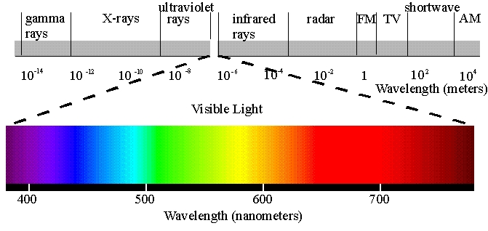
This is the electromagnetic spectrum. It consists of waves which vary in
length from very long (radio waves) to incredibly short (gamma rays). A
special part of the spectrum consists of waves that we can see. This is
called the visible spectrum. We see different wavelengths as different
colors ranging from red (long wavelengths) to blue/violet (short wave-
lengths).

Slide 2
Doppler Effect
The only way to measure motions of objects in the Universe

Slide 3

Resting sound source
Frequency f_{s}
V=340m/s
Frequency f_{o}
source
at rest
observer
at rest

Slide 4
Sound source moving toward observer
Observer hears
increased pitch
(shorter wave length)
Frequency f_{o}
Frequency f_{s}
source
observer
at rest

Slide 5

Sound source moving away from observer
Observer hears
decreased pitch
(longer wave length)
Frequency f_{o}
Frequency f_{s}
observer
at rest
source

Slide 6
The size of the spectral shift is proportional only to the velocity directly away from the observer
This is redshift velocity is called radial motion

Slide 7
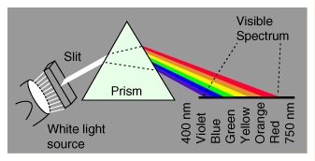
White light consists of all visible wavelengths together. When white
light passes through a prism, a triangular piece of glass or plastic, the
different wavelengths are separated and can be seen individually.
This is known as a SPECTRUM
Discovered by Newton

Slide 8

When any element is heated hot enough it begins to emit light.
The pattern of wavelengths emitted by an element are like a
fingerprint. Each element emits its own unique pattern.
Above you can see the pattern of wavelengths emitted by the
element hydrogen. Whenever this pattern is seen in the light
coming from a star it means that hydrogen is present on that
star.
This is called the emission spectrum of hydrogen.

Slide 9



So by using a spectroscope scientists can analyze all the wavelengths
that are emitted by a star and can tell exactly what the star is made
of even though it may be thousands of light years away.
calcium
uranium
oxygen

Slide 10



Remember, the greater the amount of shift,
the faster the star is moving!
Helium
Helium slightly red shifted. Moving away.
Helium more red shifted. Moving away even faster!

Slide 11
Spectra of galaxies, starting in 1910, shows that the light emitted
from galaxies is always red shifted. What does that mean?
It means that everything is moving away from us!
How can everything be moving away from us?
The only explanation for that is .............................................
THE UNIVERSE IS EXPANDING!
But its really not until about 1924 when this is believed, even though by 1912 or so there was enough evidence to support this claim

