Slide 1
Implications of the Uniform Expanding Universe
Run time backwards → all the matter has to be together at the same place and at the same time

Slide 2
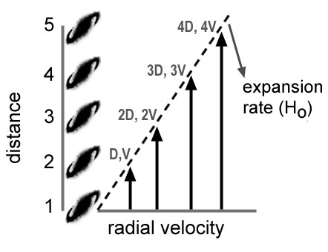
Universal Expansion
V_{r} = H_{o}D
Time = D/V

Slide 3
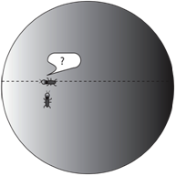
The Ant Universe
Ants on surface of a balloon are a good model – the ants can “traverse” the surface of the balloon and never run into a boundary

Slide 4
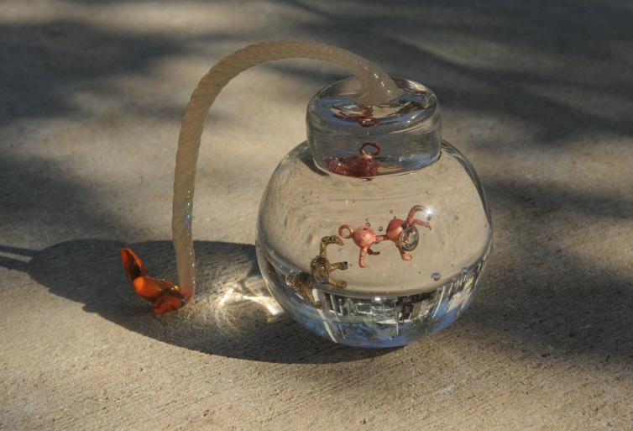
The Big Bang Ant Bomb
To start with, get a small bomb and place some ants on its surface (hint: use indestructible ants). Set the bomb off and notice what happens to the ants. The ants will fly radially away from the center of the bomb but they will be distributed on an ever expanding spherical shell. At no time will the ants become spread out in radial distance from the point of the initial explosion. Instead, they will remain confined to the shell as it diffuses outwards. This is not what we observe for galaxies, as alluded to before. Galaxies, therefore, are not "flying" through the Universe as a consequence of some physical explosion.

Slide 5
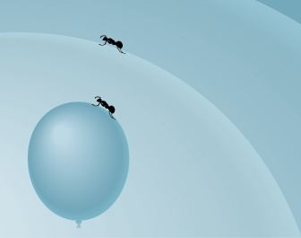
The Ant Balloon
Next, get a balloon and inflate it about half way. Sprinkle some ants onto the surface of the balloon and continue to inflate it. Notice that while you are inflating the balloon the ants are walking randomly around its surface. Some will be walking towards each other and some away. There will be no well-defined correlation between the distance between any two ants and their relative motion. This again is not what we observe and indicates there is some controlling agent that is causing the relative motion between galaxies to depend on distance.

Slide 6
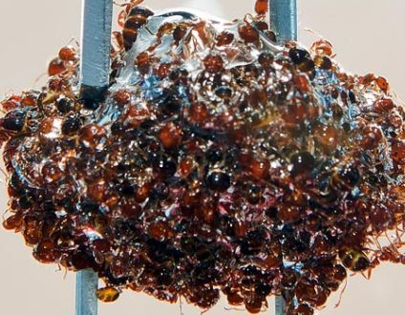
The Ant Glue Ball
Finally, get some glue (super glue works best) and glue the ants to the balloon (this is actually quite hard to do unless you have a really good pair of tweezers). As you inflate the balloon you will notice that the ants are no longer moving. The ants are stationary but the separation between each ant is increasing as the surface of the balloon increases as a result of it being inflated. If you pick any one ant on the balloon, all the other ants appear to be moving away from that ant. It matters not which ant you pick. Hence, every ant believes they are in the center of the ant distribution when in fact you know that there is no center because the ants are distributed on a surface. So what happens when you let the air out of the balloon? The ants all approach each other until they are all together (more or less) in one big ant glue-ball. → The surface area of the Universe has gone to ZERO!

Slide 7
The Observational Horizon
V = HD c = HD ==> D =c/H ==> This is our causal horizon - beyond this distance something would have to travel faster than the speed of light in order to communicate with us. All observers are surrounded by such a horizon. By assumptions of homogeneity the material outside the observer’s horizon is the exact same stuff that is already in it.

Slide 8
The Expansion Rate:
If you know the rate of inflation of the balloon (the expansion rate of the surface) and the surface area of the balloon (which is proportional to its radius) then you can determine how long it has taken for the balloon to reach its present size
. Example: I attach the ant balloon to a slow pump which increases the radius of the balloon by one foot each day. This is the expansion rate that I measure. I measure the balloon to have a radius of 8 feet. This means the expansion age of the balloon is 8 days.

Slide 9
The Hubble Parameter
V = Hd ==> 1/H = D/V
Distance/Velocity = Time
1/H = the expansion age of the Universe.
This is how long the Universe has been expanding. What it was doing prior to the expansion is anybody's guess and not even a valid physics question …

Slide 10
The Big Bang
The observed redshifts of galaxies (indicating motion away from the observer) is the principle observational foundation of the expanding Universe.
V=HD means that the expansion is uniform
A uniform expansion implies a point when all of spacetime/mass was together. The “Big Bang” then initiated the overall expansion.
Simple physics argues that the Universe had to be a very HOT and very DENSE environment in the past.

