Slide 1
Evolution of Cosmologies
From Mythic to Mathematical

Slide 2
Natural Cycles begat Explanations
Over time, people notice patterns and cycles in the sky.
The cycles of sunrise and sunset,
lunar phases,
seasonal motions of the stars,
These cycles were likely known by everyone (in contrast to today!)
Different cultures had different explanations for these observed motions. With a growing awareness of self and a need to feel connected to the cosmos, individual cultures began to project their personality onto the celestial canopy. Certain patterns of stars took on special importance as they were endowed with human or animal characteristics.

Slide 3
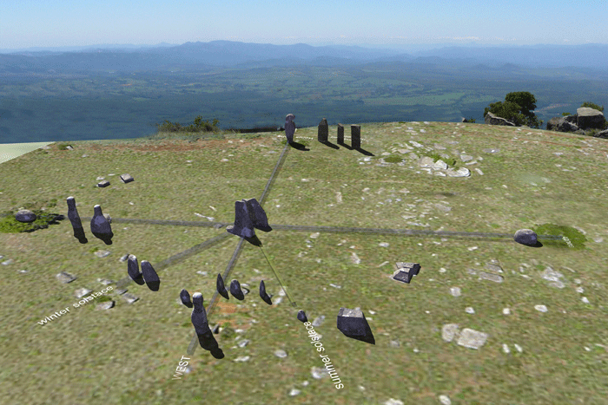
Natural Cycles and Seasonal Weather
Over time, a statistical association between weather and the positions of stars became apparent.
This leads to building very large scale calendars (Pyramids, Stonehenge, etc) as a means of known when seasonal change is coming (flooding, time to plant crops, etc)

Slide 4
Components of The Mythic Universe
Demons → represent our innate fears (of the unknown?)
Gods → a source of comfort and exist to combat Demons
Male/Female polarization → evil demons often Male; benevolent gods are Female
Cosmic Womb → primal female gives birth to the Universe

Slide 5
Cosmic Womb
This is an original idea
the entire Universe was created in a single event
Also suggests a connection between organic and inorganic material as all were created in the same place
Note that in this model, man and nature are inseparable

Slide 6
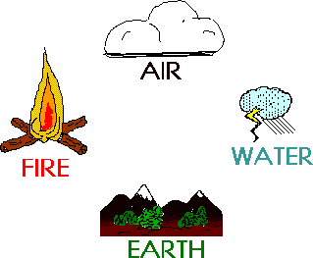
Fundamental Forces
Starting around 600 BC the Greeks developed this sense:
All the world can be understood as an interaction between 4 primal elements: Air, Earth Fire and Water.

Slide 7
Air, Earth, Fire and Water
Table of Elements → ordering the Cosmos and removing the Chaos
However, given their hierarchical nature, various Greek philosophers attempted to make one of these elements more fundamental than the others.
Thales → water
for there must be some natural substance, either one or more than one, from which the other things come-into-being, while it is preserved -- Thales
Anaximenes → Air (stars are fires in the sky → fire now subservient to Air)

Slide 8
Water is the Primary Principle
Thales’ theory of earthquakes → the (presumed flat) earth is actually floating on a vast ocean, and disturbances in that ocean occasionally cause the earth to shake or even crack, just as they would a large boat.

Slide 9
Thales
Scientific thought was the discovery of nature
natural phenomena we see around us are explicable in terms of matter interacting by natural laws, and are not the results of arbitrary acts by gods.
“nature does all things by herself without the spontaneous meddling of gods” --Lucreitus

Slide 10
More World Views
Anaximander thought of the primal elements as opposites in conflict (e.g. Fire vs Water, Air vs Earth)
Anaximenes had a different conception: the primal elements are not opposed, but different stages of a continuum.
Air is most important because other elements “condense out of it”.
Air is the nearest to an immaterial thing; for since we are generated in the flow of air, it is necessary that it should be infinite and abundant, because it is never exhausted.

Slide 11
Cause and Effect
Now we have CAUSE and EFFECT and the first hints of the physical nature of the Universe. The question is whether the CAUSE is due to human behavior or to the natural physics of nature. It is often difficult, through observations alone, to distinguish between these alternatives.

Slide 12
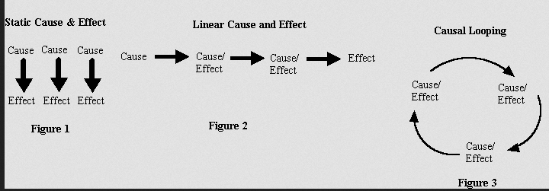
Cause and Effect
Is generally viewed as linear in either the vertical (events are isolated) or horizontal (there is a linear chain of events). The third option is not, historically, ever considered (emergent behavior)

Slide 13
Creation Ideas/Cosmology
Thales suggested that in the beginning there was only water, so somehow everything else emerged from it
Anaximander supposed that initially there was a boundless chaos, and the universe grew into this boundless space.
Anaximenes suggested that originally there was only air and the liquids and solids we see around us were formed by condensation.
This means a simple initial state develops into our world using physical processes and not the micromanaging by Gods

Slide 14
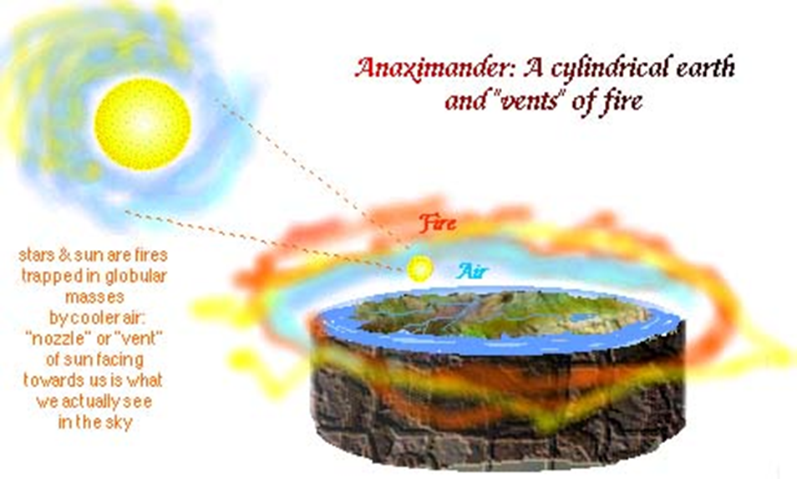
Order, order, order,
Above all, Air Earth Fire and Water are arranged in some order to create the World. Many different philosophies change component order, but order is always preserved

