Slide 1
Aristotle’s Business Card
The structure of the universe - I mean, of the heavens and the earth and the whole world - was arranged by one harmony
Quasi-theological statements but it definitely implies ONE ORDER

Slide 2
Key Assumptions for Aristotle
All bodies have natural motion
Movement of bodies is NOT the result of the influence of one body on another because motion is___________
Movement is therefore endowed to bodies and therefore is not the result of some physical interaction between bodies.
NATURAL

Slide 3
Three Kinds of Motion
At rest (the earth)
Linear (motion of objects on the earth)
Circular Motion (means the object is not of the Earth)
By Logic: since to each motion there must correspond a substance, there ought to be some bodies that naturally move in circles. Such things that move in circles are the heavenly bodies as they are made of a more exalted and perfect substance than all earthly objects.

Slide 4
Other Aristotelian Attributes
Prime Mover kicks outer sphere → that motion communicated to other spheres which move at different rates of revolution since that is what the observations demand.
Universe is FINITE; Earth at center
No void; spheres touch …
The Universe has always existed, unchanged → What does this conflict with?

Slide 5
The Anomaly
Most of science and scientific theory eventually must confront "The Anomaly". The anomaly represents and observation or experiment with an unexpected outcome, relative to the current model. That is, the Truth, has been violated. How does science and culture deal with observed anomalies? There are basically three possibilities:
Ignore it
Acknowledge it but claim its irrelevant to the model
Use it as evidence that the model is incomplete.
History shows us that options 1 and 2 are the most frequent response. Option 3 requires admitting that your known Truth may be wrong

Slide 6
The Aristotelian truth
The Earth Is the Motionless Center of the Universe and All Revolves Around the Earth. The sky is “held up” by crystalline spheres
“it is manifest to any observer that the earth occupies the middle place in the cosmos, and that all weights move toward it.
The crystalline sphere universe of Aristotle makes a simple prediction all the wheels move in the same direction. This means that any planet should always move in the same direction, with respect to the fixed outer-sphere of background stars

Slide 7
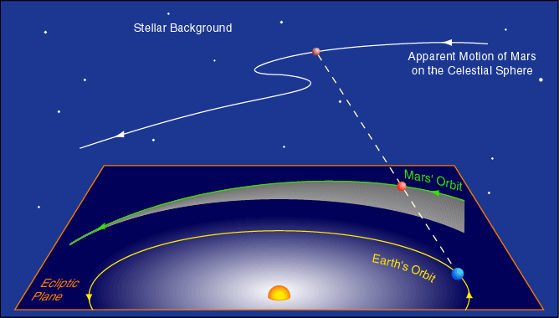
What the hell is wrong with mars? It sometimes doesn’t move the Correct Way
Mars moves west to east (right to left) against the background of stars. But every 780 days it goes through period of 83 days during which it moves east to west = the retrograde motion. The retrograde period occurs when Mars appears brightest in the sky (opposition). Thus, this phenomena could be established as repeatable and reliable after only a decade's worth of observations.

Slide 8
Save the Phenomena
Plato gave his students a major problem to work on. Their task was to find a geometric explanation for the apparent motion of the planets, especially the strange retrograde motion. One key observation: as a planet undergoes retrograde motion (drifts westward with respect to the stars), it becomes brighter. Plato and his students were, of course, also guided by the Pythagorean Paradigm.
The Greeks were guided by a paradigm first articulated by Pythagoras (569--475 BC) A paradigm is a general consensus of belief of how the world works. It is a mental framework we use to interpret what happens around us. The Pythagorean Paradigm had three key points about the movements of celestial objects:
The planets, Sun, Moon and stars move in perfectly circular orbits;
The speed of the planets, Sun, Moon and stars in their circular orbits is perfectly uniform;
The Earth is at the exact center of the motion of the celestial bodies.

Slide 9
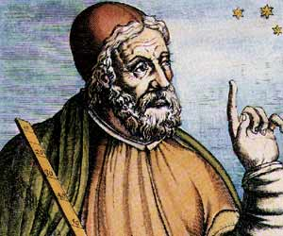
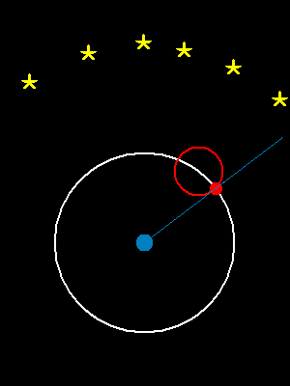
Ptolemy to the Rescue

Slide 10
The power of the Epicycle
The Ptolemaic Moment will stand unchallenged for about 1500 years. The Ptolemaic model represents an excellent example of "cultural" bias in science. Most citizens of the cultural wanted to accept the idea of the Earth being the center of the Universe (i.e. the earth was special) and therefore observations were molded in such a way so as to preserve that cultural norm.
Also, Ptolemy's model did improve the precision to which planetary positions could be predicted. Remember, however, the precision at measuring planetary positions was quite poor and therefore there was a large random error involved when comparing predictions with observations. This does not make the model correct.

Slide 11
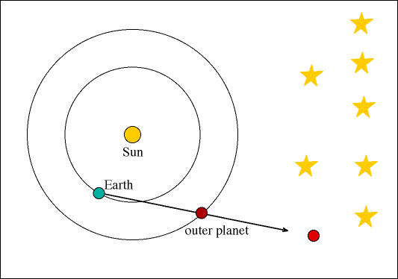
The Dissenting View - ARISTARCHUS
One student named Aristarchus (of Samos 280 BC - Google Him – he was clever) violated that rule and developed a model with the Sun at the center. He submitted to Plato, the animated model shown below which reveals how, in that model, the retrograde motion of mars is the result of the Earth "overtaking" Mars in their mutual orbits about the Sun and thus is the Natural Model.
His model was not accepted because of the obvious observations against a moving Earth.

Slide 12
Archimedes Describes Aristarchus
You are now aware ['you' being King Gelon] that the "universe" is the name given by most astronomers to the sphere the centre of which is the centre of the earth, while its radius is equal to the straight line between the centre of the sun and the centre of the earth. This is the common account as you have heard from astronomers.
But Aristarchus has brought out a book consisting of certain hypotheses, wherein it appears, as a consequence of the assumptions made, that the universe is many times greater than the "universe" just mentioned. His hypotheses are that the fixed stars and the sun remain unmoved, that the earth revolves about the sun on the circumference of a circle, the sun lying in the middle of the orbit.
This implies the Stars are many times farther away than conventionally thought and that the Sun is bigger than the Earth

