Slide 1
Enceladus and Life

Slide 2
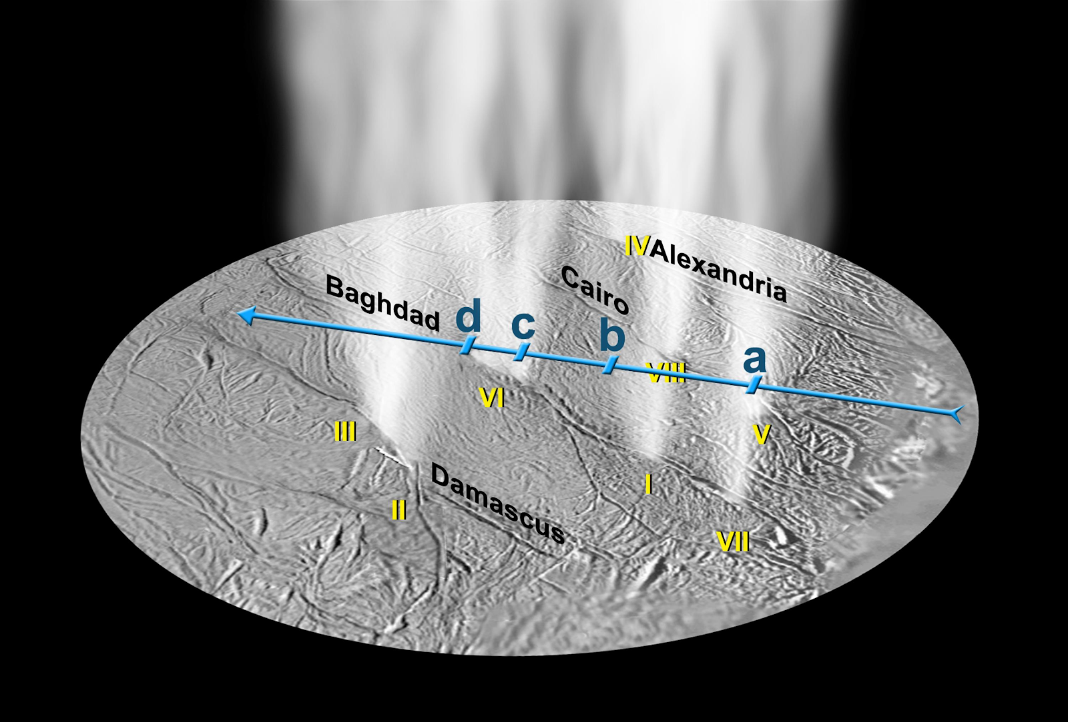

Slide 8
