Slide 1
The Hot Big Bang Model
Universe evolves from hot and dense state towards a cold vacuum

Slide 2
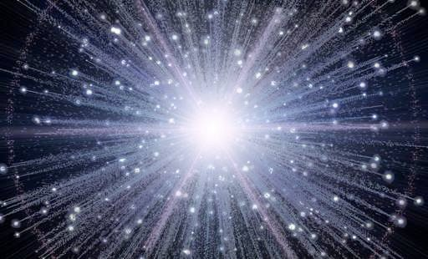
Expectations of a Hot Dense Universe
Read this directly in the ONLINE text
Simple physics argues that the initial state of the Universe was extremely hot and dense, so hot than no atomic nuclei could exist or form
If that hot gas starts to expand → it cools and the physics of the Universe is determined mostly by its temperature at some time.

Slide 3
Two Main Observations
Universal Expansion means the universe used to be a small place where all the matter was together as the universe expands (ages) its density goes down
1963 Accidental Discovery of the Microwave Background by Penzias and Wilson of Bell Labs.

Slide 4
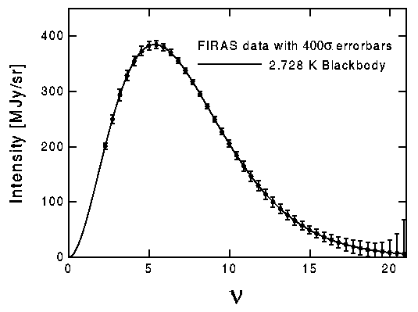
Predicted Thermal Spectrum easily confirmed
Expected spectral shape under conditions of thermal equilibrium. Temperature at this epoch is about 3K

Slide 5
The MWB
The origin of the microwave background (MWB) will become clearer later- for now considered it as the energy from the very early universe now redshifted to very long wavelengths.
The observed ratio of photons (400 per cubic centimeter) to hydrogen in the Universe is about 1 billion to 1. That is, for every H-atom there are one billion microwave background photons. This will be extremely important later.

Slide 6
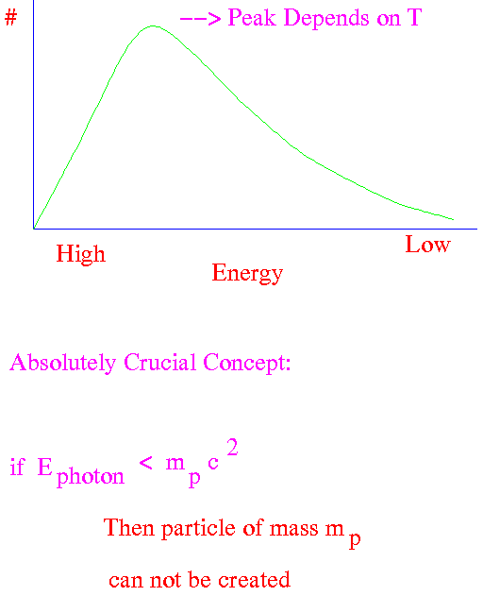
Mass- Energy exchange
photon + photon → particle + antiparticle photon + photon → particle +antiparticle
Average photon energy depends on the Temperature of the Universe
This temperature is steadily in decline and therefore the average energy per photon declines as the Universe expands and cools
At any given time in the Universe, the distribution of photon energies looks like this (this is the blackbody curve)

Slide 7
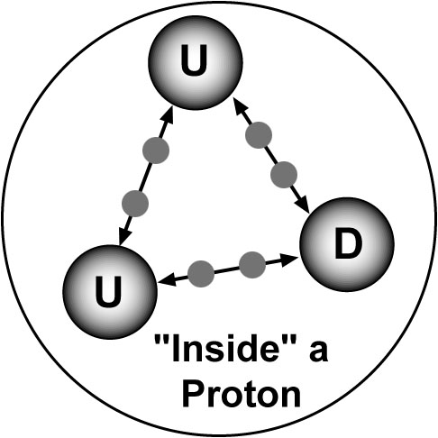
What is a Particle?
U = 2/3
D = -1/3
Quarks bound
Gluon “strings”

Slide 8
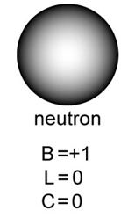
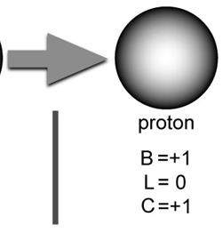
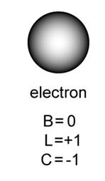
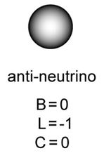
Conservation Rules
Baryon number (+1,0,-1)
Lepton Number (+1,0,-1)
Charge (+1,0,-1)

