Slide 1
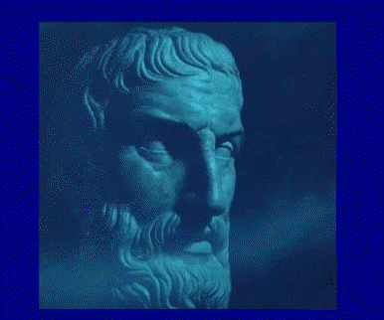
A Remarkable poem written by Lucretius in about 100 BC
On the Nature of Things

Slide 2
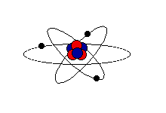
Atomism
All reality consists of minimal sized bits of matter– “atoms”—separated by empty space— “void”. The atoms randomly collide, via the “swerve” mechanism, to create all events observed in the Universe.
All things are made of various combinations of atoms.
Greek “a-tom” = not cut.

Slide 3
Lucretius
(99-55 BC)
Roman Poet
Records ideas of Epicurus in poetic form
“On the Nature of Things”
Counteract influence of religion.

Slide 4
Lucretius
Bad things in life mainly due to ignorance.
Counter ignorance & irrationality with knowledge.
Teach people truth about the nature of things.

Slide 5
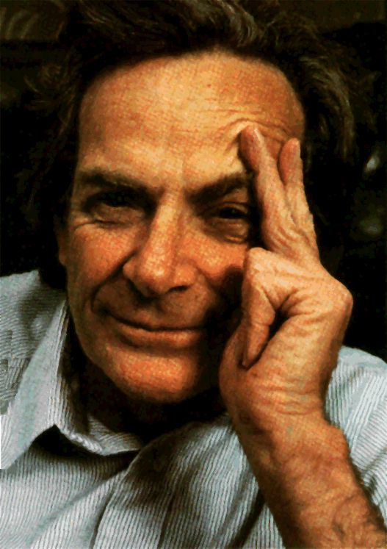
“Atomism is the most
important and far-
reaching hypothesis
ever formulated
about nature.”
Lecture at Cal Tech
1961. - Feynmann

Slide 6
