Slide 1
2019/2020 Discoveries of New Earth like Planets located in the habitable zone of the host star
Kepler mission: 2009 – 2028 → 2500 new planets
Tess: Transiting Exoplanet Survey Satellite → more sensitive than Kepler: launched about a year ago and has already produced new discoveries
exoplanets.nasa.gov

Slide 2
The Transit method of discovery

Slide 3
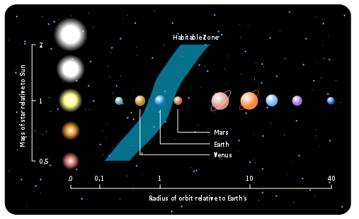

Slide 4
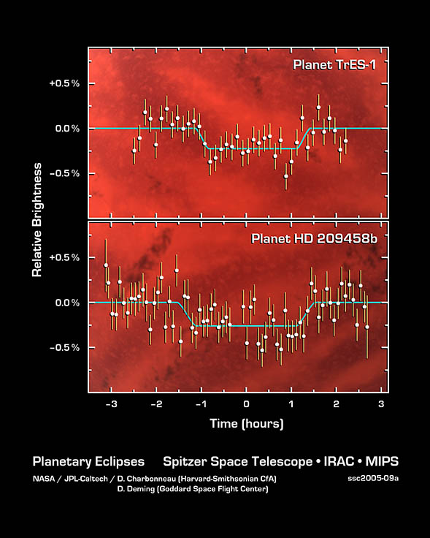
NOTICE THE PRECISION

Slide 6
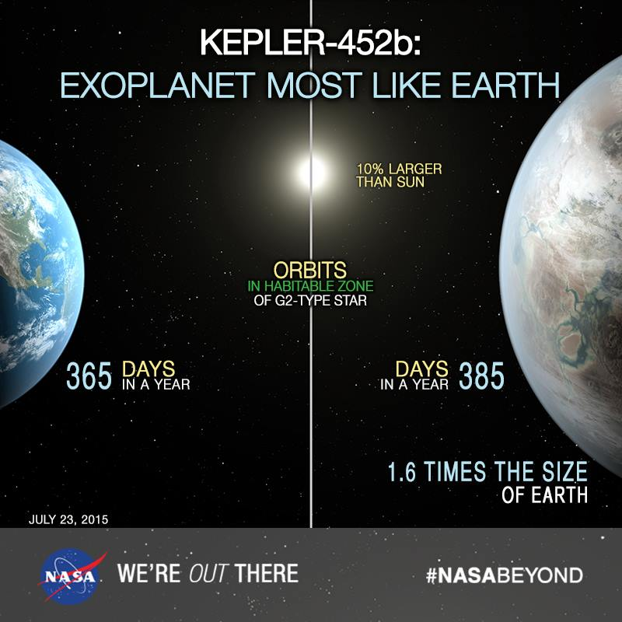
1.6 Earth Masses likely
Means a much different atmospheric evolution – also not
Clear if this object would be in the habitable zone

Slide 9
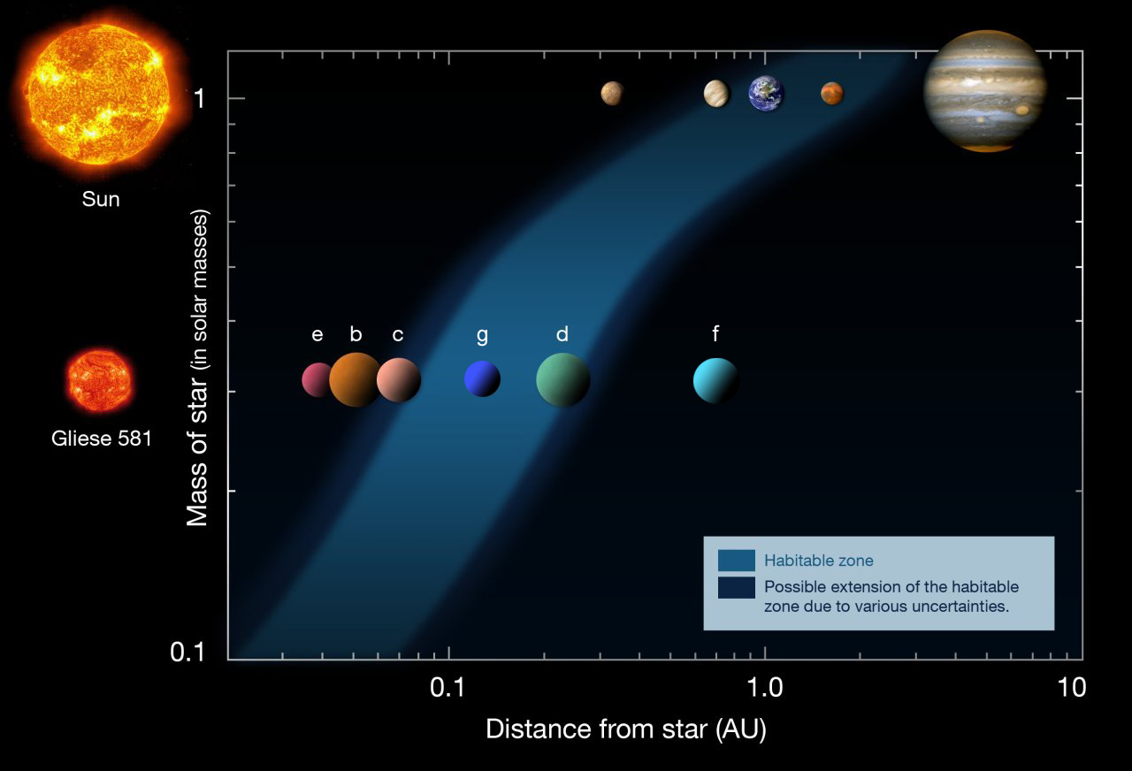

Slide 11
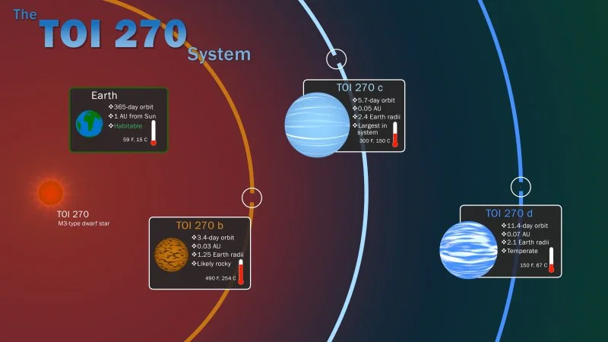

Slide 12
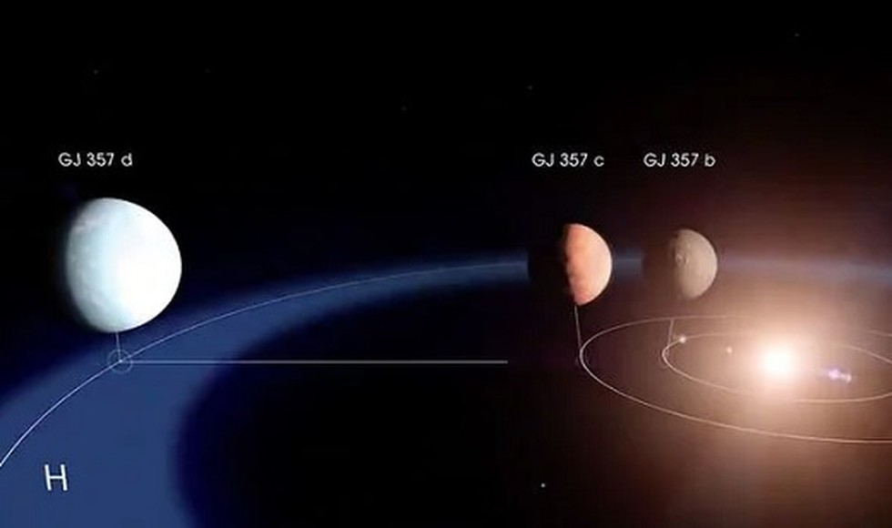
TESS GJ 357 System Discovery: If the atmosphere is thick on planet d then it could easily maintain liquid surface water

Slide 13
Summary
Within the last 18 months approximately 20 new “earth like” planets have been discovered located within 50 light years.
Most all of these have been discovered around very loss mass stars ranging from 10-20% the mass of the sun.
These planets to be in the habitable zone have to have orbits around their parent stars less than the Sun-Mercury distance with orbital times of 10-20 days so multiple transits can be observed
Most of these stars are volatile and subject to relatively large radiation outbursts that would definitely impact these planets.
Still an ocean would protect life and allow it to develop at the bacteria level.

