Slide 1
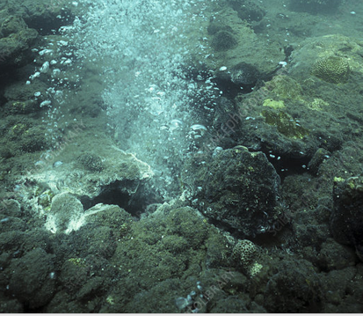
The RNA world may well have developed from the robust chemical/mineral reactions that are occurring in a well mixed deep sea thermal vent environment. This could be the basic mechanism that makes big molecules, a necessary first step towards biology.

Slide 2
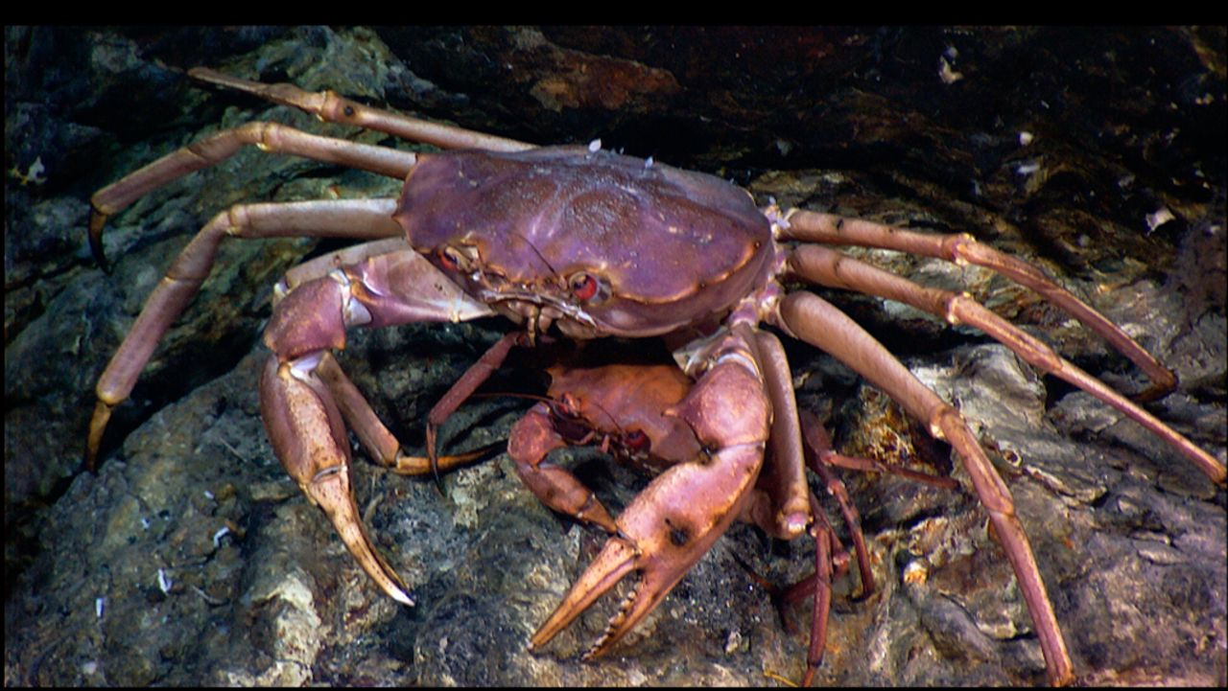
BIOLOGY

Slide 3
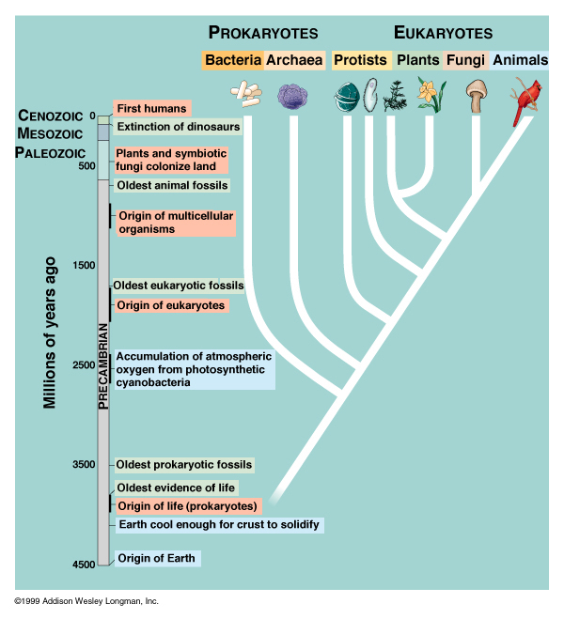
Global overview of all life

