Slide 1
The Rise of Social Darwinism
All based on “…because it’s a scientific fact…”

Slide 2
Selection as “Deficiency Correction”→ advancement of the mean
The most common action of natural selection is to remove unfit variants as they arise (randomly) via mutation. In other words, natural selection usually prevents unfit genes from increasing in frequency in the gene pool.
Advancement of the Mean is dangerous and erroneous concept
Evolution is not an optimization process – there is never enough time for that – so why do we pretend that is natural optimization instead of natural selection?
Supports the Social Darwinist Agenda that society can be engineered
Takes nature out of statistical equilibrium if it can optimize to produce the Master Race

Slide 3
Statistical Types of Selection
Stabilization: Extreme ends of the distribution are disfavored. Moves every individual closer to the average state.
Directional: What you think is evolution – removes the deficient
Disruptive: Individuals with average traits are disfavored. Better leads to species diversification (or a class society)
Each Black Dot in each distribution represent individuals that die out before passing on their genes
Mutations will affect largest number of individuals (i.e. average). Leads to development of new species and arguably is the process that happens on Earth via random catastrophes and mass extinction.

Slide 4
Darwin Abused: “Survival of the Fittest”
Hebert Spencer (1864): This survival of the fittest, which I have here sought to express in mechanical terms, is that which Mr. Darwin has called "natural selection” or the preservation of favored races in the struggle for life
Social Engineering will now use this new scientific theory of evolution via adaptation as the scientific basis on which to engineer society. This justification will come from the malformed continuous “tweet” that it’s a scientific fact that nature behaves this way.

Slide 5
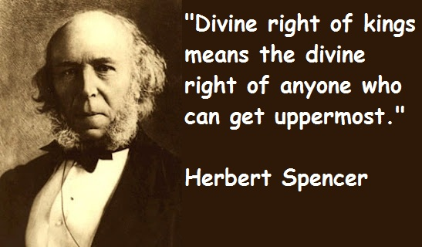
The Aberrated View of Spencer
Spencer quickly adapted Darwinian ideas to his own ethical theories. The concept of adaptation allowed him to claim that the rich and powerful were better adapted to the social and economic climate of the time, and the concept of natural selection allowed him to argue that it was natural, normal, and proper for the strong to thrive at the expense of the weak. After all, he claimed, that is exactly what occurs in nature every day.

Slide 6
What is Social Darwinism?
Social Darwinism (as a scientific fact) is:
- individuals compete naturally.
- the incompetent lose and the strong
win. ie. “survival of the fittest”.
Government must not interfere unless the unfit are stealing from the fit.
The fit are arbitrarily determine by the e(lite) based on “it’s a scientific fact”

Slide 7
Justifying Imperialism (Spencer):
“Within the human species, nations are locked in a struggle for survival. Everywhere, civilized nations are supplanting barbarous nations. Advanced civilization, obviously, has inherited valuable traits from its ancestors. Therefore, natural order obligates powerful, civilized nations to appropriate the limited resources of the weak.”
It’s a Scientific Fact

Slide 8
The policy of colonial expansion is a political and economic system ... that can be connected to three sets of ideas: economic ideas; the most far-reaching ideas of civilization; and ideas of a political and patriotic sort. ... In the area of economics, I am placing before you, with the support of some statistics, the considerations that justify the policy of colonial expansion, as seen from the perspective of a need, felt more and more urgently by the industrialized population of Europe and especially the people of our rich and hardworking country of France: the need for outlets [for our exports]. ... Gentlemen, we must speak more loudly and more honestly! We must say openly that indeed the higher races have a right over the lower races .... I repeat, that the superior races have a right because they have a duty. They have the duty to civilize the inferior races .... In the history of earlier centuries these duties, gentlemen, have often been misunderstood; and certainly when the Spanish soldiers and explorers introduced slavery into Central America, they did not fulfill their duty as men of a higher race .... But, in our time, I maintain that European nations acquit themselves with generosity, with grandeur, and with sincerity of this superior civilizing duty.
--Julian Ferry (1881)Prime Minster of France

Slide 9
Three Big Themes drive the notion of Cultural Superiority
These themes emerge in the 18th century to greatly shape the 19th century to set up the 20th century as one of mass resource exploitation; These “ideas” stem mostly from the “scientific” application of technology
Humans can control their destiny (where have we seen this before?)
Some groups viewed themselves as superior to others because of advanced technology
Appropriate combinations of science and technology could produce the superior human being.

Slide 10
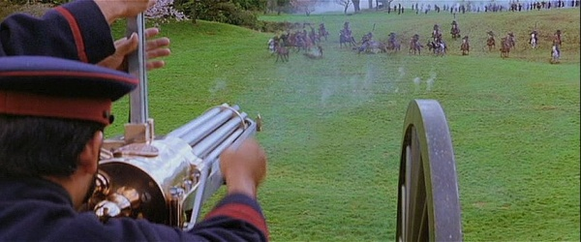
Social Darwinism and Race
Only the strong races can survive.
Technology should be kept by races that create advancement.
Justification for colonization (genocide)
Note: In the 19th century the word race meant something much different than today; e.g. the French were a race; the German race was another.

Slide 11
Social Darwinism
Not only was survival of the fittest natural, but it was also morally correct.
it was morally incorrect to assist those weaker than oneself, since that would be promoting the survival and possible reproduction of someone who was fundamentally unfit.
This is also a blue print for how business should run -- “the growth of a large business is merely a survival of the fittest.“ - John D. Rockefeller

Slide 12
Elimination Events
1877: Satsuma Rebellion in the Battle of Shiroyama > Japanese Imperial Army finally extinguishes the Samurai using Gatling guns against swords. (aboriginal vs progress)
1870s "Conquest of the Desert" was a sustained military campaign that established Argentine (e.g. Spanish) dominance over Patagonia through systematic elimination of all indigenous tribes.

Slide 13
Canada
1857 Canadian Law: An Act to Encourage the Gradual Civilization of the Indian Tribes in the Province
Our objective is to continue until there is not a single Indian in Canada that has not been absorbed into the body politic, and there is no Indian question, and no Indian Department -Duncan Campbell Scott 1920

Slide 14
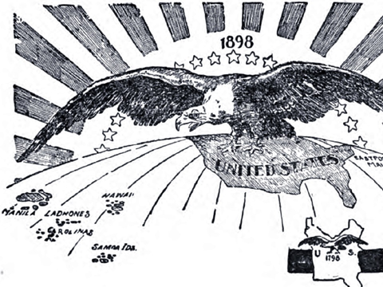
American Progress
1890: Wounded Knee Massacre represents the last major skirmish in the American Indian Wars
1898: America gains control over Puerto Rico, Cuba and the Philippines after the Spanish American War. But, War of the Philippines goes from 1899 - 1902

Slide 15
Summary
Most of this “imperialism” is being justified as progress.
Obviously this “progress” borders on Genocide.
The more relevant question is where does culture get the notion of moral superiority and how is that used to justify these acts?
Does religion grant moral superiority? Does scientific prowess grant the same?

Slide 16
Social Darwinism and Business
Natural Competition controls the economy.
Government is not there to help people, but to support business.
Big business can take over small business.
Ruthless methods are OK.

Slide 17
America’s Reaction
“Self-made man” concept built the country.
“Rugged Individualism” is good.
Wealth is the reward for hard work and ability.
Failure is due to lack of ability and laziness.

Slide 18
A Modern day example:
The strangest thing about fascism in America today is that American fascists are so dumb, they don't even know they're fascists. They don't even know what the word fascism means. They vaguely know that it had something to do with Hitler and the Nazis, but that's it. They have no idea that the first words of the Nazi anthem were "Germany above all else" which was their version of "America first." And the way Nazis demonized Jews was no different than the way American fascists demonize liberals. Hitler promised to "make Germany great again." And Hitler denounced the newspapers, which exposed him for what he really was, as "Lügenpresse," which is German for "fake news." If the German Nazi party still existed today, they would look exactly like the Republican party under Trump. Hitler's rallies looked no different than Trump's rallies. And Hitler would absolutely love a well-oiled propaganda outlet like Fox News.”
― Oliver Markus Malloy, Inside The Mind of an Introvert

