Slide 1
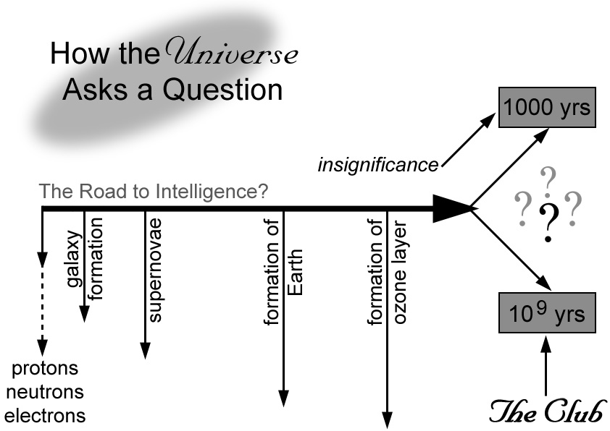
Does this diagram matter + Failure points along this road
Cosmological Intelligence

