Slide 1
An Event Road Map

Slide 2
A Container of Life

Slide 3
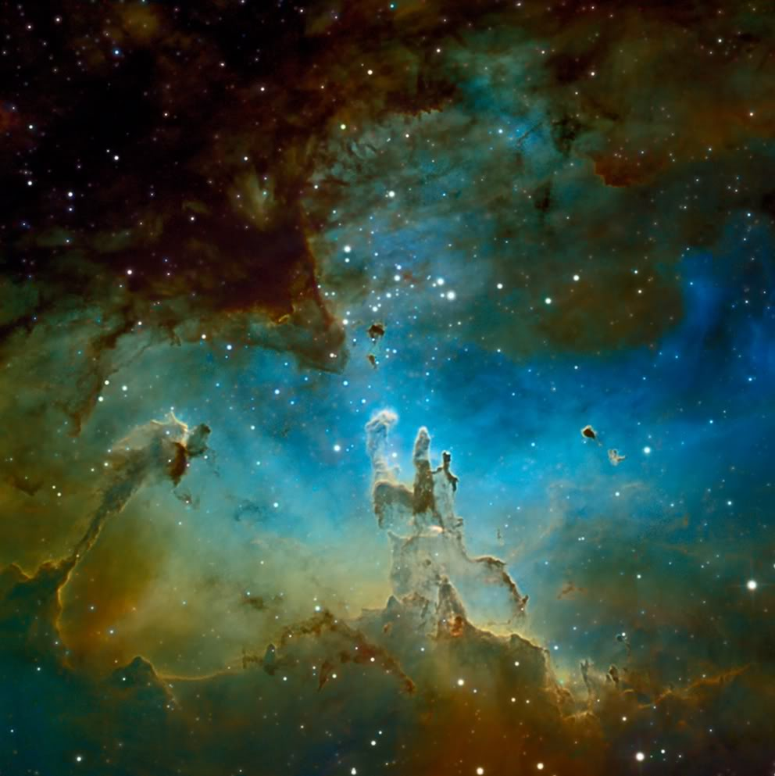
Star Formation and Element Creation

Slide 4
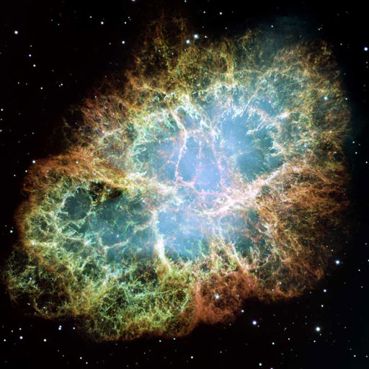
Supernova are your Mother

Slide 5
Expect Solar System Formation

Slide 6
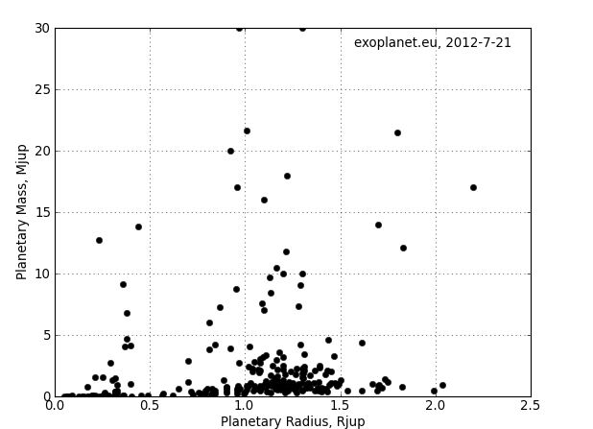
Expectations are Confirmed

Slide 7
Now we have a Rock – how does life arise?
Water on Earth:
Outgassing – NO
Delivered Later
Delivery Mechanism
Asteroids – Maybe
Comets – Probable
NEED JUPITER

Slide 8
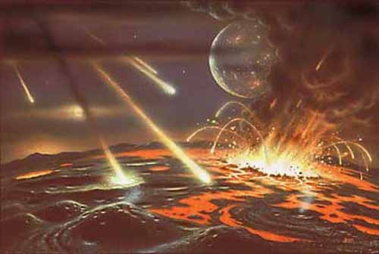
The Water Network of the Solar System

Slide 9
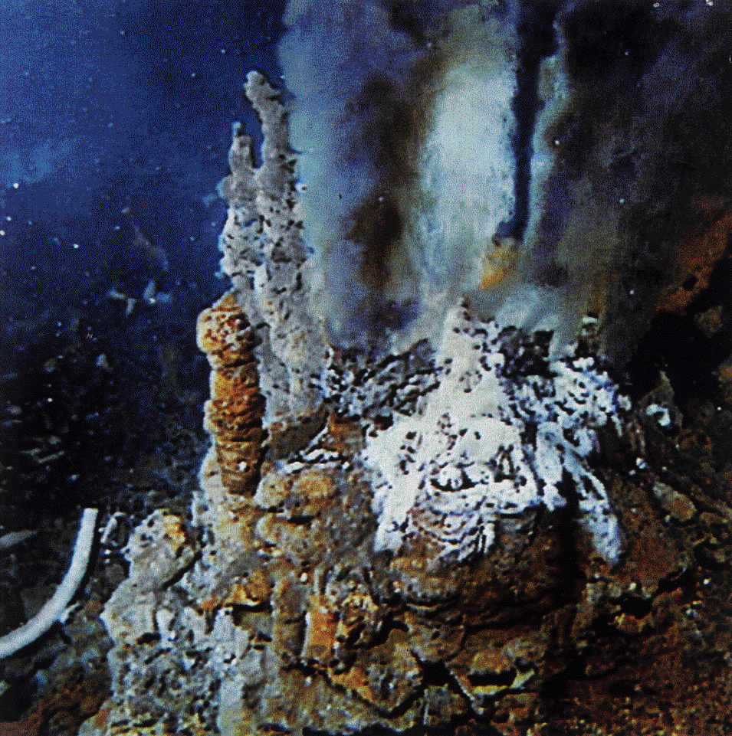
Life Begins in the Oceans
Result is the production of simple organic compounds.
Energy source could be lightning in the atmosphere
Or
Heat Vents in the Ocean

Slide 10
Now Need to Make Macro Molecules
Trial and Error Process to make
RNA/DNA
Took about 1 Billion years

Slide 11
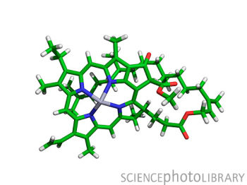
Then simple to complex:
DNA needs protection from Oxygen or it dies.
Oxygen production comes from aerobic organisms but they need chlorophyll to capture enough solar energy to metabolize H2O and give off Oxygen as a waste product.
Chlorophyll is a Big Molecule – that’s why it works

Slide 12
Chemistry Now gets in the Way
It takes 2 Billion years for this process to stop

Slide 13
Takes Time to Make Ozone Layer

Slide 14
Land Stimulates Diversification

Slide 15
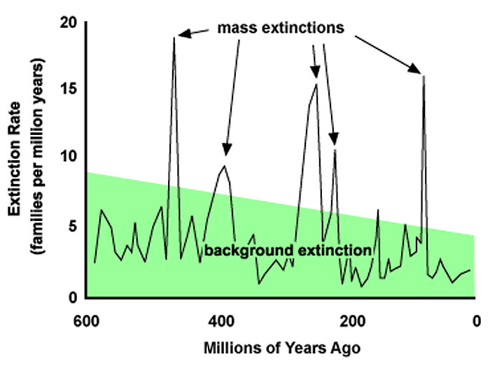
Now you need to Survive!

Slide 16
So Life is Tough!
Long Term Survival is Difficult. Period.

Slide 17
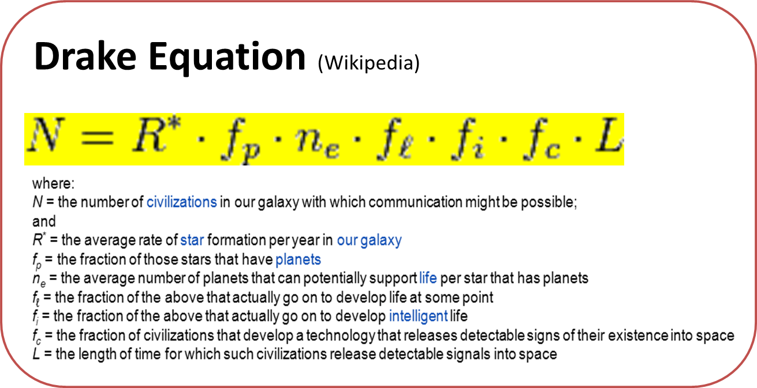
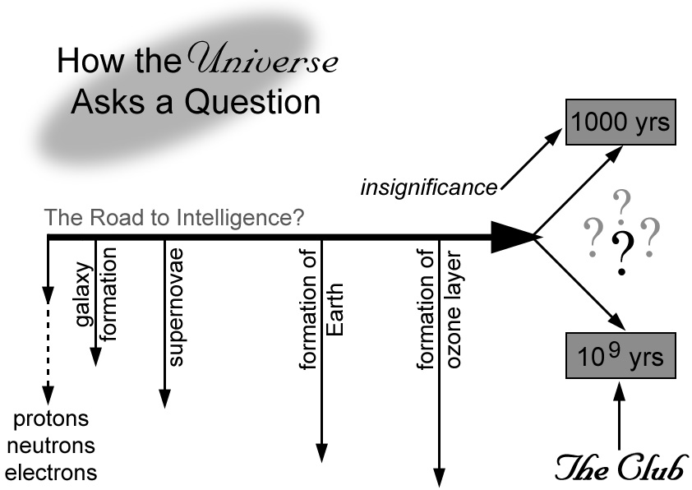
Are we Alone?
=1% of 1 Billion
10 Million
10
1
1
1
1/10
1/10
=1 million

Slide 18
Implications of N= 1 million
1 Civilization per 100,000 stars
Nearest random one is 1000 light years away!
Life (all life) is RARE!
If intelligent life is UNIQUE to the Earth then either:
F_i = 1 in a billion
L = 1000 (for everyone) !!
This seems unlikely and therefore, with proper planetary management, one day we will be in the club and know the answer.

