Slide 1
Astronomy 123
Cosmology and the Origin of Life

Slide 2
Cosmology
Cosmology is the empirical study of the organization, structure and evolution of the Universe
At any given time we always think our Cosmology is correct:
  Ancient: Earth is at center of Universe
  Current: Dark Matter and Dark Energy
At any given time our Cosmological models are always incomplete

Slide 3
A Cosmological Model
Models are made from observations and are empirical. This necessarily means that models are limited because the range of accessible observations is limited.
Good models make predictions that can be tested. This is the "acid" test of any model and is the root of the scientific method . Without this test, models can simply be arbitrary

Slide 4
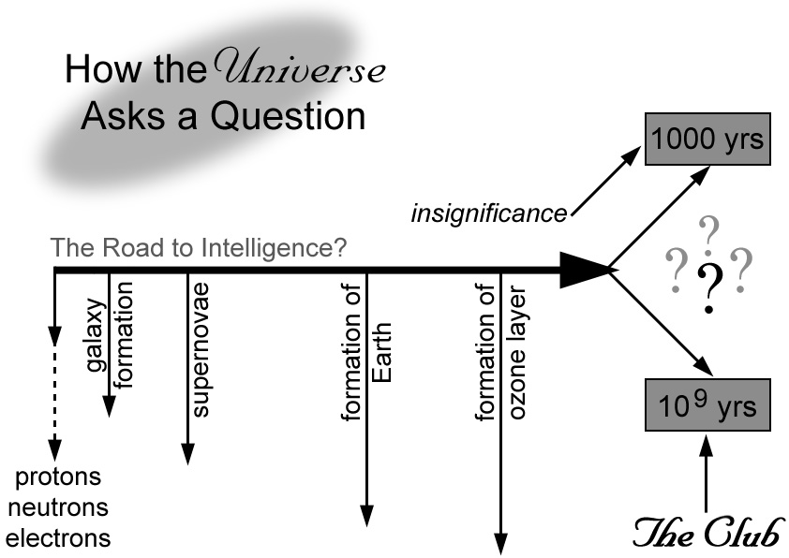
Theme of Course

