Slide 1
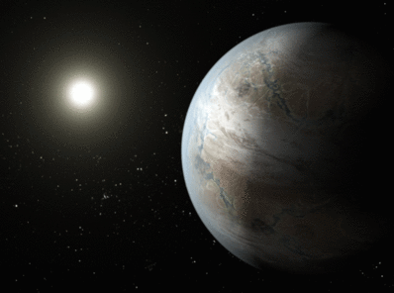
The Discovery
In July 2015, NASA announced the discovery of the closest “cousin” to Earth yet discovered—in data collected by the Kepler spacecraft during its four-year mission.
The planet, designated Kepler-452b, is 1.6 times the diameter of Earth, orbiting every 385 days in the “habitable zone” of a star about the same size and temperature as the sun and just 20% brighter.
In
IF this planet as the same density of the Earth then it is also 5 times more massive than the Earth
Notes:
The habitable zone of a star is the region around it in which an orbiting planet could experience temperatures suitable for liquid water to exist on the surface.
Kepler’s initial data-collection mission lasted four years, from May 2009 to May 2013, when on-board equipment failure compromised the ability to point the spacecraft with sufficient accuracy to continue the original mission. The spacecraft was repurposed for the K2 Mission, in which the spacecraft continues to search for and discover extrasolar planets around stars by aiming at starfields along the ecliptic for periods of about 75 days.

Slide 2
How was the Discovery Made?
Kepler detects possible planets by taking a photometric measurement of the stars in its field of view every 30 minutes. A planet transit will show as a small periodic dip in the “light curve” of a star over time.
The time between transits gives the orbital period of the planet. If the star’s size and temperature are known, the dip in the light curve indicates the size of the planet.
Mission scientists require at least three transits—three orbits, or planetary “years”—to verify that a planet is present.
Notes:
Run your cursor over the upper image and click on the arrow to run the animation. If you have trouble running the animation, you may need to load Quicktime.
Note: Kepler can only detect the presence of planets whose orbits are oriented so that the planets pass across the face of their parent stars from the spacecraft’s perspective.
Photometric—referring to photometry, the measurement of the intensity of light.
A light curve is a graphical representation of the intensity of light over time.
Lower light curve of Kepler-452b caption: Phase-folded, detrended flux time series for Kepler-452 versus phase in hours. The flux
time series plotted here phase folded at the period of the planet, 384.84 days. The triangle symbol indicates the location of the four transits at
zero phase. The full resolution data are represented by black dots. The cyan filled circles represent the results of binning the data in phase with a bin
width of 1/5 of the DV-fitted duration of the transit, 10.5 hr

Slide 3
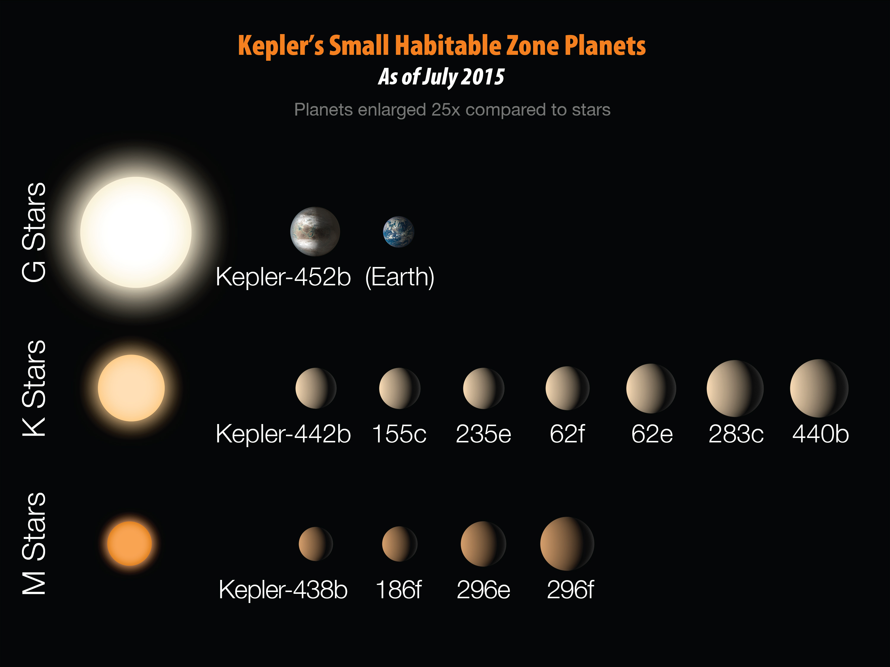
The Big Picture
One of the key questions Kepler was created to answer was whether there were other planets like Earth.
Most confirmed Earth-size planet discoveries orbit smaller and cooler stars than the sun and have short years—because these planets transit more often and are thus more readily confirmed.
Notes:
M, K, and G stars are spectral classes of stars—categories which sort stars by their spectral types, which essentially sorts them by surface temperature. M and K stars are cooler and G stars are hotter; the sun is a G-type star.

Slide 4
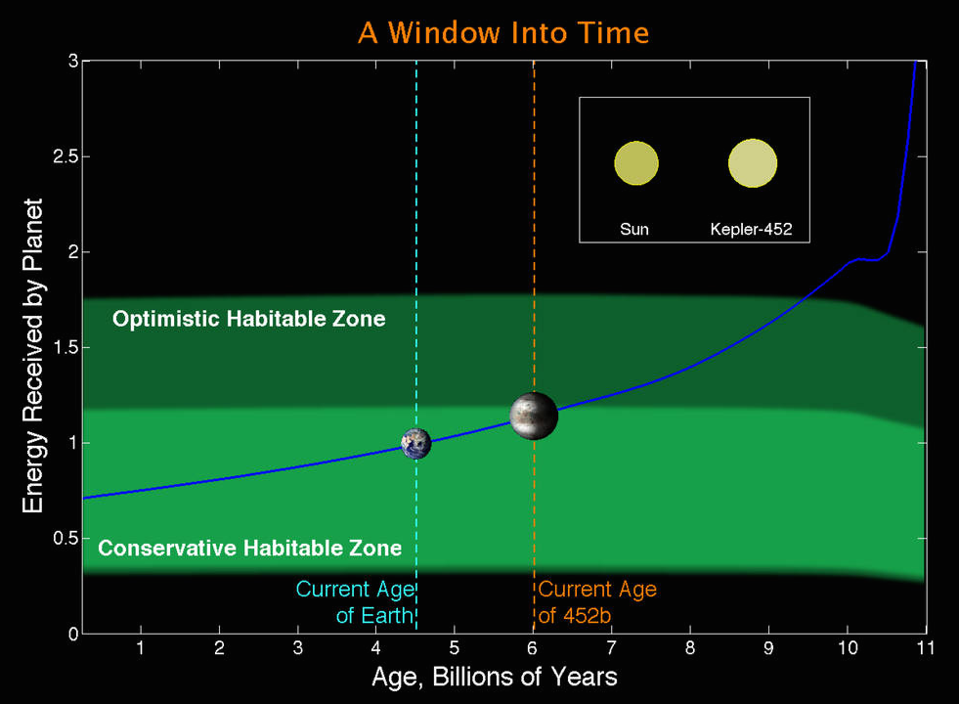
Life on Kepler 452b?
Kepler-452b is both larger and older than Earth. 452b receives 10% more energy than Earth; if it were the same size as Earth, there would be a run-away greenhouse effect.
Because it is 5 times more massive than Earth, its size may allow it to retain an more of an atmosphere that might mitigate against a run away greenhouse effect.
Credit: NASA Ames/J. Jenkins.
Notes:
The star Kepler-452 is six billion years old compared to our sun’s 4.5 billion years, so the planet Kepler-452b has existed 1.5 billion years longer in the habitable zone of its star than Earth.
Kepler-452b is receiving 10 percent more energy from its parent star than the Earth is from the Sun. If Kepler-452b had the same mass as Earth it would be almost experiencing a runaway greenhouse effect and the loss of its water inventory. However, since it is 60 percent bigger than Earth, and is approximately five Earth masses, its larger size provides additional protection from any greenhouse effect for another 500 million years.
Note: The habitability of Kepler-452b is debated among astronomers. It is not absolutely a habitable world.

Slide 5
More examples – host star = 0.5 solar masses

Slide 6
Ross 128 B
Discovered in Fall of 2017
This exoplanet is located only 11 light years away
Orbits a red dwarf star every 10 days
Planet gets 1.4 times more radiation from its host star than the Earth does
But, host star is much cooler, so very few “blue” and “green” photons are emitted. That would greatly hamper the earth equivalent of photosynthesis
But clearly the object is sufficiently nearby that detailed studies are planned

