Slide 1
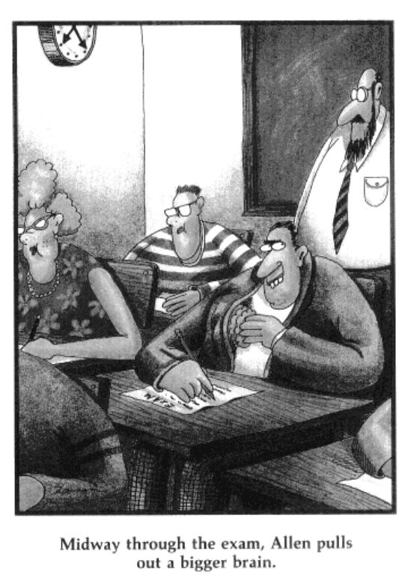
Is there Intelligent
Life On Earth?
Final Exam
Mon Dec 4 at 7:15 pm

Slide 2
Standard Definitions of Intelligence:
Ability to Reason
Problem Solving
Use tools to build stuff
Ability to Create
Ability to think abstractly
Ability to communicate → complexity of the language

Slide 3
Cosmological Intelligence
The ability to exist on your planet in an equilibrium manner with respect to resources and other creatures.

Slide 4
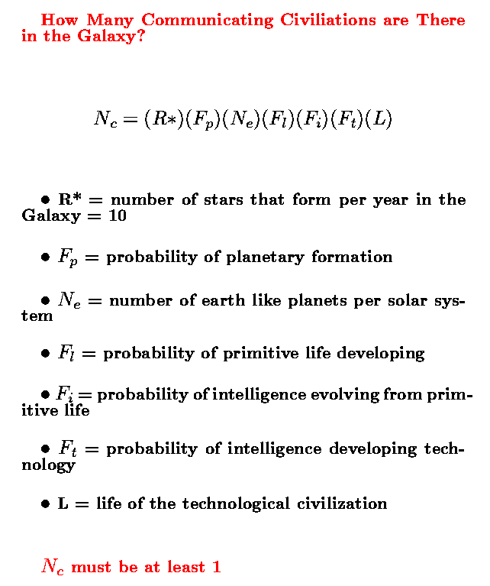
The Drake Equation
The Astronomical part is the first three terms
The Biological part is the next two
The socio-economic part are the final two terms
The uncertainty in each term grows as you move right

Slide 5
R*F_{P}*N_{e} = 10*1*1 = 10
The Astronomical Part: Observations suggest that planetary formation is a natural consequence of star formation. Nearby stars exhibit dusty disks in orbit about them which are likely solar systems in the process of formation. For every star of some temperature. Now over 3500 exoplanets have been discovered.
Around each start there is a habitable zone in which the temperature is right for the condensation of water vapor. The width of the habitable zone depends on the temperature of the star. If you make enough planets via the accretion of small grains then it is likely that one of the accreting planets will land in this habitable zone.
We have now discovered some Earth like planets in a Habitable Zone around nearby stars.

Slide 6
F_{L} * F_{I} = (1) * (0.1) = 0.1
The Biological Part: Given enough time, chemistry, mixing in the liquid surface, local concentration of organic molecules, etc, will eventually lead to a self-replicating system.
The deep sea thermal vent environment greatly facilitates this process which is likely common.
That process took a billion years to happen on the earth so maybe all you need is time. But, since the planet is subject to random catastrophe, there are all kinds of problems that species have to overcome, I rate the probability of reaching intelligence as only 10% (of course it could be much smaller!).

Slide 7
The Socio-Economic Part: Does intelligence automatically begat Technology? Does the capacity to destroy our planet mean that we can never really be Intelligent? And what about our lifetime as a technical civilization, will it be short or long?
Here we assume only a 10% probability of intelligent civilizations becoming technological. (F_{t} = 0.1)
Since previously F_{i} was taken to be 0.1 so now F_{i} *F_{t} = 0.1 * 0.1 = 0.01 – 1% → on only 1% of all planets with a liquid surface does a civilization which builds radio telescopes arise.

Slide 8
What about L?
99% of all technological civilizations extinct themselves after 1000 years
The remaining 1% survive, in harmony with their planetary resources for 1 billion years.
This leads to an average lifetime of 10 million years (1% of 1 billion)
N_{C} = (10) * (0.1) * (0.1) * (10⁷) = one million

Slide 9
What is L for US?
Key Question: Can we on some future timescale cooperate better as a collective to more wisely use planetary resources?
Some of the responses to your homework poll are relevant in this regard

Slide 10

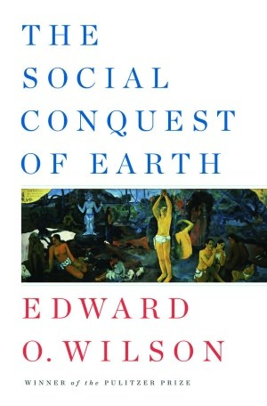
Four view of Nature and Humans
Only one of these views is likely to the choice of all currently intelligent civilizations in the galaxy

Slide 11
Religious View
God intervenes and can alter the world via punishment and redemption.
Truth is given through divine revelation to those that can interpret the signs.
Nature is God's Medium; Humans can control nature through their actions

Slide 12
Mechanical (mostly from Descartes)
God only creates the initial conditions and sets the springs.
Truth is acquired via rational and reductionist means so as to discover the workings of the springs.
Nature is lifeless matter in motion, it is a Machine.
Humans are distinct from nature and are entitled to control it because Nature has no soul, only humans do.
Operationally, this is the collective world view of humanity

Slide 13
Scientific
Nature is governed by a small set of consistent operating principles that can evolve with time.
Careful observation and experimentation can reveal many of those principles.
God may or may not exist.
Truth is manifest as consistency with observations.
Humans are necessarily a physical part of Nature.

Slide 14
Aboriginal
Nature is sacred.
Humans are directly connected to nature.
Harm to nature is harm to humans.
Truth is unimportant.
Knowledge and Wisdom comes from recognizing that all components of the system are equal and necessary - Nothing in nature is unnecessary.

Slide 15
From a Recent Article and how to have a long L
To restore equilibrium requires a systems thinking approach that prioritizes human equity, dignity, environmental justice and environmental health over escalating global GDP. In turn the view of the Earth as a resource to exhaust must be supplanted with the view that the Earth is a sacred equilibrium system for the welfare of all.

