Slide 1
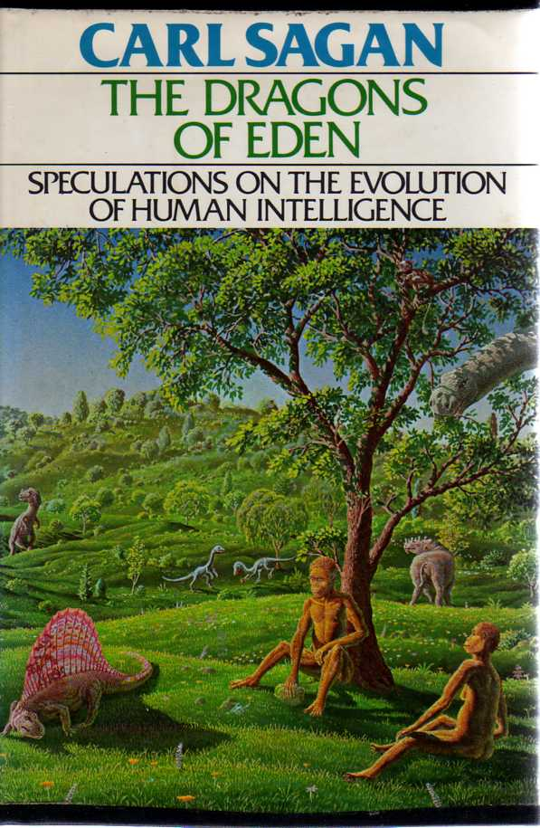
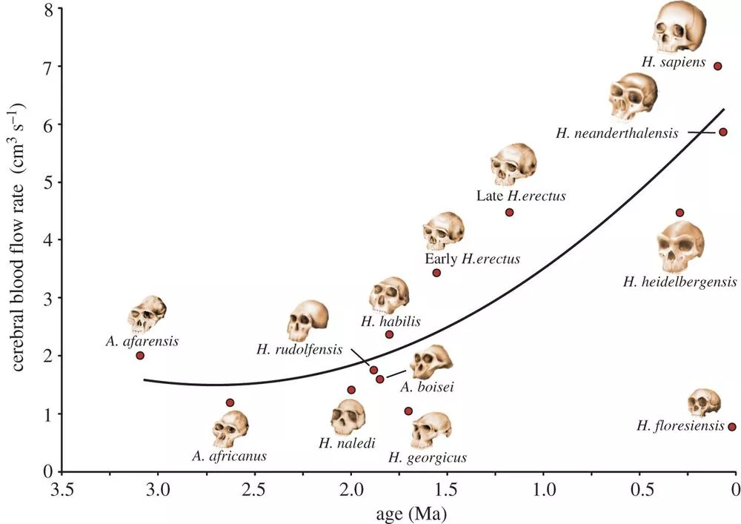
The Evolution of Intelligence
Blood Flow to the Brain

Slide 2
Evolution of Intelligence
We know very little about this
We pretend to know a lot about this
Is intelligence innate or learned? → Does the need to adapt to a changing environment accelerate the evolution of intelligence?
We do know that the brain size of mammals does slowly increase over geologic time.
Brain size is proportional to body weight in mammals (not dinosaurs)

Slide 3
What is Intelligence?
Biological Intelligence: environmental conditions determine the rate of growth of intelligence
Artificial Intelligence: number of neurons basically correlates with learning ability
"The true sign of intelligence is not knowledge but imagination.“ [creativity]
Intelligence likely transcends problem solving

Slide 4
Relative Intelligence
Define as the amount of brain tissue in excess of that required for basic body function.
This is known as the level of Encephalization (EL)
EL = K(P)^{2/3}
P = body mass; K= some efficiency factor that can be partially recovered from the fossil record

Slide 5
The EL Scale
This is relative intelligence, there is nothing absolute about it.

Slide 6
What does the data say?

Slide 7
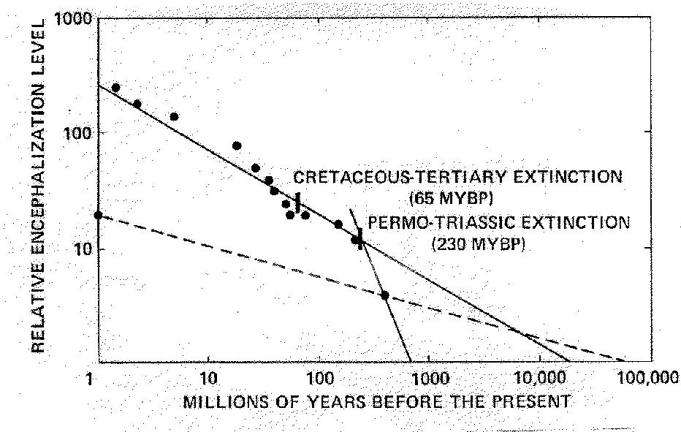

Slide 8
Increase in Relative EL exhibits a well defined pattern over the last 200 million years
Fastest growth was from 600--250 million years ago when species first emerged on the land

Slide 9
Mass extinctions clearly are important as they substantially alter the rate of growth
Minor Extinction event 35 million years ago may have suppressed rate again

Slide 10
Unaltered rate would have produced current human level of EL about 60 million years ago

Slide 11
LAND
OCEANS
Continental rate is much higher than the oceanic rate
Oceans are a benign environment and do not need much adaptation to changing conditions

Slide 12
Extrapolation to EL =0 is consistent with the known age of the Universe. This is just weird. Was the universe born with emergent intelligence and it just takes 13.5 billion years for it to emerge?

Slide 13
Factors that might contribute to rate of growth of intelligence:
Temperature: Many species function/learn best in a constant temperature environment. Large temperature variations are then not conducive to learning (this applies mostly to reptiles)
Time - clearly EL evolves slowly upwards with time. Doubling time appears to be about 2 million years – so primitive human is essentially ½ as “intelligent” as we are currently.

Slide 14
Factors that might contribute to rate of growth of intelligence:
Biogenic Environmental Diversity: the more diverse the ecosystem the more competition for scarce resources (food) there is could be strong environmental stimulus for growth of intelligence.
Suppression of diversity by environmental disaster, climate change, or nutrient depletion would then reduce this growth

Slide 15
Factors that might contribute to rate of growth of intelligence:
Trophic Level is important where you are in the food chain does this favor growth in predator or prey?
Adaptation: Species defense mechanisms are a signature of evolution of intelligence.
For instance, Coral defends itself statically but glue-secreting frogs have ingenious method for fending off predators.
Metabolism: large metabolism of mammals demands larger brain and hence establishes initial capacity for evolution of intelligence in mammals

Slide 16
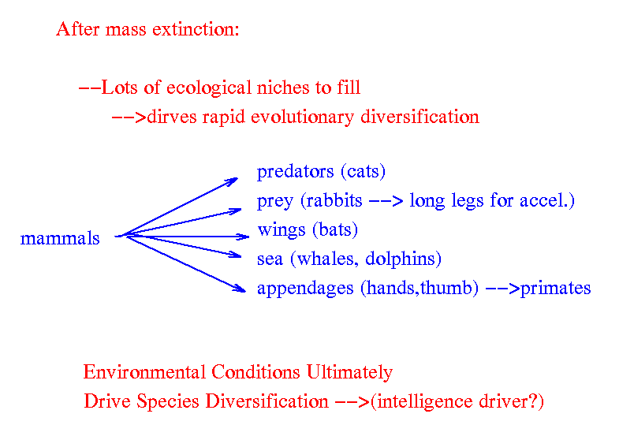
But clearly the role of mass extinction is paramount and allows the survivors to fill the newly opened ecological niches

