Slide 1
What Happened?
Over the last 13.5 Billion years?

Slide 2
The Universe is Born
Initially it is just a state of pure energy
Later that energy will transform into matter
But this is very much the Cosmic Womb moment – everything that exists in the Universe was created in a single moment

Slide 3
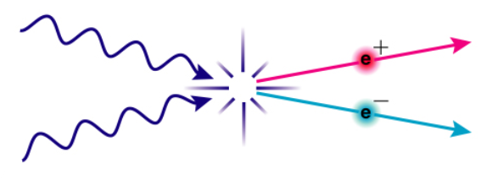
Physics Emerges
At some point, the Universe knows about
E = mc²
Photon + photon particle + anti-particle

Slide 4
Thermal Equilibrium
Mass and Energy constantly changing places
Eventually pair production produces Quarks + Anti-Quarks
Some Unknown Process now causes an excess of quarks over anti-quarks by 1 part in one billion.
With quarks, UUD = proton; UDD = neutron

Slide 5
Neutrons Decay
A free neutron will decay in about 15 minutes
Hydrogen fusion to Helium in the first 3 minutes of the Universe preserves the neutrons in Helium nuclei
Energy density in the radiation (photons) much greater than energy density in matter so matter can not combine

Slide 6
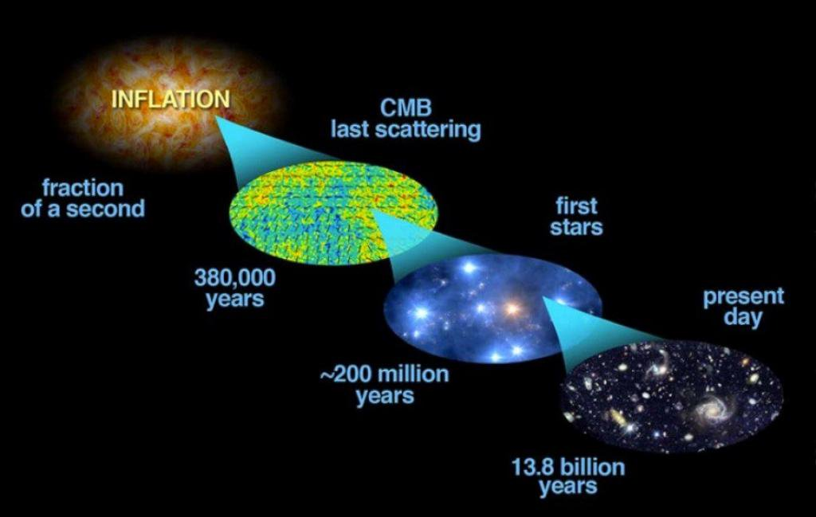
Radiation Dominance

Slide 7
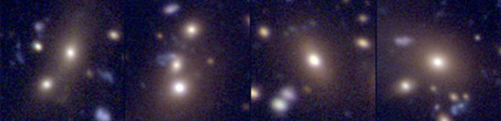
After Recombination
Small Clumps of matter begin to merge together, again by some UNKNOWN PROCESS, to make Galaxies

Slide 8
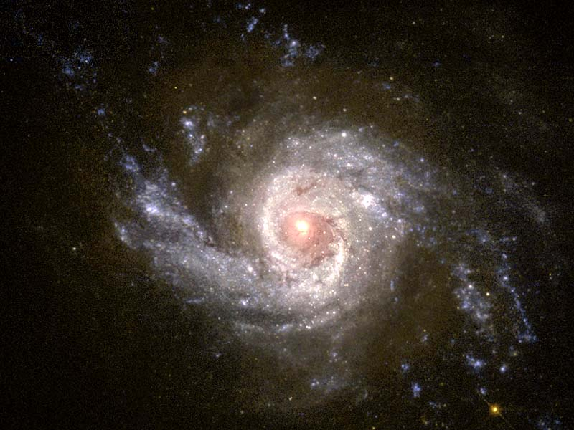
Galaxy = container of gas for star formation to make elements heavier than Helium

Slide 9
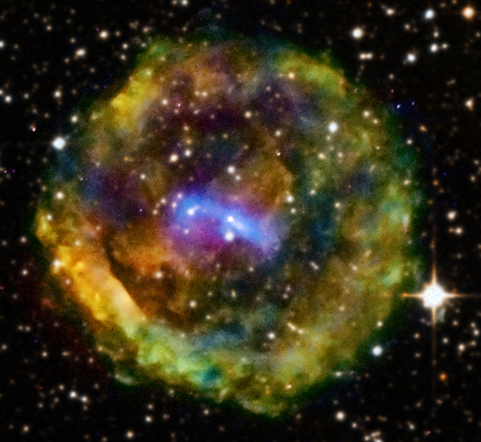
Stellar Evolution
Fusion in Stars makes lots of Carbon, Nitrogen, and Oxygen
Massive stars go supernova
Supernova make the entire periodic table of elements – another example of the Cosmic Womb Idea
These elements are distributed throughout the Galaxy making it chemically homogeneous

Slide 10
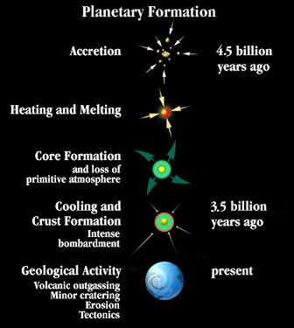
Eventually there have been enough Supernova to seed the Galaxy with the elements necessary to make rocky planets

Slide 11
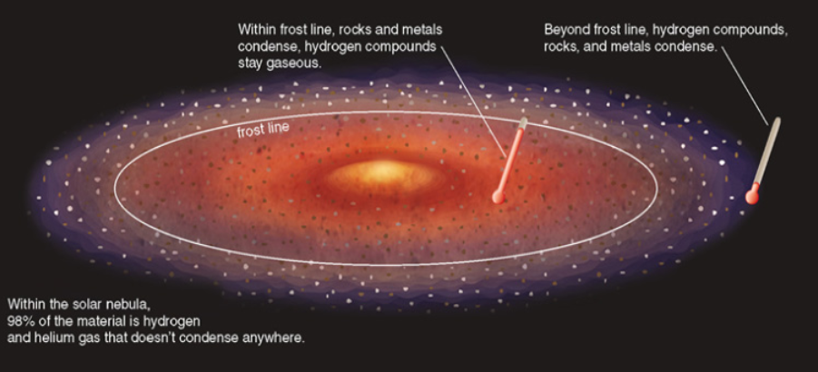
Make enough planets around some star it is likely that one of them will be in the Habitable Zone

Slide 12
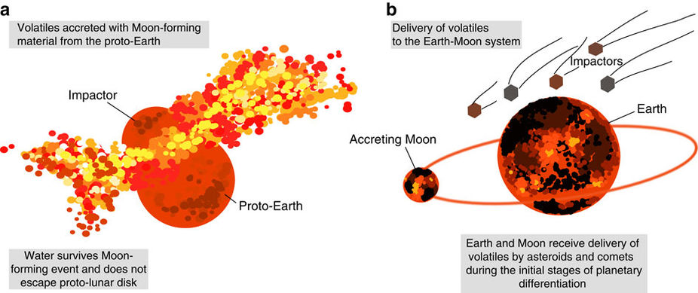
Water is Delivered to Earth (another unknown process)

Slide 13
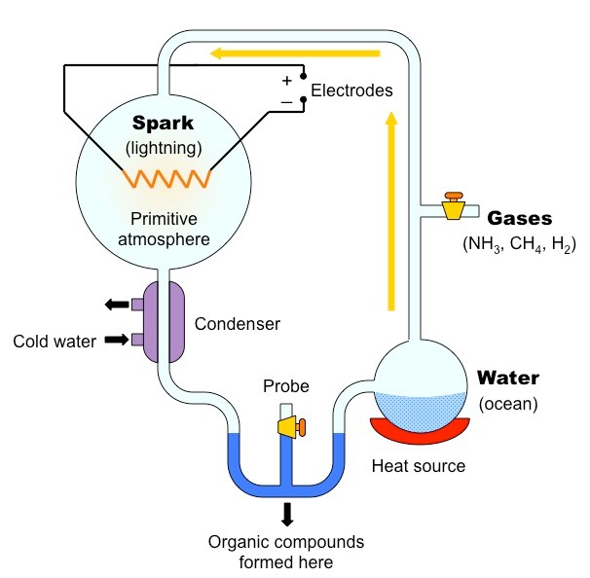
Miller Urey experiment shows that amino acids are easy to synthesize

Slide 14
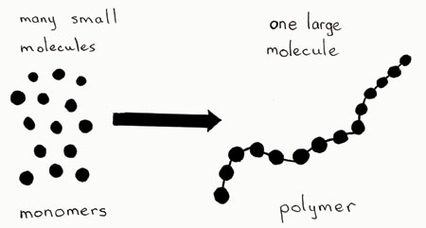
Monomers to Polymers

Slide 15
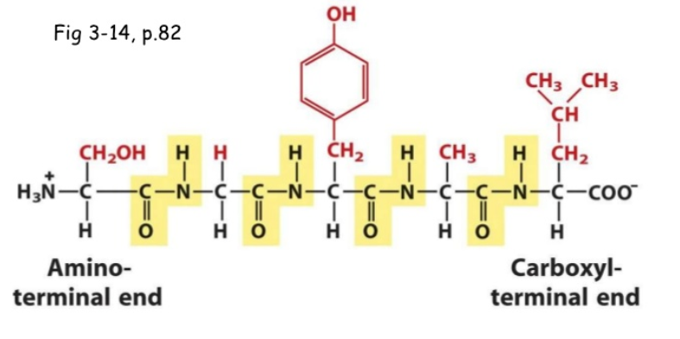
Can make long polymers called peptide chains with various active areas

Slide 16
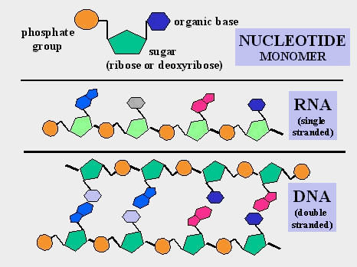
Trial and Error interaction of polymers produces DNA about 750 million years after Earth formation

Slide 17
Formation of DNA
Requires a long time scale in a stable fluid medium to eventually accidentally discover the genetic code for Earth.
Now we have self-replicating bacteria that need an energy source
The Deep Sea Thermal Vent environment is likely the best source of nutrients for the initial bacteria
Eventually early bacteria will evolve to phytoplankton that can harness UV sunlight (there is no ozone layer at this time) to metabolize H₂O

Slide 18
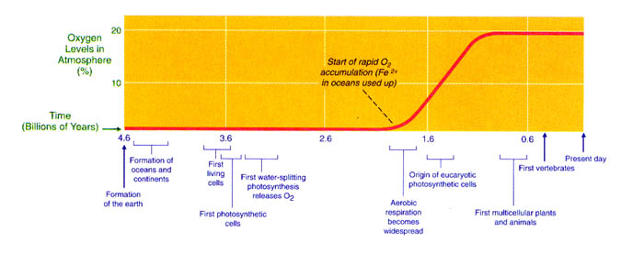
Slow rise of atmospheric Oxygen

Slide 19
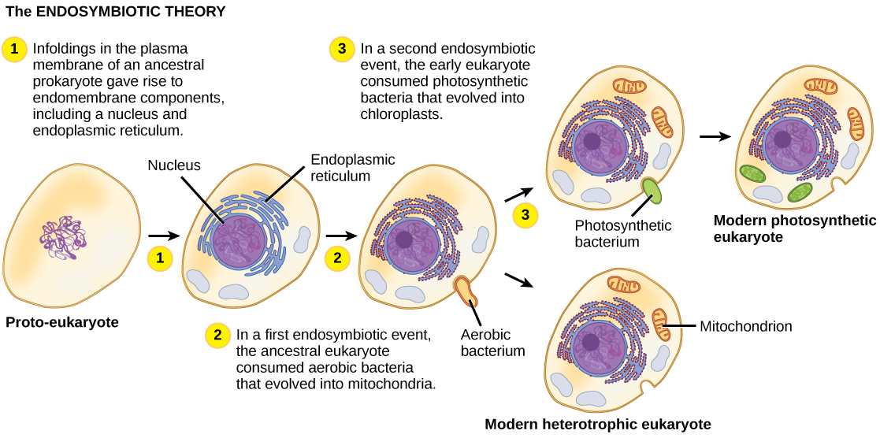
The Nucleated Cell (Eukaryote)
By yet another unknown process, single cells (prokaryote) evolved to nucleated cells. A nucleated cell is required to protect DNA. Eukaryotic cells seem to have first emerged about 1.5 billion years ago.

Slide 20
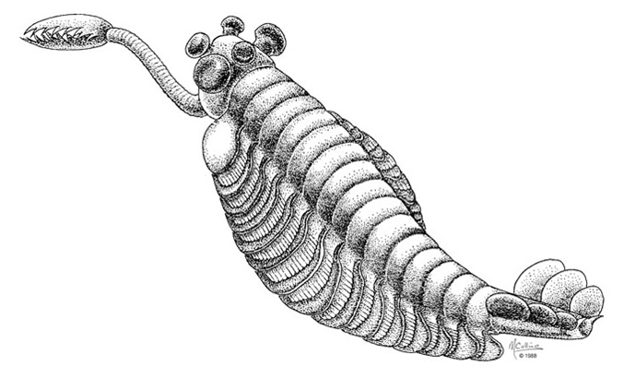
Multicellular Eukaryotes
Otherwise known as plants and animals start to evolve in the sea about and many strange fossils have been found dating back to about 1 billion years ago

Slide 21
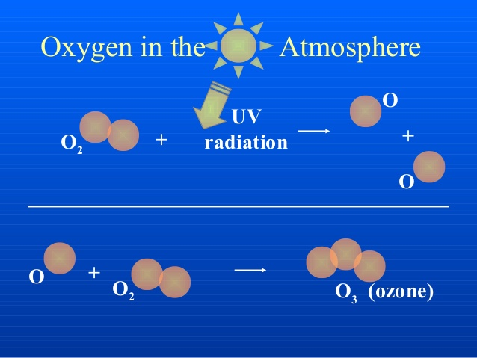
Migration from Sea to Land
This requires protection from UV Sunlight
So the Ozone Layer needs to form first:

Slide 22
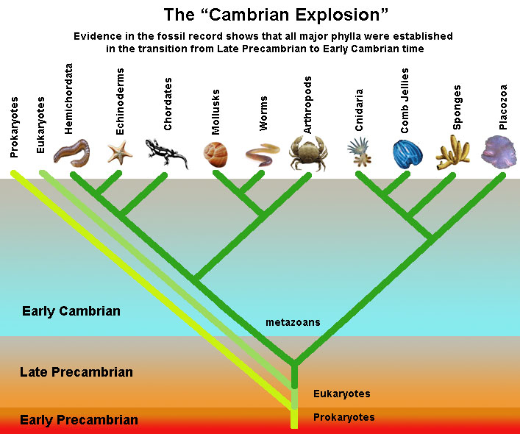
Ozone layer forms 600 million years ago
Explosion of Species occurs in a relatively short period of time (600 – 500 million years ago)

Slide 23
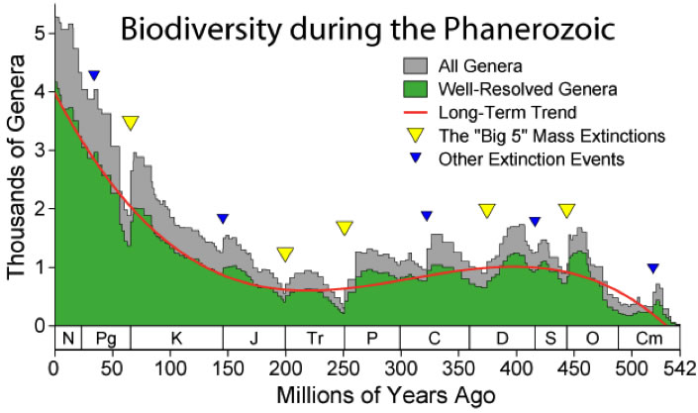
Now lands species have to deal with periodic extinction events

Slide 24
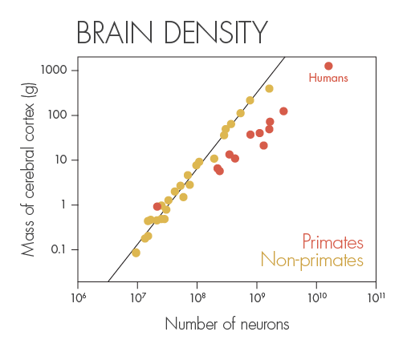
Evolution of Intelligence ensues
This evolution is likely strongly stimulated by changing environmental conditions where mass extinctions will play a crucial role.

Slide 25
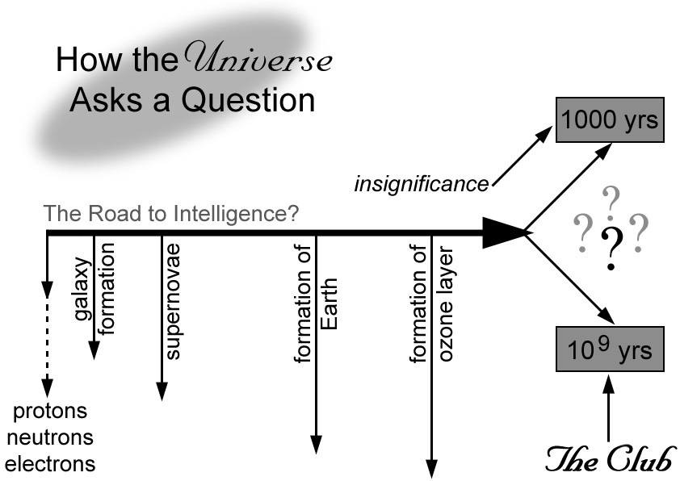
Now we are here? Where do we go?

