Slide 1
Midterm 2
Common Problems

Slide 2
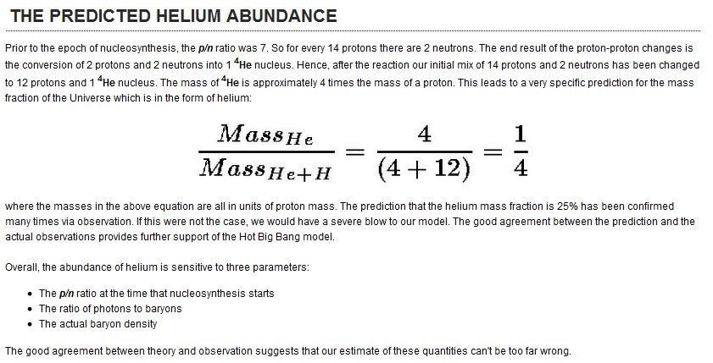
Helium Abundance
Stage 5: 3-20 minutes: The Onset of Helium Formation

Slide 3
Choose the “Best” Answer
Best answer means in the context of what is covered in lecture, in your homework, or in the web textbook.
A = no; not responsible; matter-anti matter annihilation
B = red herring
C = yes electrons result individual neutron decays but not at the cosmological level as most created neutrons ended up in helium
D = yes – kangaroos – mentioned often in class
E = red herring

Slide 4
Choose the “Best” Answer
Best answer means in the context of what is covered in lecture, in your homework, or in the web textbook.
A = no; rate depends on details of actual SN explosion not the initial mass
B = yes; Gold is only formed from how many neutron captures occur during SN
C = the rate doesn’t determine the speed; the speed might determine the rate
D = red herring
E = Silicon is not produced from Neutron Capture

Slide 5
In the early Universe we assume Thermal Equilibrium. What is the simplification that this assumption gives us about the conditions of the early Universe?

Slide 6
Explain why Carbon can not be created in the very early Universe

Slide 7
Explain why dark matter may be necessary to facilitate the formation of Galaxies.
Hardest question but best diagnostic

