Slide 1
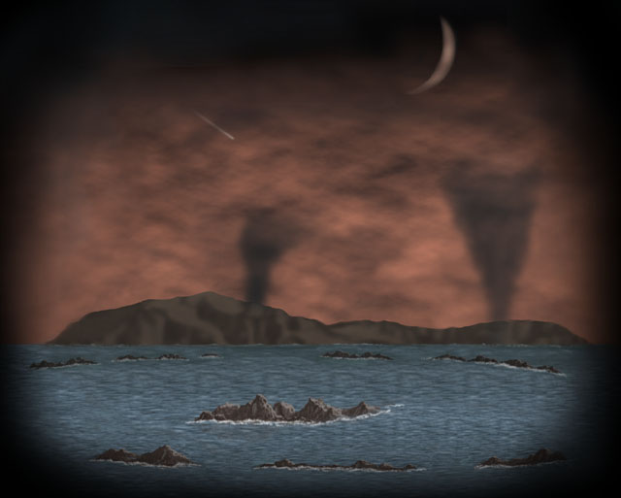
Evolution of the Early Earth
And its
Atmosphere

Slide 2
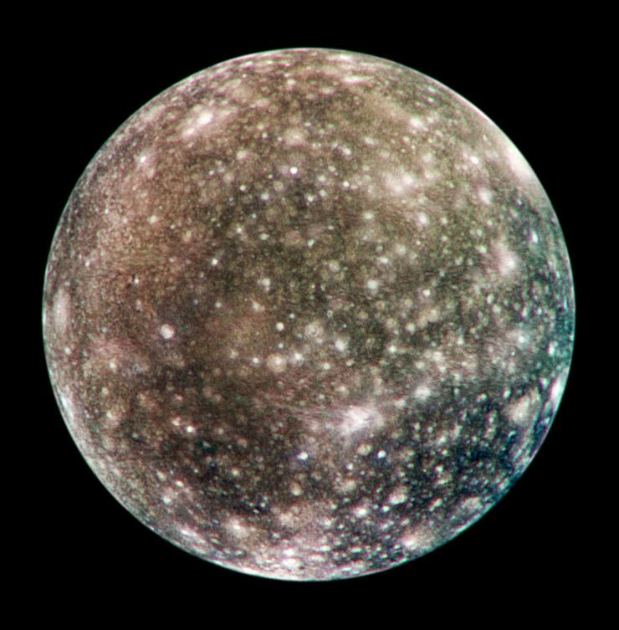
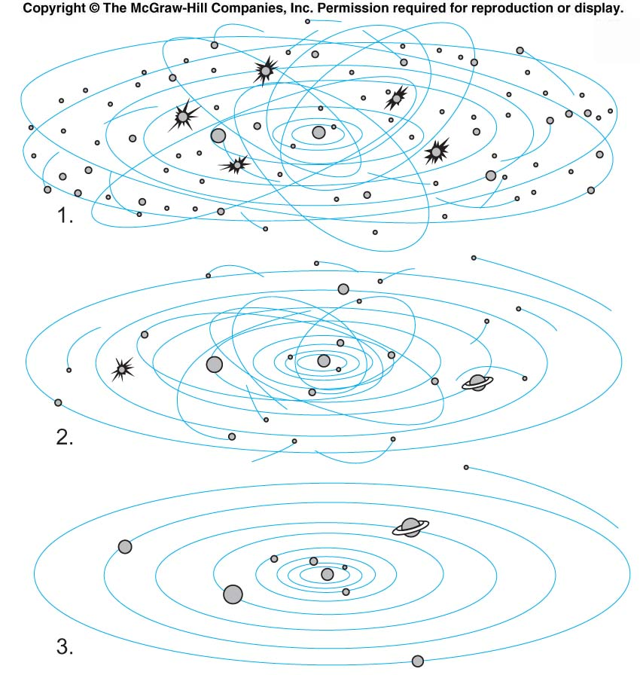
Stages in Planetary Evolution
1. Planetesimals
… small bodies formed from dust and gas eddies
2. Protoplanets
9 or 10 formed from planetesimals accretion
3. Planets
formed by combining protoplanets swept up by gravitational attraction.
4. Left over debris craters newly formed planets

Slide 3
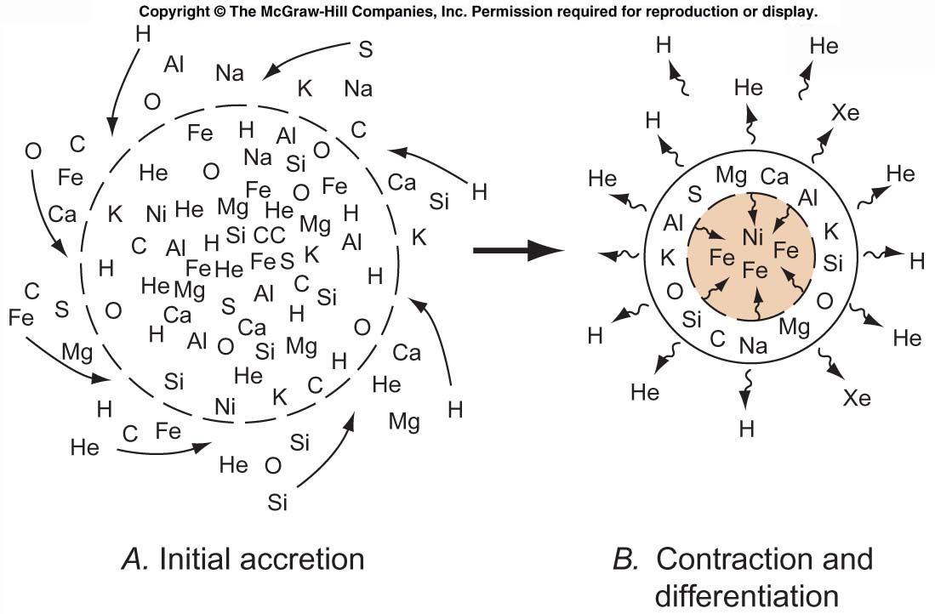
Stages in Formation of Early Earth
From (A) a homogeneous, low-density protoplanet to (B) a dense, differentiated planet

Slide 4
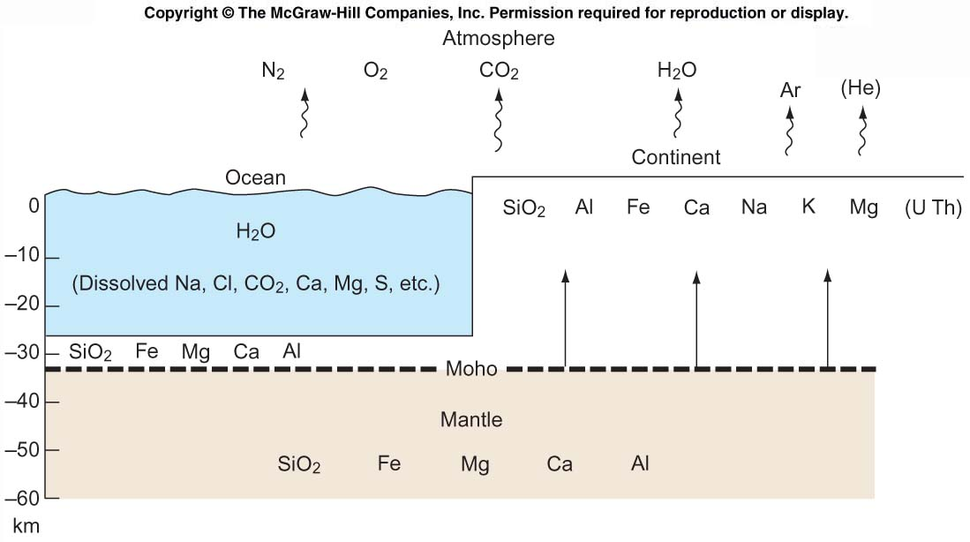
Differentiation of Chemical Elements in Earth
Present distribution of major elements and U, Th, He and Ar in the Earth’s atmosphere, crust and in seawater. (Elements listed in order of abundance).

Slide 5
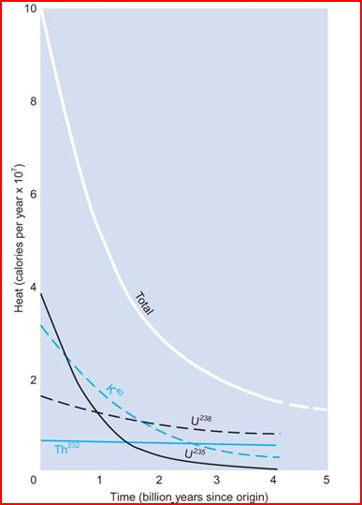
This means that the interior of the Earth remains hot for billions of years
Earth is internally heated mostly by the decay of Uranium 238 and Potassium 40 – eventually U-238 (R-process element) dominates

Slide 6
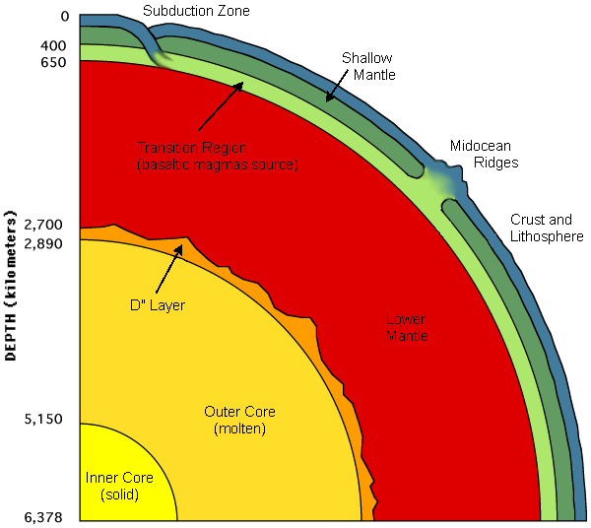
Divisions of the Earth's interior
Cross section of Earth showing in a rudimentary way the relation of the upper mantle to subduction zones and midocean ridges.
Internal heating eventually drives plate tectonics.

Slide 7
The First Atmosphere
The early atmosphere would have been similar to the Sun--mainly hydrogen and helium, but this atmosphere was lost quickly for two reasons:
  (1) The gravity of the modest size earth was not strong enough to prevent such light gases from escaping to space. Particularly since the early earth was hot!
  (2) It appears that around 30-100 million years after the earth’s formation, it was struck by a large object…the size of Mars. The result: the origin of the moon and loss of earth’s early H, He atmosphere.
Notes:
7

Slide 8
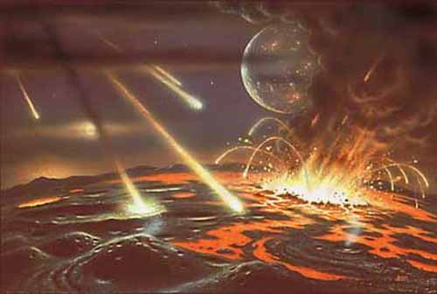
“Hadean” is name given to Eon in which Earth formed by accretion and meteorite bombardment. It was truly “hell on earth” as constant meteorite bombardment and high interior heat flow combined to keep early Earth surface in nearly constant molten state.
Atmosphere of early Earth likely reducing (i.e. no oxygen) and similar to present Jupiter atmosphere (?), mostly:
The first atmosphere: methane (CH₄), ammonia (NH₃), hydrogen (H₂) and helium (He)

Slide 9
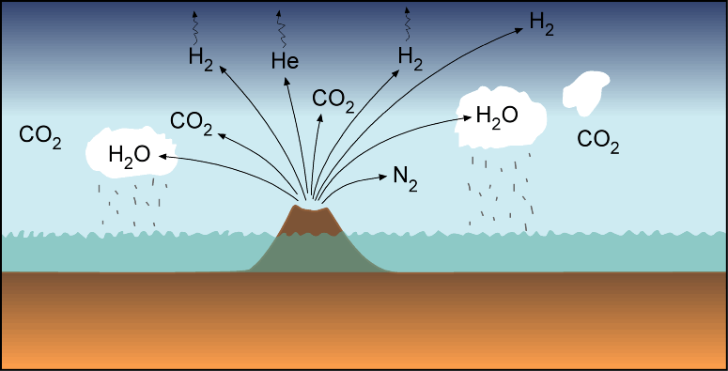
The Second Atmosphere
Volcanic Out-gassing radically changed the chemical composition of the atmosphere

Slide 10
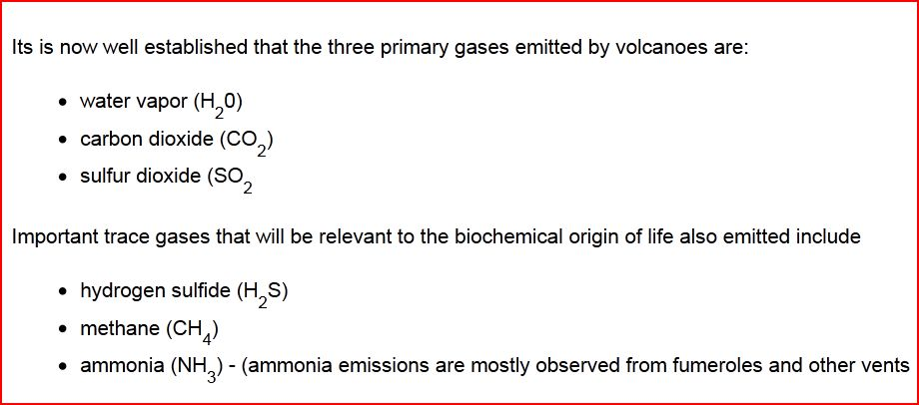
Earth’s Second Atmosphere
A new atmosphere was established by the outgasing of volcanoes…the mixture of gases was probably similar to those of today’s volcanoes:
H₂0 vapor (roughly 80%)
CO₂ (roughly 10%)
N₂ (few percent)
Small amounts of CO, HCL, HS (Hydrogen Sulfide), SO₂, CH₄ (Methane), Ammonia (NH₃), and other trace gases.
Water vapor about 60-80% of total emission; carbon dioxide 10-30%
Notes:
10

Slide 11
Earth’s Second Atmosphere
Virtually no oxygen in that second atmosphere.
Thus, no ozone layer, so ultraviolet radiation flooded the earth’s surface.
With a huge influx (origin remains mysterious) of water vapor and the cooling of the planet, clouds and earth’s oceans formed over a period of 300-700 million years. Banded iron formations dated at 3.8 billion years indicate oceans were in place.
At that time the sun was about 30% weaker than today…why didn’t the earth freeze over?
The apparent reason: so much CO₂ so there was a very strong greenhouse effect.
But now have to get rid of the CO₂ so conditions favorable to life can exist
Notes:
11

Slide 12
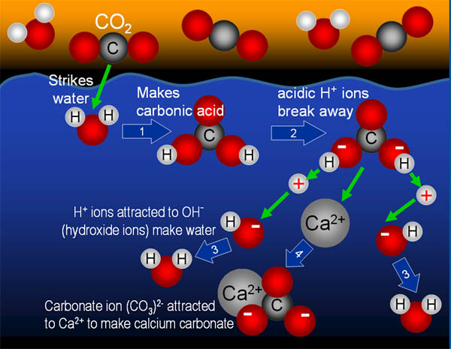
Chemical Weathering
H₂O + CO₂ --> H₂CO₃ carbonic acid
CaSiO₃ + H₂CO₃ --> CaCO₃ + SiO₂ + H₂O
Silicate Rock Carbonate
Oceans dissolve most of the CO₂
Marine organisms would eventually incorporate carbonate into their shells, which would fall to the ocean bottom when they died---thus, removing them from the system for a long time.
The bottom line…CO2 was being removed from the system over the course of a few hundred million years
Notes:
12

Slide 13
More Changes
Sulfur compounds were taken out of the atmosphere as acid rain and were deposited on the ground as sulfates.
Nitrogen (N₂) gas increased slowly but progressively since it was relatively inert.
Current composition of the atmosphere was established approximately a billion years ago.
Notes:
13

Slide 14
The Rise of Oxygen and the Third Atmosphere
In the first two billion years of the planet’s evolution, the atmosphere acquired a small amount of oxygen, probably by the splitting of water (H20) molecules by solar radiation.
The evidence of this oxygen is suggested by minor rust in some early rocks.
The oxygen also led to the establishment of an ozone layer that reduced UV radiation at the surface.
With the rise of photosynthetic bacteria (cyanobacteria) and early plants, oxygen levels began to rise rapidly as did indications of rust in rocks
Between 2.5 billion years ago to about 500 bya, 0₂ rose to near current levels.
This means Oxygen in the Earth’s atmosphere is a LATE arrival!
Notes:
14

Slide 15
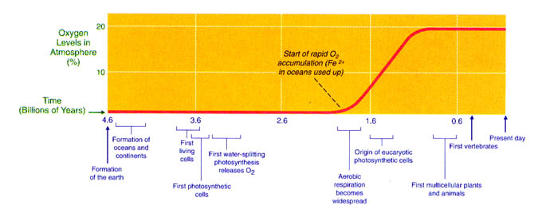
Overall, we have to wait about 2.5 billion years from formation to the first signs of oxygen in the atmosphere: Fe⁺⁺ dissolved in the oceans (thanks to supernova) scavenge the O₂ for 2 billion years until saturation.
Notes:
15

Slide 16
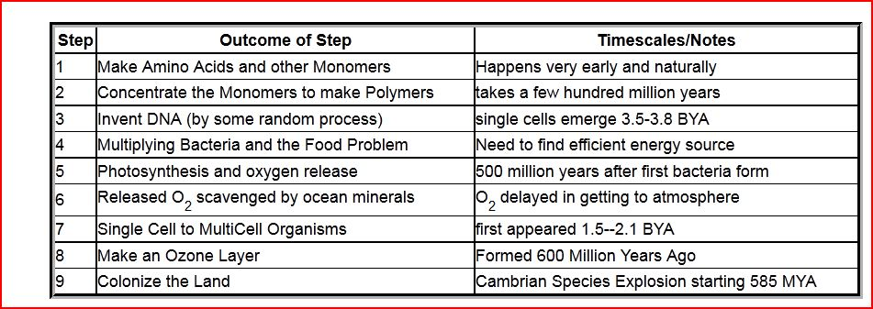
Evolution of Life

