Slide 1
Snowball Earth! Hot House Earth!
Past radical climate change
Making surface life difficult – the oceans are, in general, unaffected by this

Slide 2
Origin of Snowball Earth Theory
W. Brian Harland (1917-2003)created in 1964
The premise of this theory is that during the Pre-Cambrian era, the continents resided near the Southern Hemisphere and the inter planet was covered by Glacial Ice Sheets form the Poles to the Equator.

Slide 3
Snowball Earth Definition
It is a time of one of the most intense ice ages-up to four episodes of climate changes.
750-580 Mya
Mile high Ice covered completely (or almost) on earth
World-wide glaciations
Pure White Earth
Eight hundred million years ago, Earth under went a monstrous ice age. There is evidence of glacial ice in tropical latitudes, only 15º to 30º north of equator. Earth would have looked like a different planet, with no open ocean and few areas of exposed rock

Slide 4
Theories of Snowball Earth
1) High Tilt Axis- 70 degrees and “preferential” glaciation at low altitude. – but how does the tilt change so much from 70 to 23 in a few hundred million years?
2) Extreme runaway glaciation due to ice reflection of sun light (Albedo). This is a tipping point
3) Plate tectonic action creates more land surface for more ice leading to higher albedo? (this seems likely)
4) Possibly lower solar luminosities by as much as 6% (this seems highly unlikely)

Slide 5
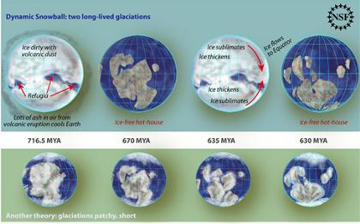
Snowball Earth Process
http://content.usatoday.com/communities/sciencefair/post/2010/03/snowball-earth-date-frozen-by-scientists/1

Slide 6
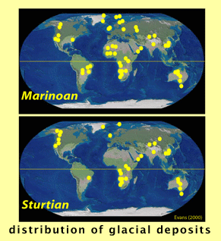
Evidence of SB Earth Theory
Phosphorus nutrients helped speeds up the evolution of underwater life. “A spike in ancient marine phosphorus concentration from 750 to 635 million years ago is linked to emergence of complex life.”
Age Dating of massive glacier deposits:
Banded Iron Formations;
(BIF) in glacial marine strata
Indicates widespread anoxia
(ice-covered ocean) → no
Photosynthesis from plankton

Slide 7
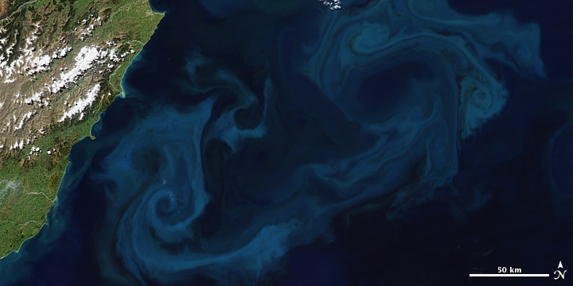
Phytoplankton Bloom

Slide 8
Did the Oceans Entirely Freeze?
One of the present holes in the ‘Snowball’ Earth theory are intervals in chemical weathering found during this time period, which leads one to belief that there were both warm and cold periods during the so called ‘Snowball’ Earth, which is not possible if the Earth was completely frozen over.
One of the other present details anomalous to the ‘Snowball’ Earth theory is the finding of complex photosynthesizing organisms found in black shale rock dating to this time period, indicating that there were some open areas of ocean at the time.
Some call it “Slushball Earth” because maybe equatorial waters did not freeze; also some volcanic eruptions could produce local warming

Slide 9
Contributions of CO2 through Plate Tectonics
“As we can see, geologic processes contribute CO2 to the atmosphere by three main routes:
1) Volcanism: outgassing of magmas formed in crust and mantle
2) Production of calcium carbonate: the precipitation of calcium carbonate (part of the biological pump) also releases CO2 to the atmosphere
3) Metamorphism: CO2 is liberated when carbonate minerals undergo metamorphism”
http://www.indiana.edu/~geol105b/1425chap8.htm

Slide 10
A Balancing Act
Plate tectonics can produce supercontinent formation that offers more biomass to drawdown CO2 from the atmosphere
More land mass means more ice means higher Albedo so the Earth cools and the ice became more permanent.
Massive volcanic eruption helped developed intense greenhouse effect to prevent permanent ice age.
Catastrophic releases of methane (super greenhouse gas)
Life flourished after that
At least two huge and long glacial events

Slide 11
Evidences all around the world
Evidences of fossil species change
Fossilized drop stones found worldwide: China, Russia, Australia, Africa, North America, and others.
California, Death Valley National Park
Formation: Panamint Range, Kingston Peak, Noonday Dolomite

Slide 12
Avg. Earth Global Temp
http://www.snowballearth.org/end.html

Slide 13
The Role Water Vapor
Land mass were not as big as today and plants have not reached to the land yet; therefore, there is no plant on land to hold or collect water.
Water vapor contributes or control the global temperature.
Water vapors controls 95% of global temperature (greenhouse gas by volume).
This all means that the greenhouse gas effect changes over time between CO2 dominated, Methane dominated and water vapor dominated (today)

Slide 14
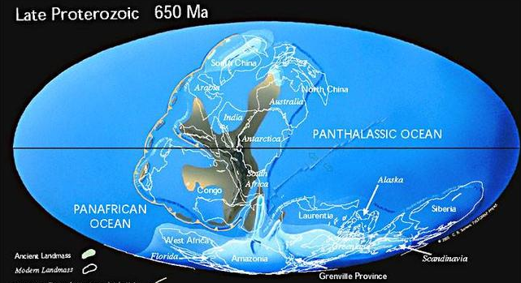
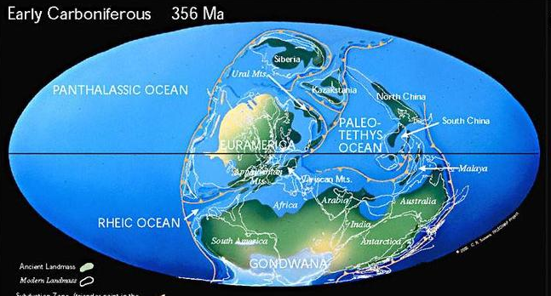
Significant increase in land surface over 300 million years
http://www.scotese.com

Slide 15
Animal Ecosystem Build-up
Speed up of animal ecosystems well documented from 600 mya to 300 mya
Simple one celled species to multicelluar animals
Extreme hot & cold climate pushed species to the edge of survival.
Changing climates speed up the evolution process.
Several trials and errors of species build-up are normal. This is the way evolution works (more on this later)

Slide 16
By About 570 MYA
Volcanic eruption ensued to give room for Greenhouse effects to warm up the Earth.
Final global glaciation was over.
Cambrian Explosion
Burgess Shale in Canada(“Serengeti” animals in the past)
Rises of the shelly fossils.
Predators were diversified extremely rapidly.
The new species ate so predator-prey relations becomes a source of intelligence evolution
Calcified (CaCO3) sea help developed hard shell for more protection from other predators.
Limestone-sea shells, coral, skeleton, etc.
http://www.astrobio.net/exclusive/2360/phosphate-does-a-body-good

Slide 17
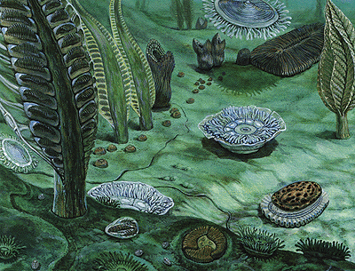
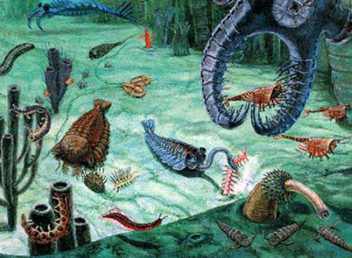
Comparing the difference in a mere ~ fifty million years apart.
Ediacara Cambrian
http://www.astrobio.net/exclusive/2360/phosphate-does-a-body-good
http://www.artsjournal.com/artopia/ptgbyD.W.%20Miller.jpg

