Slide 1
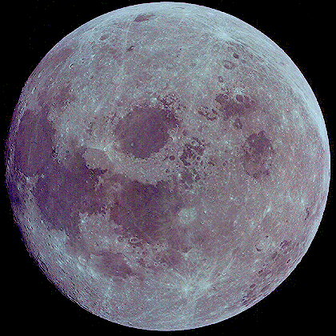
How did this get Here?

Slide 2
Why is that question?
The earth has a bulk density of 5.5 grams per cubic centimeter.
This density reflects the composition of material at the location in the solar system where the Earth was assembled via accretion. Logically one would therefore expect the moon to the have the same density
However, the moon has a density of 3.3 grams per cubic centimeter.
The moon is also an anomaly because its mass compared to the earth is 1/80 and there is very large for a planetary satellite

Slide 3
So the moon did not co-form with the Earth
Possibilities for Lunar Origin:
The moon formed by accretion somewhere else in the solar system where the material would form an object with a density of ~3.5 g/cc. So where would this place be? In the vicinity of Mars → okay how the hell did it get here then?
It separated out of the Earth after the Earth formed and differentiated? Since the mantle of the Earth has a density of 3.5 g/cc then the overall composition of the Moon must be like that of the Earth’s mantle. But what is the mechanism that would cause this separation?
This was a mysterious problem for about 30 years until finally, computer simulations improved to the point that offered a plausible explanation.

Slide 4
Earth Encounter between Molten Earth and Mars size Planetesimal
Step 1: The Mars planetesimal is poised to strike the molten protoplanet earth which has already differentiated

Slide 5
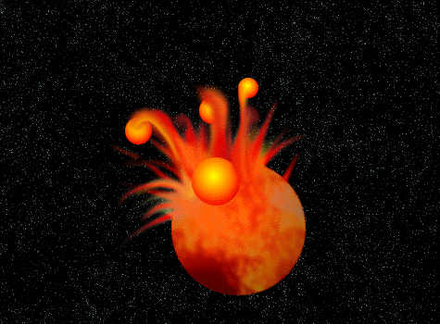
Step 2: The impact into the molten earth sends large molten lumps of debris out of the earth - mostly from the middle layers of the differeniated earth.

Slide 6
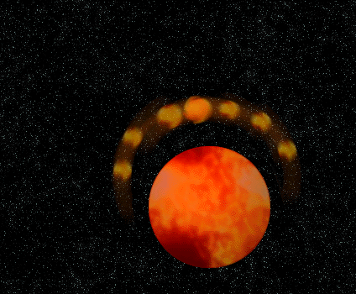
Step 3: The debris ring of molten ejecta coalesces, by accretion, into a single object. The density of that object would be similar to the density of the middle layers of the earth (e.g. about 3.5 grams/cc). In computer numerical models, this coalescence occurs fast, on a timescale of about 100 million years.

Slide 7
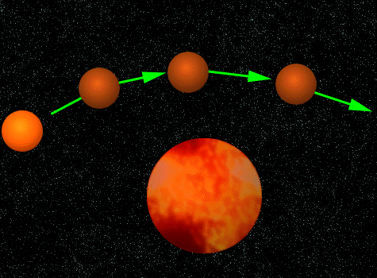
The problem with this scenario is that the probability of a direct collision is small. However, the same result can occur if there is not a direct collision but instead there is a close passage by the Mars sizes object. Here is the Sequence if it was a close passage as shown below:

Slide 8
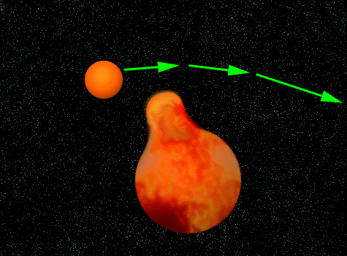
Step 1: A tidal force is exerted on the molten earth which causes an obvious deformation.

Slide 9
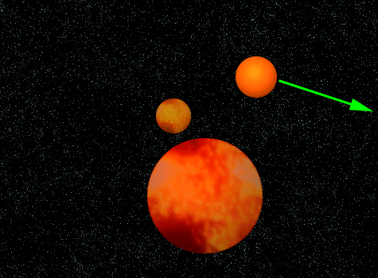
Step 2: The deformation actually separates from the earth initially as a whole molten blob whose composition again reflects the middle layers of the Earth

Slide 10
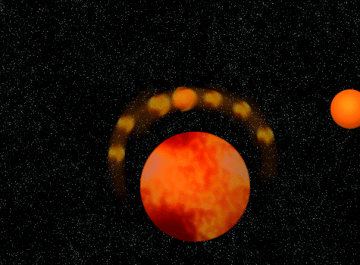
Step 3: However, this molten blob is gravitationally perturbed by the combined forces of the Earth and the still near Mars size object so it distengrates into a debris ring.

Slide 11
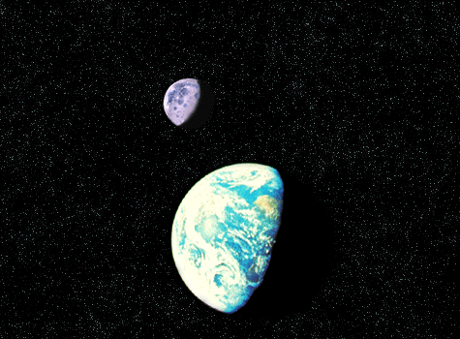
After a 100 million years or so, the debris ring has coalesced into the moon, and the Earth has cooled so that water vapor in its atmosphere (combined with bombardment by comets) has produced the oceans

Slide 12
Since the moon formed from the condensation of a debris ring in relatively near-earth orbit, the moon was initially quite close to the earth. At this time (4.6 billion years ago) the earth was rotating quite rapidly (about once every 5 hours). The nearby moon exerted large tidal forces on oceans which acts a source of friction slowing down the rotation of the Earth. This process continues to day.
To conserve total system angular momentum, the response of the moon is then to move farther away from the earth at a rate of 3.8 cm per year.

