Slide 1
A tale of Two Universes
Radiation vs Matter Dominance

Slide 2
Radiation vs Matter
Matter energy density and radiation energy density have difference dependence on expansion factor R:
Radiation density falls more rapidly than matter energy density.

Slide 3
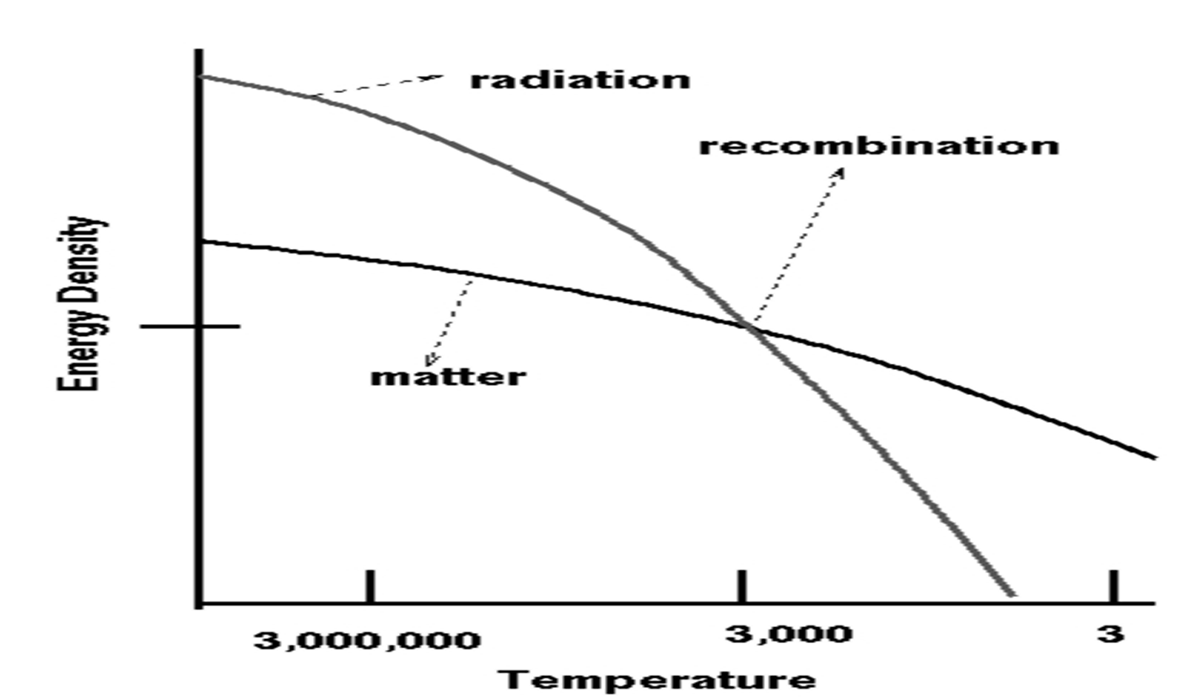
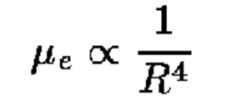
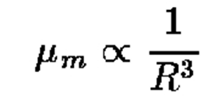

Slide 4
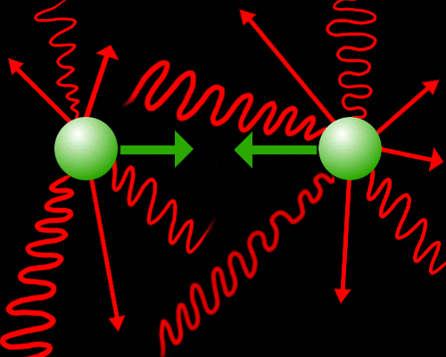
Radiation Dominated Era
One billion photons to one piece of matter means that matter can not CLUMP.
Radiation Pressure is trying to smooth out the distribution of matter → if successful then no galaxy formation can happen.

Slide 5
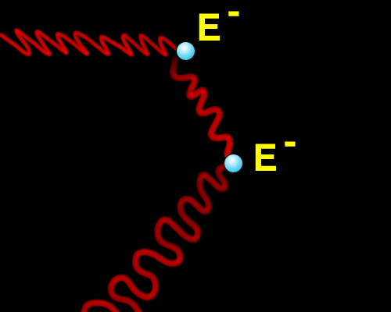
Opacity vs Transparency
During the radiation dominated period, the Universe is ionized.
Free electrons create a scattering network for photons.
This means the photons are COUPLED to the matter → they can not escape from the matter

Slide 6
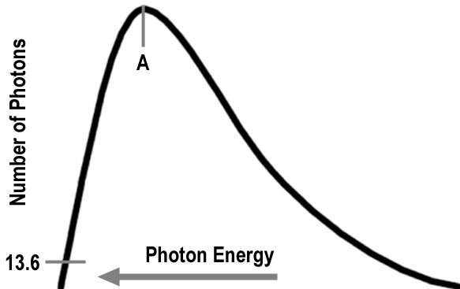
Opaque Kangaroos and Students (roo.swf)
Forms a surface of last scattering from which the MWB signal emerges.
The point marked A is average energy per photon. The point marked 13.6 is the ionization energy of hydrogen. All photons with energies greater than this will ionize hydrogen. Even though only a small percentage of the total number of photons is contained in the region of the curve above 13.6 eV, the large ratio of photons to protons means that the matter can still be ionized at this temperature.
3000 K is the critical temperature for recombination

Slide 7
Surviving Density Enhancements
After recombination has occurred, radiation is no longer an influence on the distribution of matter. Hence, matter will clump around any surviving density enhancements.
Ultimately these density enhancements have to grow to produce the structure we observe today (e.g. galaxies)

Slide 8
Elements Beyond Helium
³He + ⁴He ==> ⁷Be + photon
⁷Be + electron ==> ⁷Li + photon
⁷Li + proton ==> ⁷Li + neutrino (some Li might survive)
⁷Be + proton ==> ⁸Bo + photon
⁸Bo ==> ⁸Be + anti-electron + neutrino
⁸Be ==> ⁴He + ⁴He
END PRODUCT OF ALL THIS IS STILL ⁴He

Slide 9
No Carbon Formation
Element production stops at ⁸Bo (Boron) which has 5 protons and 3 neutrons in its nucleus. Heavier elements cannot be produced because:
Bo is very unstable (1/2 life = 0.8 seconds) and rapidly decays into the even more unstable element ⁸Be (1/2 life ~ 10⁻¹⁷ seconds) which rapidly decays back into two ⁴He nuclei. This short half life makes it impossible for either Boron or Beryllium to capture a ⁴He to make Carbon.
The Universe is cooling too fast for the triple-alpha reaction to occur. Namely
⁴He + ⁴He + ⁴He ==> ¹²C

Slide 10
End of Element Production
We are now done with element production. At this point the Universe consists of photons and the elements H,²H,³He,⁴He,⁷Li as well as one billion photons per hydrogen atom. At this time these photons all have energies sufficient to ionize hydrogen and helium.

