Slide 1
The radio signature of the Earth
Escaping TV and Military Radar would be detected as excess radio “noise” coming from the vicinity of the Sun

Slide 2
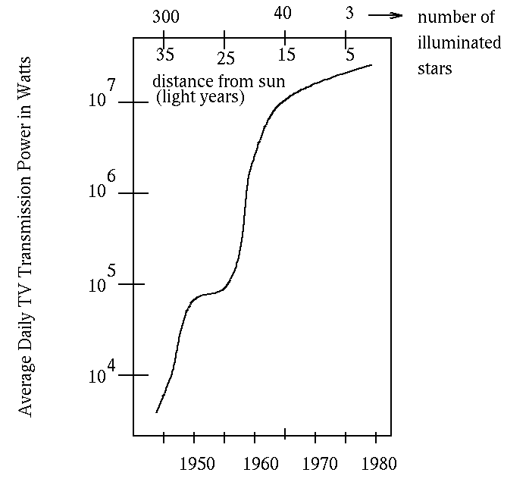
Emission Profile
Leakage slows down in late 1970s as Cable TV starts to replace Broadcasting Towers
Post WW II development
Still, this 1000 fold increase in radio emission over 20 years would be noticed as NON natural

Slide 3
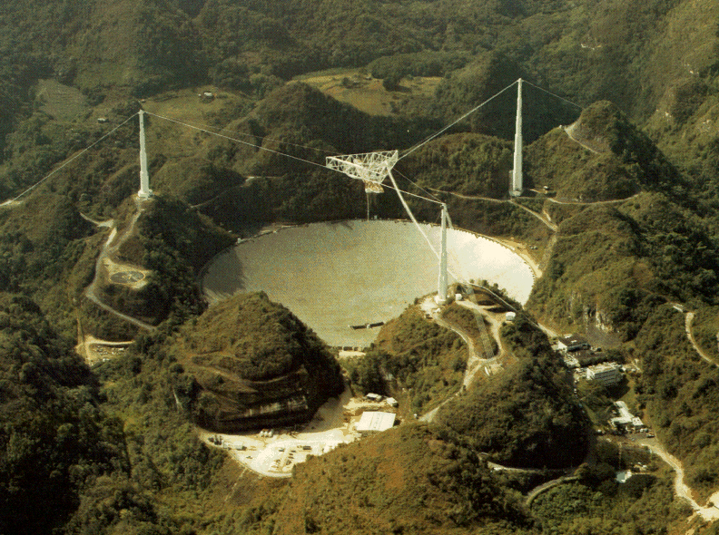
Plus we have one of these

Slide 4
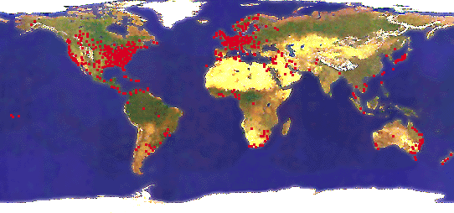
A thought experiment
Distribution of TV transmission (~1980)

Slide 5
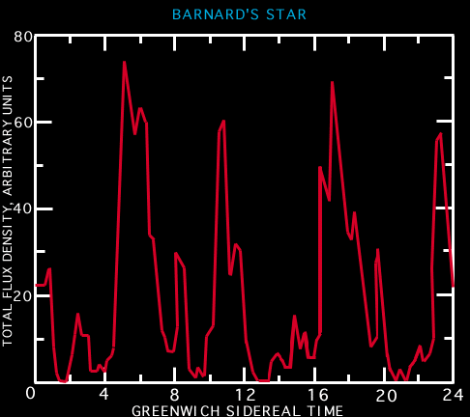
Observed Spectral Signature
Earths Rotation Rate
Distribution and Width of continental Land masses
Differential rate of growth on continents

Slide 6
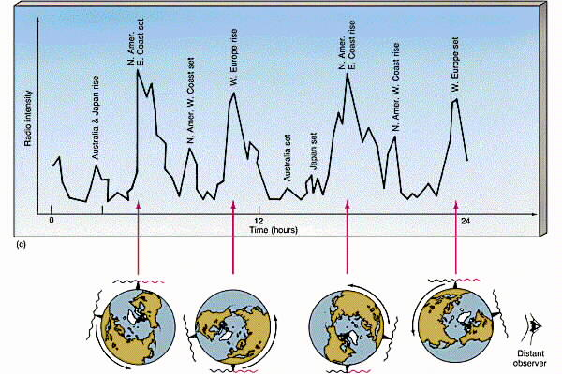

Slide 7
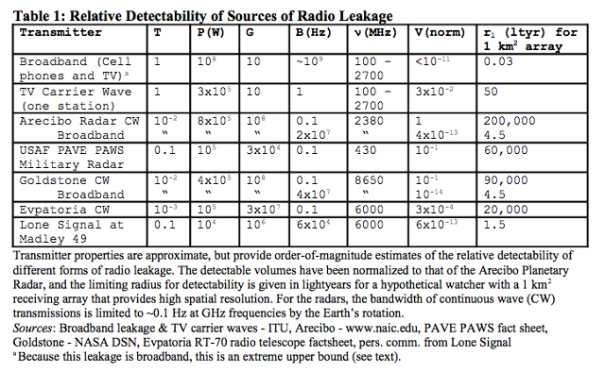
Detectability
Radius of detection

