Slide 1
The problem of Retrograde Motion
Observations of Anomalous Motion
Ignore it? Retrofit it? Revise the model with it?

Slide 2
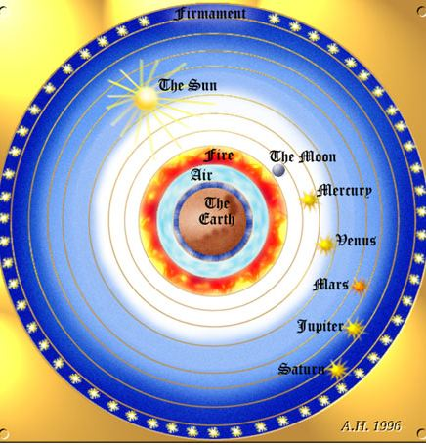
All the Wheels we Move all the Same Way!

Slide 3
The Prime Mover Kick
The initial motion of these spheres was caused by the action of a prime mover which acts on the outermost sphere of the fixed stars; somehow, however, this action is communicated to the other spheres and they move as well, but at different rates, since that is what the observations demand. (planets move through the stars)

Slide 4
The Problem with Mars

Slide 5
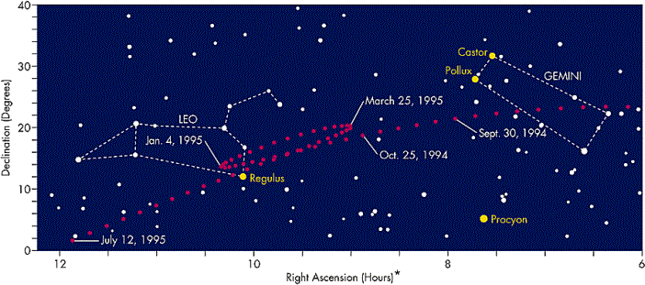
Retrograde Motion
Occurs when Mars is in Opposition
Every 780 days Mars goes through a period of 83 days of retrograde motion – thus the phenomena establishes itself after about a decade as repeatable.

Slide 6
The Ptolemaic Epicycle

Slide 7
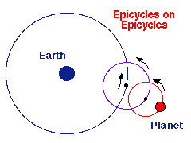
Epicyclical Motion
Needs to be complicated to fully account for the 83 day observed retrograde motion.
All celestial motion is uniform circular motion
Celestial objects are perfect and unchanging (same brightness always)
The Earth is unmoving and is at the center of all motions (all revolves around the Earth)
The Truth

