Slide 1
Quick Review of What we Have Done:
The historical overview is important to understand
The evolution of ideas
That a cultural truth can withstand scientific data quite easily
That cultural bias determines how you look at the world
That throughout history new ideas are not tolerated very well
That science is a process that maps out the unknown, primarily through accidental discovery and an open mind which is receptive to that discovery
The above list makes learning slow, hard and inefficient.

Slide 2
Once upon a Time:
Everything Was Known
Tell the people the Known Truth
Disregard the anomaly as the Truth is already known

Slide 3
Yet Science is NOT a pathway to the truth – in fact, just the opposite – Science is a process that maps out everything which is unknown.
Science is a process that should produce humility not a process that produces arrogance because we think we understand everything
The current management of the planet is very arrogant – this needs to change – this is the big picture of science literacy

Slide 4
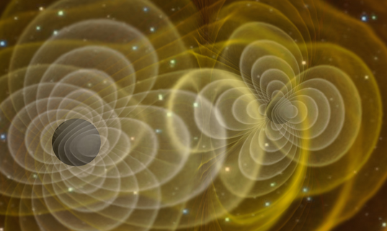
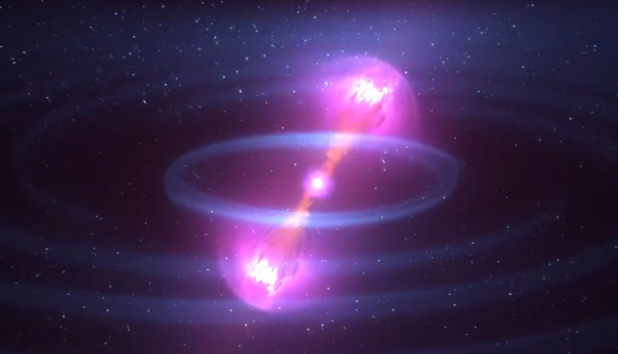
Discovery in Astronomy
Has almost always progressed by building new Detectors (Not Necessarily Large Apertures!) and opening up new wavelengths to survey the Universe.
The Universe reveals most of its interesting physics in wavelengths other than the optical regime
The New Gravitational Wave Sources Discovered in 9/2015 and again today (10/2017) are excellent examples

Slide 5
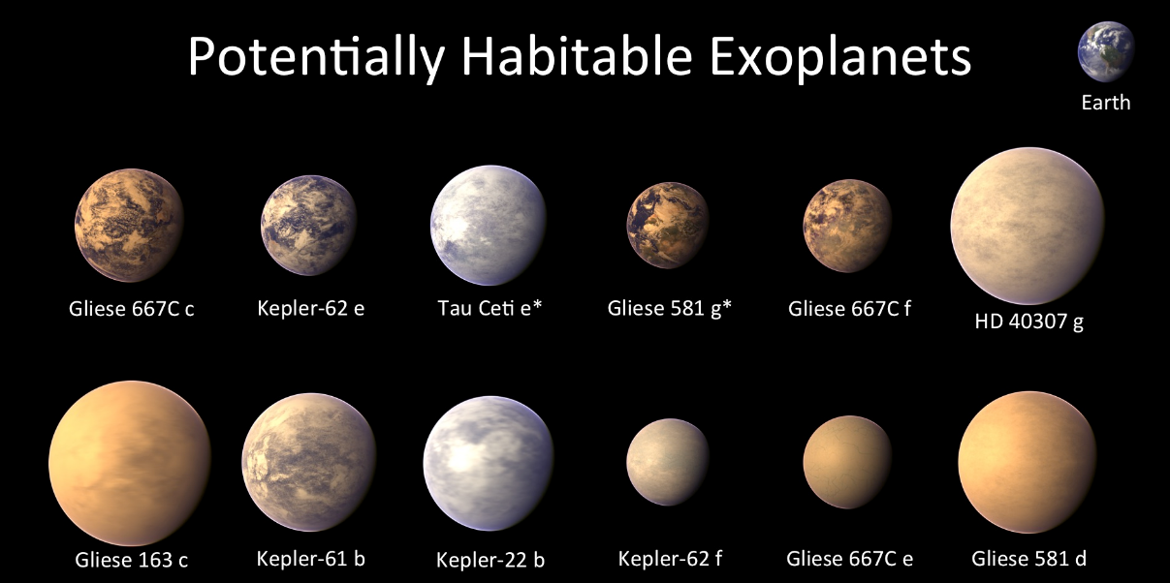
The Story of Life may indeed be Universal (as scientifically expected)

Slide 6
Some Milestones
Cusa espouses the idea of relative motion (1450)
Kepler shows that orbits are not perfect circles (1608)
Galileo discovers phases of Venus and therefore the Earth must go around the sun (1609)
Newton explains Kepler’s laws because there is a Universal gravitational Force (1687)
Herschel shows that double starts obey Kepler’s laws and thus Newtonian gravity is Universal and applies everywhere (1780s)
First stellar parallax measured in 1839 – what is the energy source of stars?

Slide 7
More
By 1859 the orbit of Mercury is shown to be anomalous without explanation
1905; Einstein; Gravity – curve space time; E = mc²
1914 – 1929; Acquisition of galaxy redshifts show that the Universe is expanding uniformly
Now we know that once the Universe was a very hot and dense ball of energy that has been expanding and cooling ever since the expansion began.
Expansions means the amount of surface area in the Universe is increasing

