Slide 1
Relative Motion
An important concept of formalize

Slide 2
Cusa (1440) argument
the earth and the sun are merely possible points of view from which the motions of the celestial bodies may be described. While the Ptolemaic system which represent the planetary motions by combinations of circular motions - could take any point to be fixed, the choice of any particular point required some justification on other than astronomical grounds - there has to be some sensible definition and agreement on what is chosen as fixed.

Slide 3
Galileo’s Argument
If the earth is rotating sufficiently uniformly, a stone dropped from the tower will fall straight to the base, just as a stone dropped from the mast of a uniformly moving ship will fall to the foot of the mast. In both cases the stone's vertical motion will be smoothly composed with its horizontal motion. Hence a sufficiently uniform motion will be indistinguishable from rest.

Slide 4
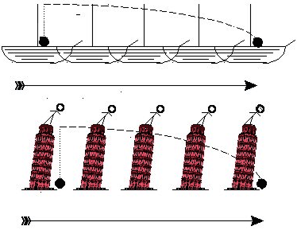
Try this on an Airplane

Slide 5
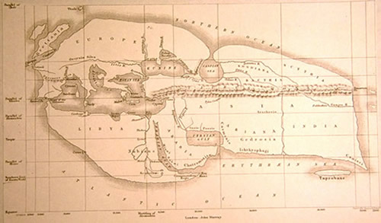
An example coordinate system
Eratosthenes Map of the World - 220 BC

Slide 6
A coordinate system
An agreed upon reference frame
The position and time (difficult) of a physical event can be placed in this coordinate system
All observers, independent of their particular location, can agree on the occurrence of that event
Without a coordinate system, there can be no UNIVERSAL event.

