Slide 1
Star formation

Slide 6
Possible Failure Mode

Slide 7
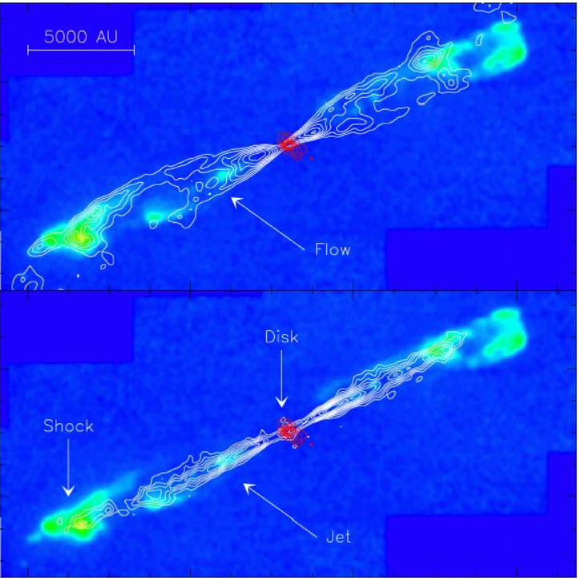

Slide 9
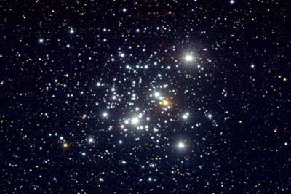
The Overall Process

