Slide 1
Formation of the Solar System

Slide 2
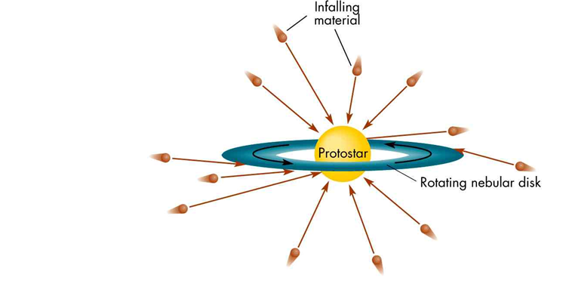
The Sun is radiating energy prior to the formation of the planets

Slide 3
Temperature Gradient!

Slide 4
Accretion Process

Slide 5
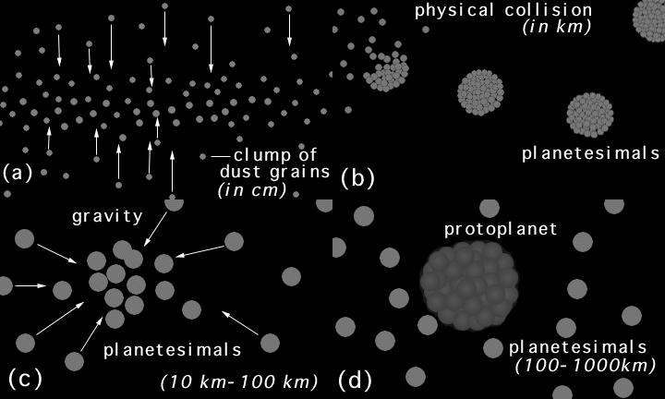

Slide 8
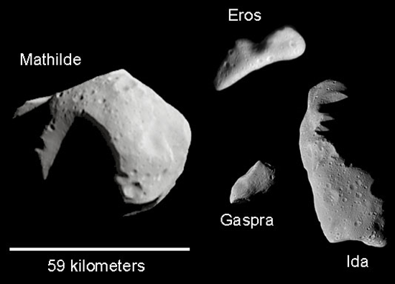
Asteroid Belt – Clear Testimony to the Accretion Process

Slide 9
Jupiter
More likely, asteroids are material that never coalesced into a planet. In fact, if the estimated total mass of all asteroids was gathered into a single object, the object would be less than 1,500 kilometers (932 miles) across -- less than half the diameter of our Moon.
Jupiter high gravity accelerates velocities of the grains and they collide at high velocity and shatter

