Slide 1
The Future of the Internet and its applications

Slide 2
10 Years of Rapid Penetration

Slide 3
Everything Doubles Fast (except for Display Pixels)

Slide 4
The process

Slide 5
Scorecard so far from 2005 report

Slide 6
From the 2006 report

Slide 7
2008 Report
In general, the role of Virtual Reality or Augmented Reality has not been strongly considered. Progress in Haptic interfaces has also been somewhat slow.

Slide 8
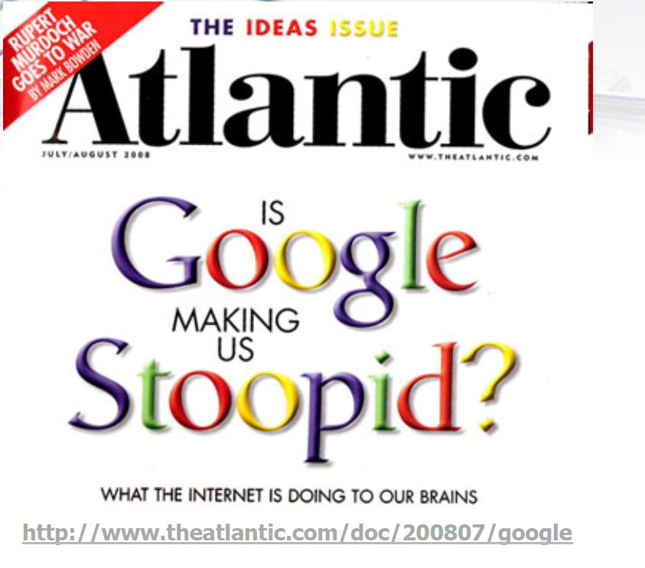
The Experiment in Progress –article by Nicholas Carr

Slide 9
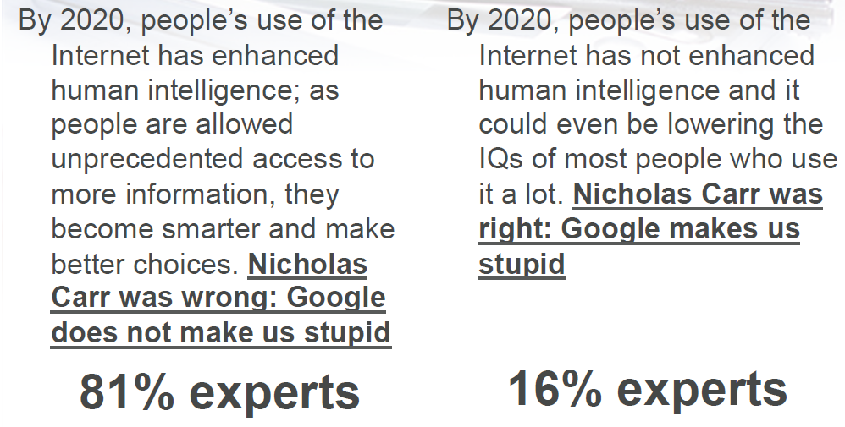
A prediction

Slide 10
Expectations

Slide 11
More

Slide 12
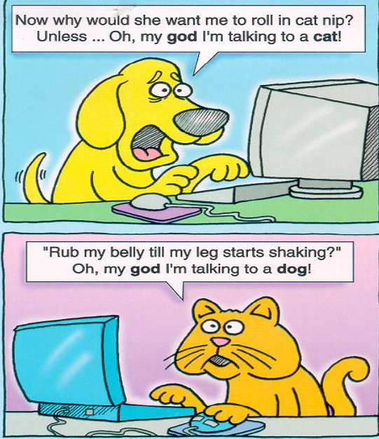
Anonymous Communication
Social Media Taken to an extreme –but we are surely on this path
The rise of social media is as much a challenge to
anonymity as authentication requirements. Reputation
management and “information responsibility” will emerge.

Slide 13
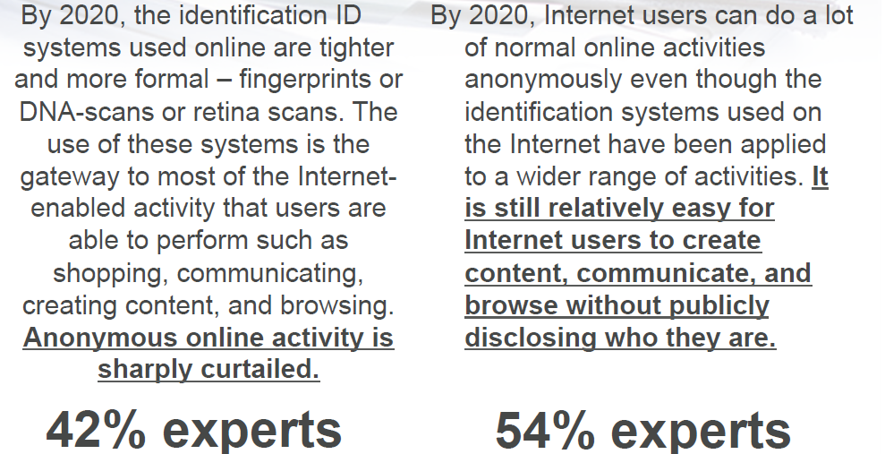
But security requirements may overrule anonymity

Slide 14
The impact of the internet on institutions

Slide 15
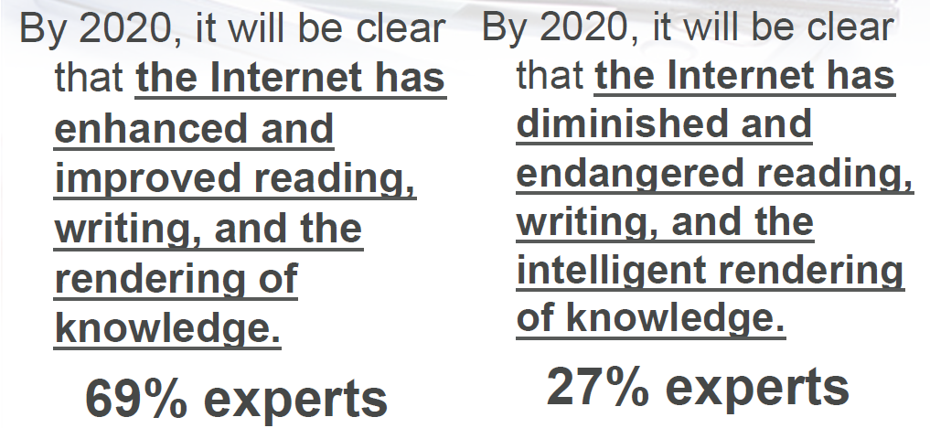
Impact of internet on reading, writing, rendering of knowledge?

Slide 16
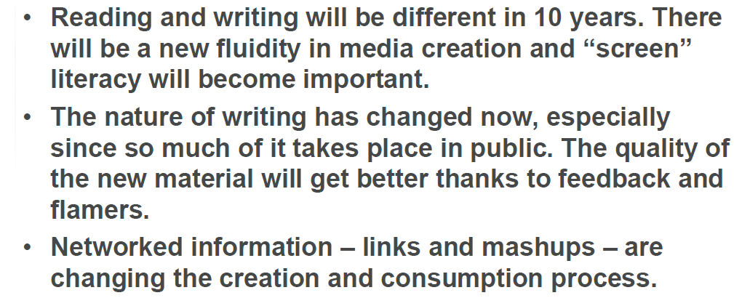
Expectations

Slide 17
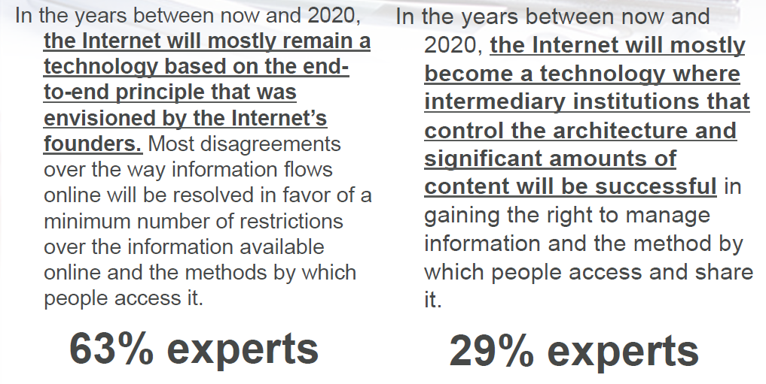
Managed Information?

Slide 18
Arguments for Keeping the Internet “Open”
But, and this is where technology improvements become important

Slide 19
What Millennials Say

Slide 20
But is this narcissism, myopia, or broadminded information sharing?

