Slide 1
The Future Internet: 2
One possible vision among many

Slide 2
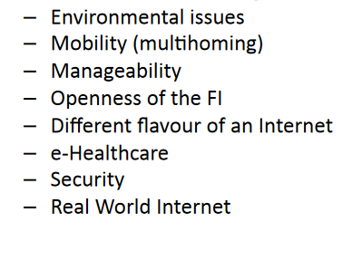
Issues and Challenges
Short term and mid term challenges for the Future Internet (FI) in terms of thematic areas and applications

Slide 3
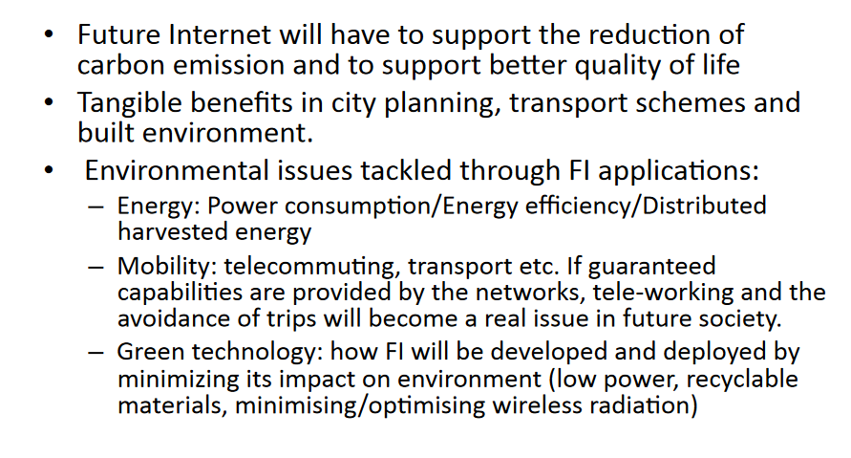
Environmental Issues

Slide 4
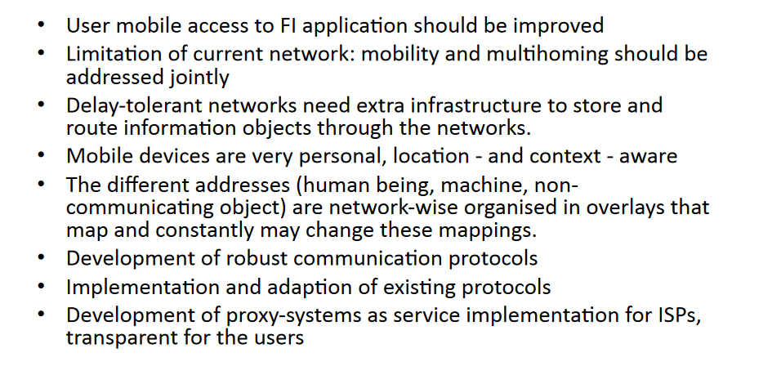
Mobility

Slide 5
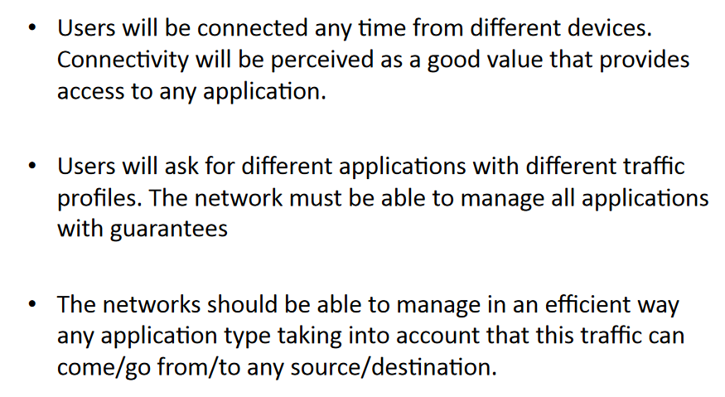
Openness of the FI

Slide 6
Each Internet has different “flavor” for each user – yes the internet becomes 33 kinds of Ice Cream

Slide 7
E-HealthCare

Slide 8
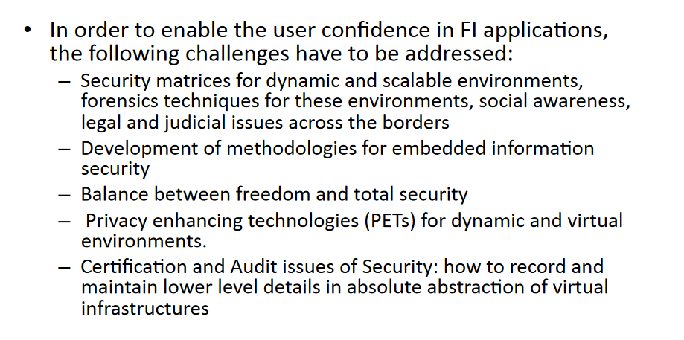
Security

Slide 9
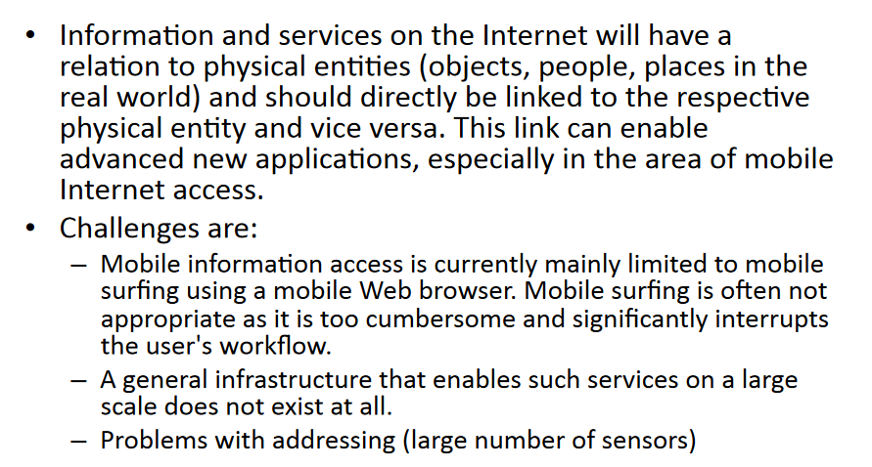
Real World Reality Check

Slide 10
A 2014 Analysis

Slide 12
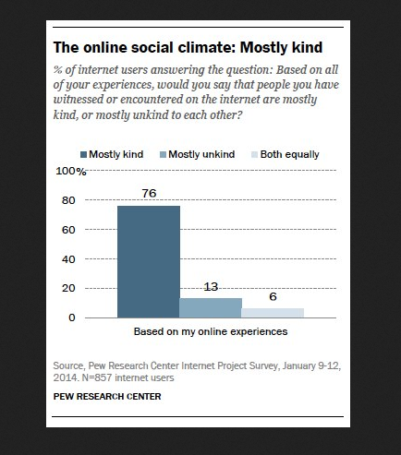

Slide 13
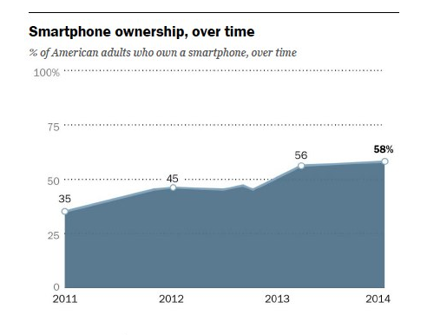
Mobility Explodes to include almost everyone

Slide 14
A real shift in “Screen” preference

Slide 15
Age Matters

Slide 16
More Predictions

Slide 17
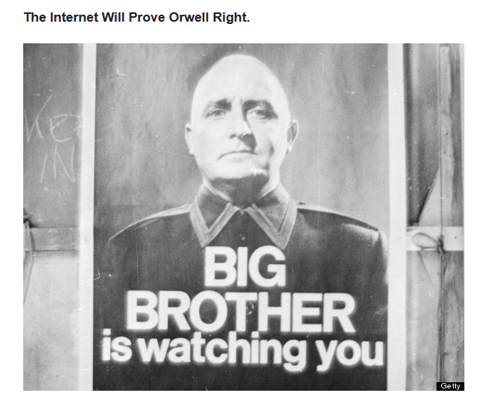
V for Vendetta

Slide 18
50 Billion Devices predicted for 2020

Slide 19
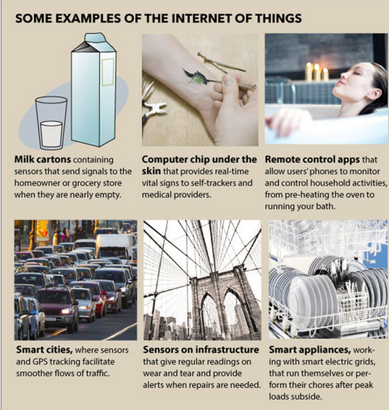

Slide 22
But then again:
1909
1923

