Slide 1
The immediate Post Newton world
England, France, Spain, Netherlands and Portugal are all now competing to gather resources for economic prowess and global markets.
Indigenous culture will not start to vanish or be absorbed. The sovereignty of nations will not be respected.

Slide 2
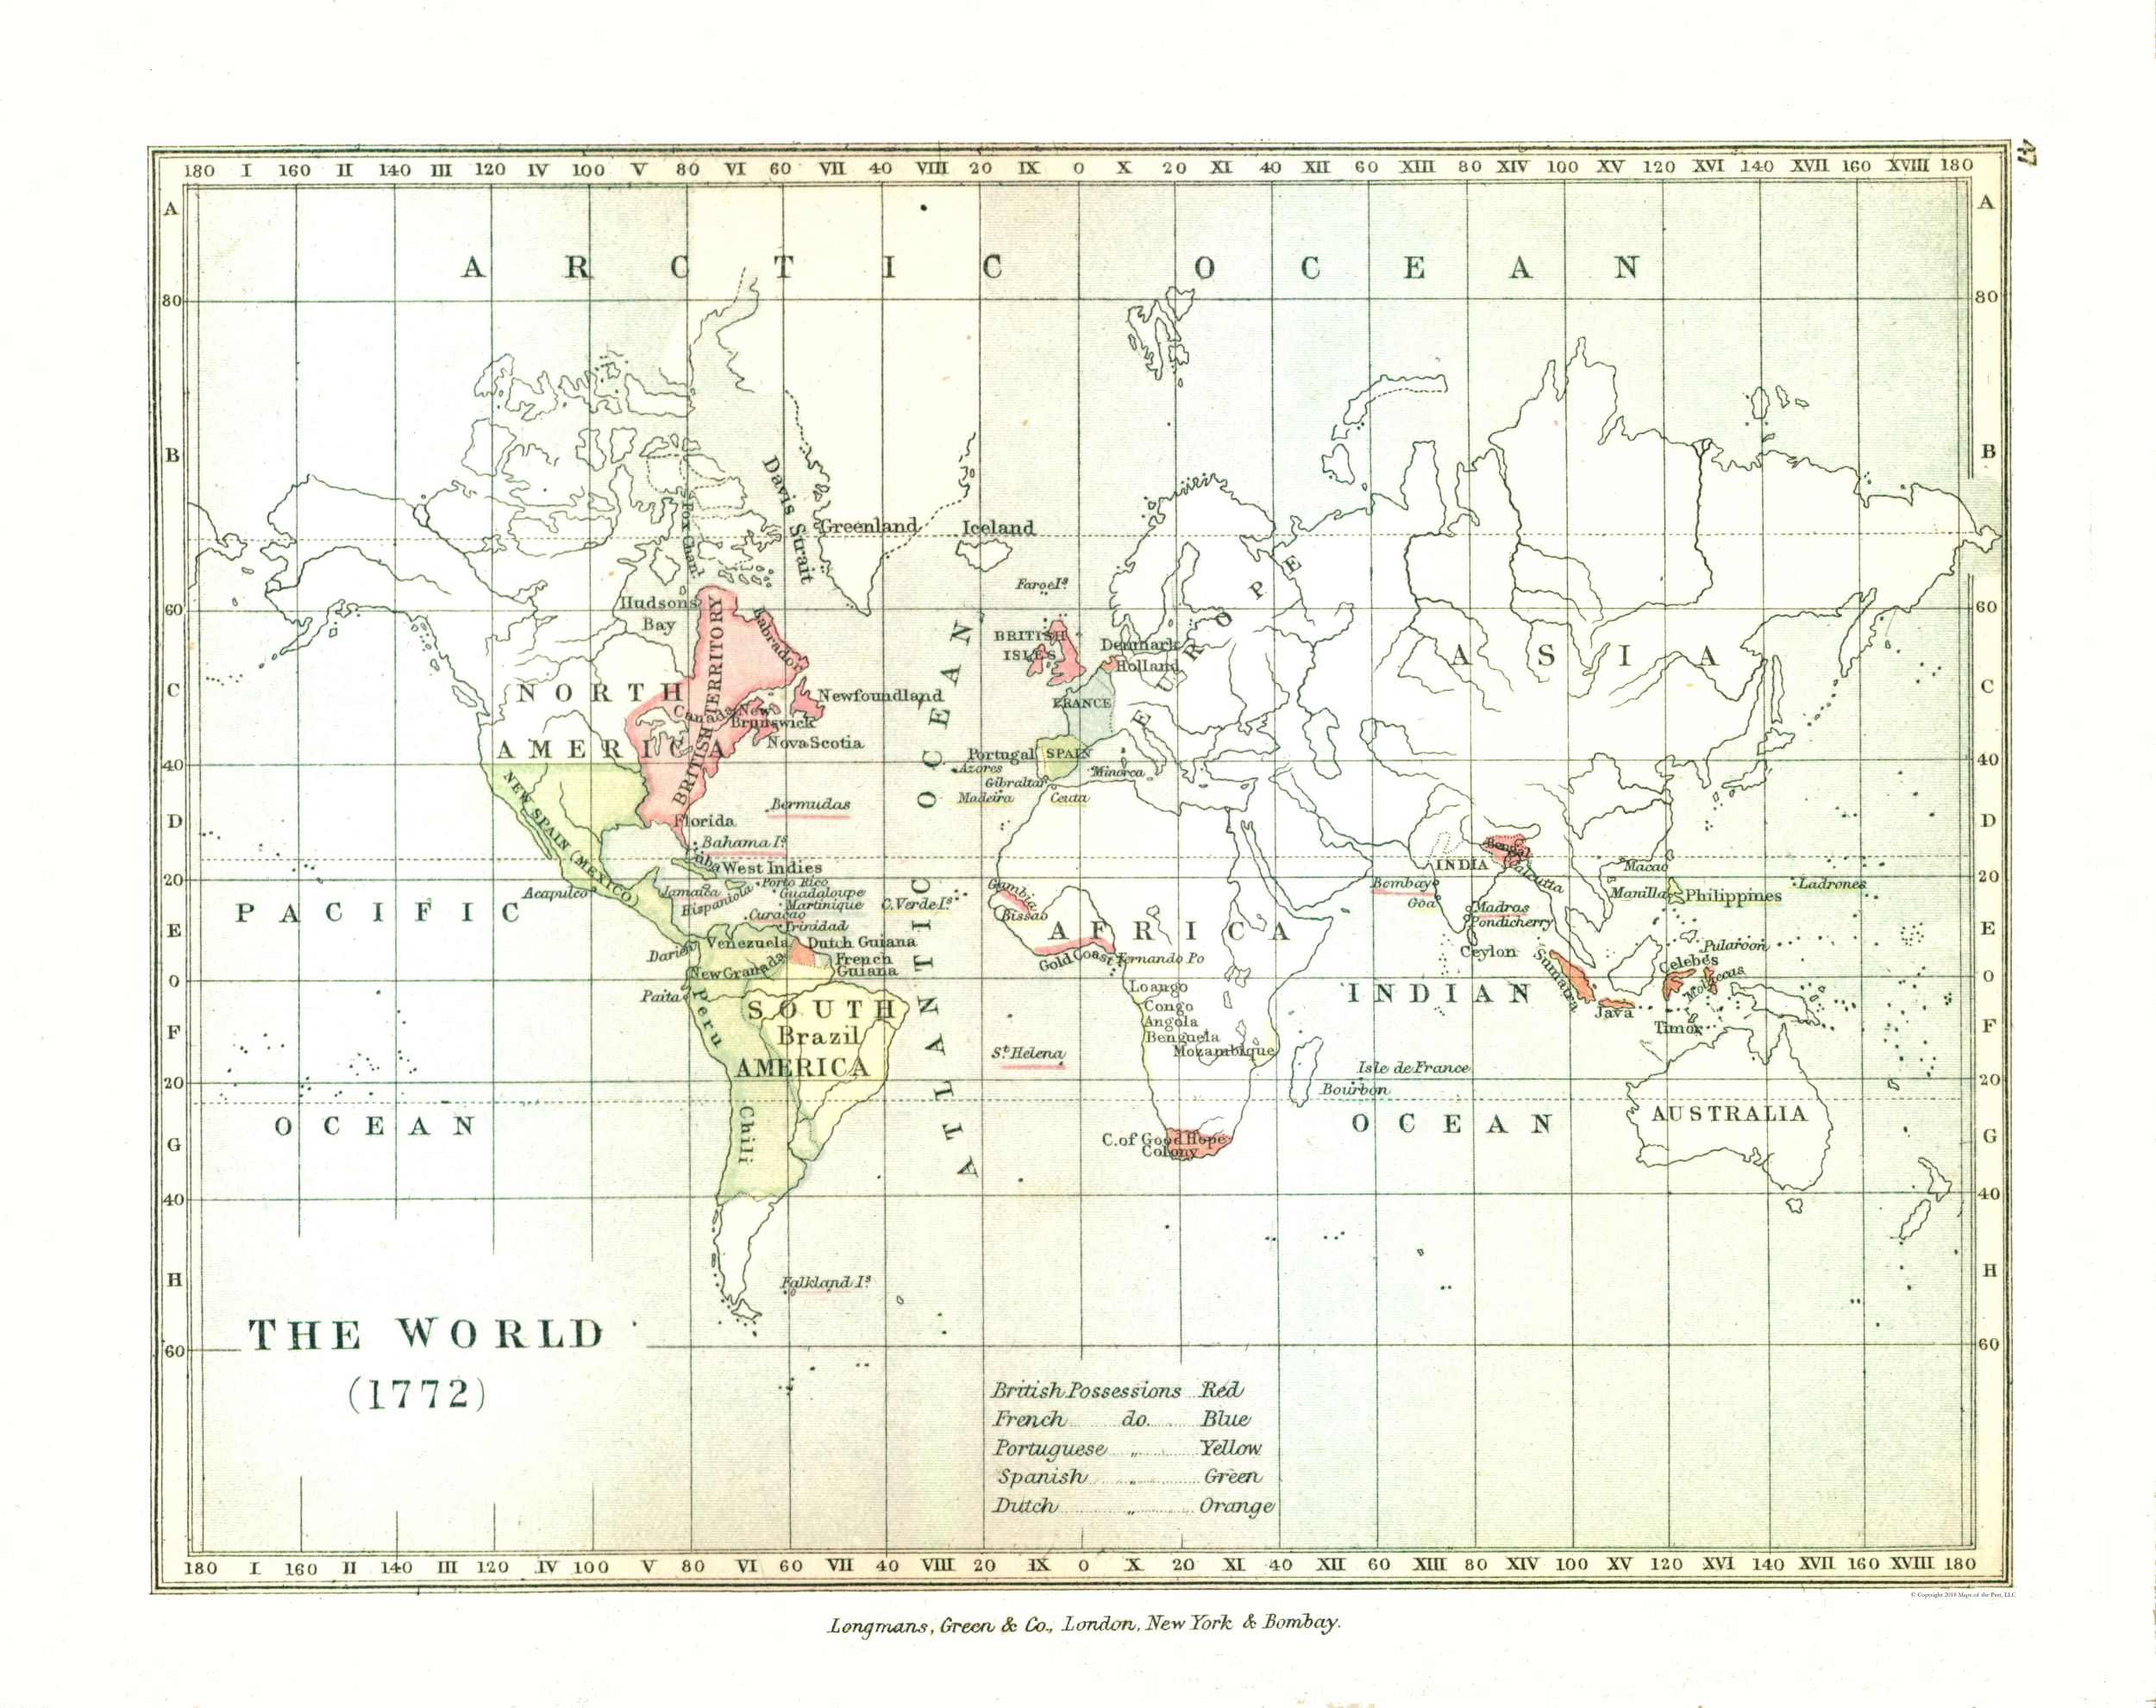

Slide 3
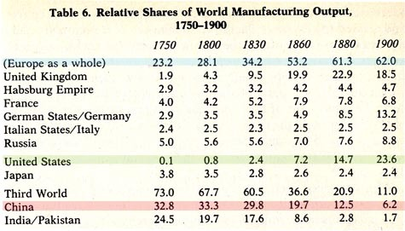
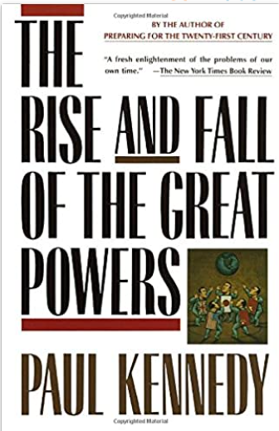
Economics becomes our God

Slide 4
In 1750 all of Europe is 23% of the world; by 1860 this has risen to more than 50%
Britain dominates 1860--1900 over France/Germany
By 1900 the US becomes a late but relevant player
India/Pakistan get absorbed into British Empire because of 1750 dominance.
China collapses from 1750 to 1900.
By 1900, the third world becomes the third world, Europe+America have 85% of the world market output; in 1750 the third world dominated

