Slide 1
Four Views of Nature
Are now possible to have by around 1750 AD – some of these views are ancient

Slide 2
Religious View
God intervenes and can alter the world via punishment and redemption.
Truth is given through divine revelation to those that can interpret the signs.
Nature is God's Medium; Humans can control nature through their actions

Slide 3
Mechanical Philosophy
God only creates the initial conditions and sets the springs.
Truth is acquired via rational and reductionist means so as to discover the workings of the springs.
Nature is lifeless matter in motion, it is a Machine.
Humans are distinct from nature and are entitled to control it because Nature has no soul, only humans do.

Slide 4
Scientific Wordview
Nature is governed by a small set of consistent operating principles that can evolve with time.
Careful observation and experimentation can reveal many of those principles.
God may or may not exist.
Truth is manifest as consistency with observations.
Humans are necessarily a physical part of Nature.

Slide 5
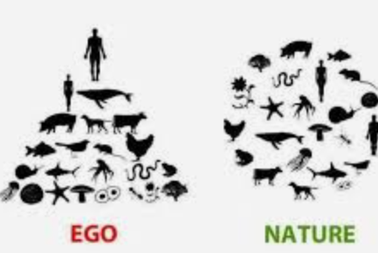
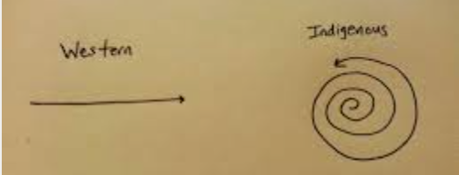
Aboriginal worldview
Nature is sacred.
Humans are directly connected to nature.
Harm to nature is harm to humans.
Truth is unimportant.
Knowledge and Wisdom comes from recognizing that all components of the system are equal and necessary - Nothing in nature is unnecessary.

