Slide 1
Capella’s revision of Ptolemy on Planetary Motion
An obscure figure in history but his work is preserved for Copernicus to “cite”

Slide 2
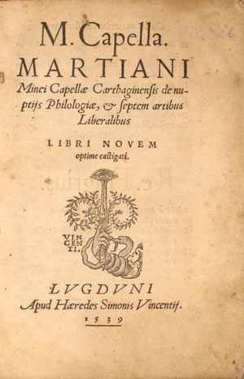
Originally written after the sack of Rome (410 AD) but before the conquest of North Africa by the Vandals in 429.
De nuptiis Philologiae et Mercurii ("On the Marriage of Philology and Mercury“) is an 8 Volume work. The 8th book has the astronomy in it.
The title refers to the allegorical union of the intellectually profitable pursuit (Mercury) of learning by way of the art of letters (Philology).
Reprinted in 1539 through the printing press and thus available to Copernicus

Slide 3
Impact of this work*
241 duplicate manuscripts made during the Middle Ages (prior to printing press)
Translated into Old German in the 11th Century
Much of this work was apparently used as a textbook up until about 1300
* - all of the above form Wikipedia, so …

Slide 4
what do you notice?
Mercury and Venus now orbit directly around the SUN and that SYSTEM orbits around the Earth.

