Slide 1
Quantum Mechanics
Intrinsic Uncertainty
Nothing is Impossible
Merely Improbable

Slide 2
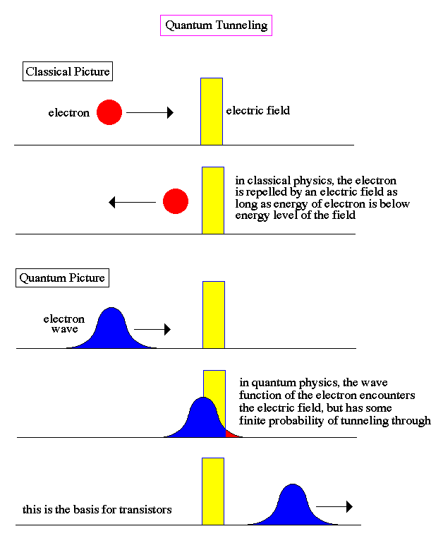
Quantum Tunneling
At any given time, one particle can’t precisely know where another particle is → quantum tunneling results → no energy barriers

Slide 3
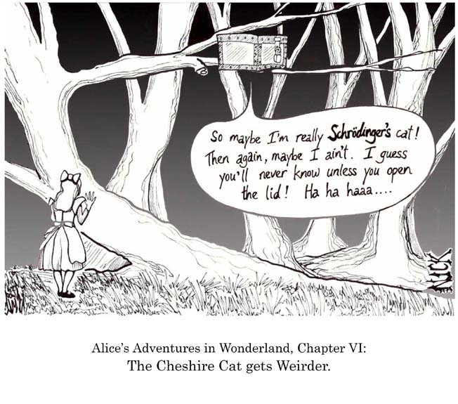
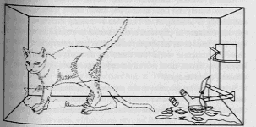
Cats as Quantum Beings

Slide 4
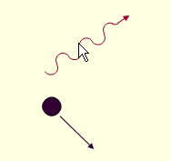
The Principle of Uncertainty: An observer can not simultaneously know the position and momentum (velocity) of any particle to absolute certainty.
Consider the following Case: I want to know the position of a particle but can only detect the particle by bouncing photons off of the particle
As soon as I have detected the spatial position of the particle, momentum has been transferred to the particle and its position has changed
BUT: this uncertainty is an intrinsic limit in nature, not an artifact of measurement.

Slide 5
Big questions
Is the physical world shaped in some sense by our perception of it?
Is there an element of randomness in the universe or are all events predetermined?
Reality doesn't exist until it is measured and this can be profoundly disturbing. Most physicists don't let this bother them and take the utilitarian approach all of the time.
The most profound lesson of quantum mechanics, he remarks, is that physical phenomena are somehow defined by the questions we ask of them.
“This is in some sense a participatory universe” -Wheeler

