Slide 1
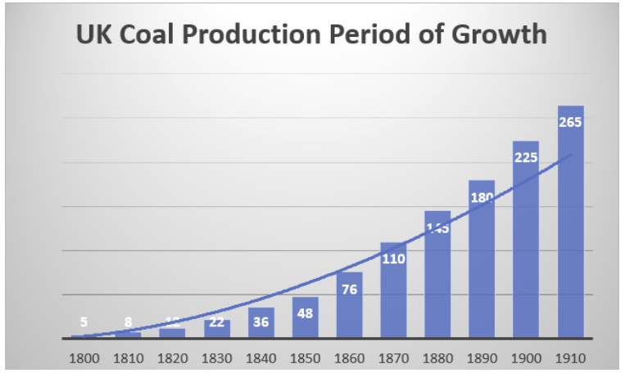
Non linear Growth of Resource use is first seen for Coal in the UK
How? Hire more miners; build more mines; scale the infrastructure to support global demand

Slide 2
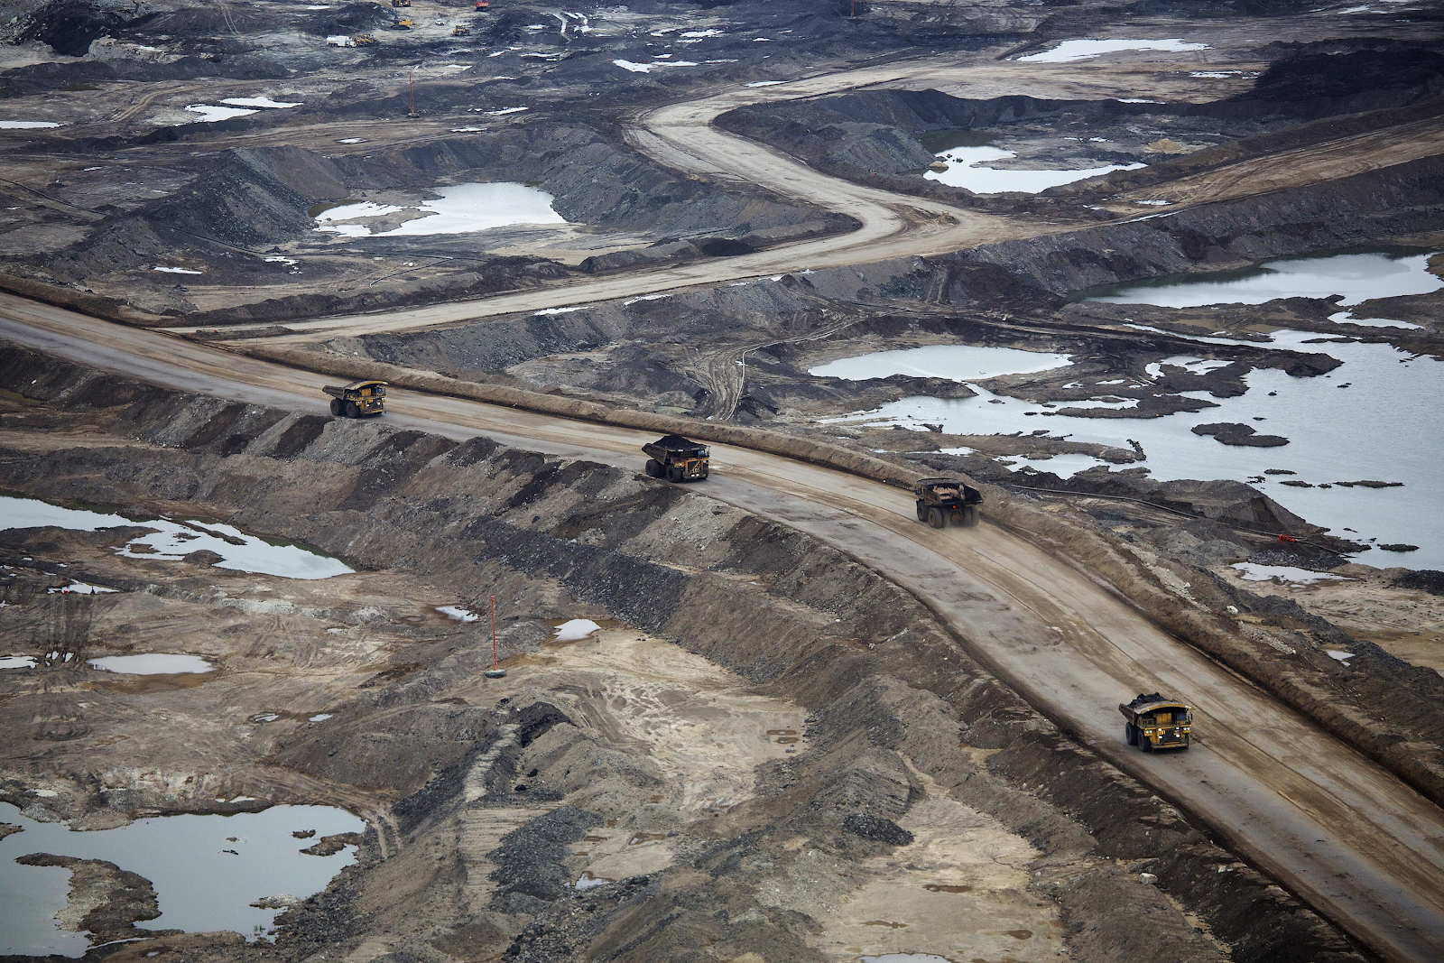
Scaled Infrastructure

Slide 3
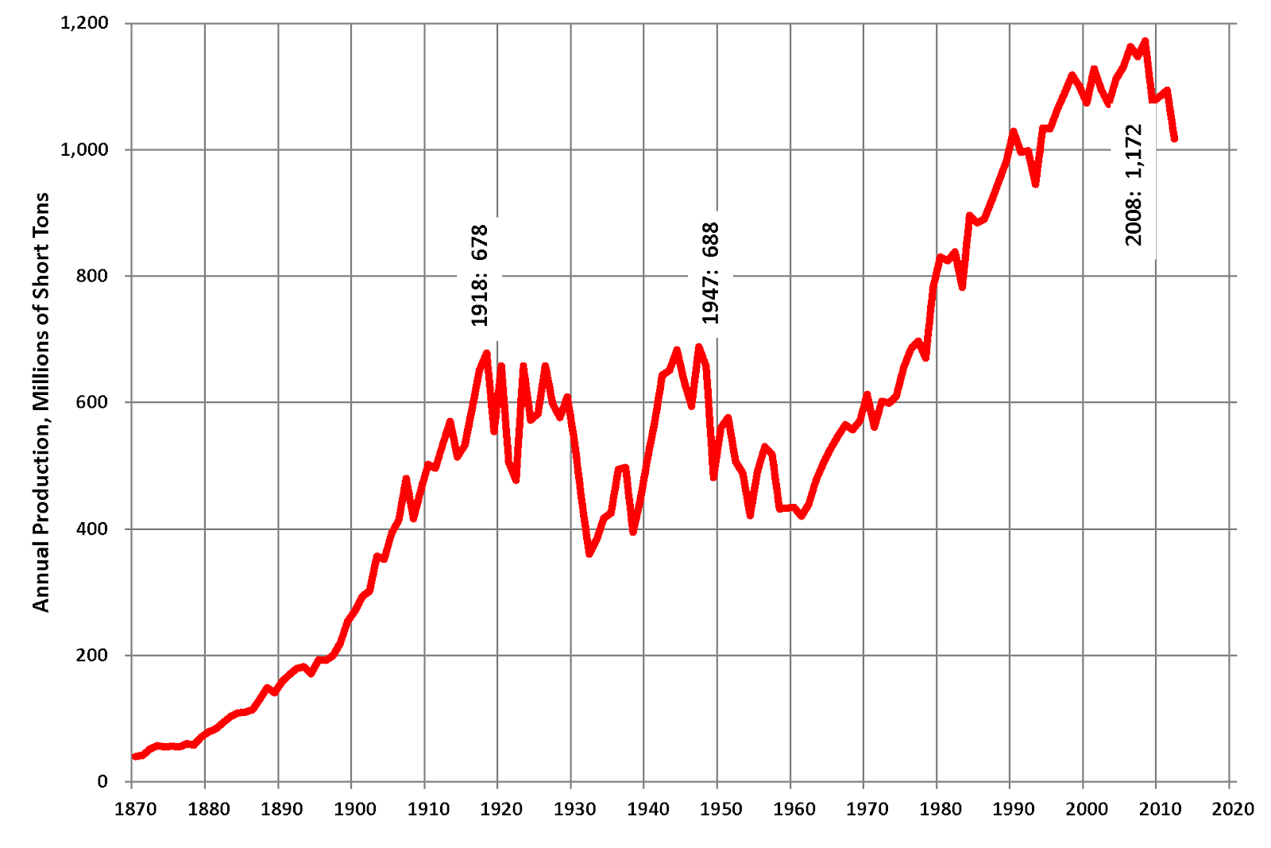
US Coal Consumption
Factor of 10 growth from 1870-1920

Slide 4
Technology Efficiency Increases Consumption

