Slide 1
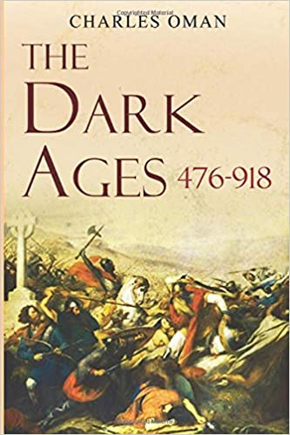
Science in the “Dark Ages”
The world is still largely undiscovered. People in one country or continent know little or nothing about people or ideas elsewhere. Much of the flourishing of scientific thought is taking place in China and what is now known as the Middle East.
The only “common” languages at the time in which ideas are recorded are Greek, Egyptian and Latin

Slide 3
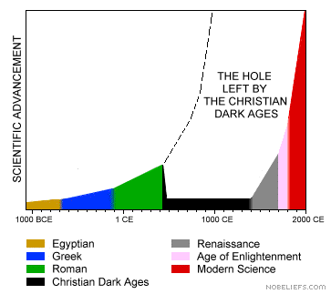
One Possible Waveform of Knowledge Evolution
Oops …
The Barbarian
Hole

Slide 4
Important Conditions
Barbarians, hordes, warrior-kings and empire building is a major aspiration of some cultures.
Translation of ancient latin/greek texts into Arabic becomes very important for the transmission of knowledge

Slide 5
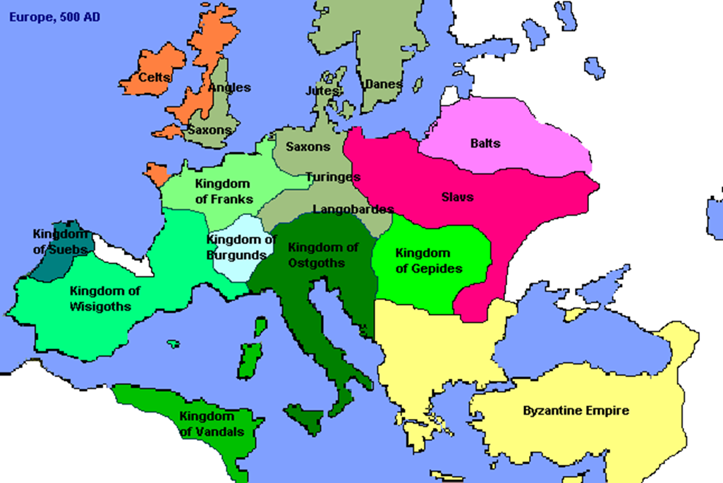
Tribe Empire Building

Slide 6
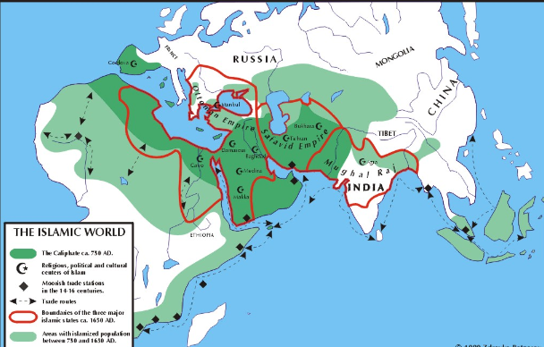

Slide 7
Science and Learning in Medieval Islam
Early Islamic teaching encouraged the pursuit of all knowledge that helped to improve people’s lives – this might be different from pursuing knowledge to understand the Universe
Muslims translated important works from ancient Greece and Egypt into Arabic
Huge libraries were established in big cities like Baghdad, Cairo and Damascus

Slide 8
Priorities
Things that improved the quality of life, like science and technology, were encouraged and welcomed. These included practical things like navigational aids, geographical maps, medical knowledge, ways of measuring and calculating, and tools for agriculture.
The use of paper and books was very important in sharing and promoting knowledge in early Islam. Muslim scholars in institutions such as ‘The House of Wisdom’ in Baghdad translated many important works from Greek, Latin and other languages.

Slide 9
The “Golden Age” of Medieval Islam
Islam spread rapidly with the conquests of the first caliphs, or Muslim rulers
750-1050 AD was a “golden age” for the Islamic world
Arabia was at the crossroads of trade between Asia, Africa and Europe
Trade and conquest (Caliphate Empire) led to cultural exchange and the spread of knowledge
Cities like Baghdad and Alexandria became great centres of scholarship

Slide 10
Mathematics
Islamic theory of numbers was influenced by the Greek mathematician, Pythagoras, and viewed mathematics as having sacred significance symbolizing the inner reality of all things created by God. Number systems were also important for practical things like measurement and money calculations in trade
Algebra first became a separate field of mathematics in Islam. The word “algebra” comes from the Arabic word “al-jabr” which means “restoring balance” in an equation. The development of algebra allowed mathematicians to represent numbers in the form of generalized symbols and allowed for the unknown variable; e.g. 4 +x = 6

Slide 11
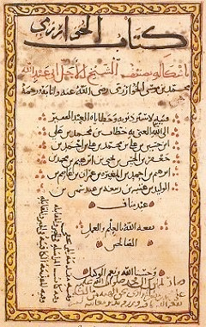
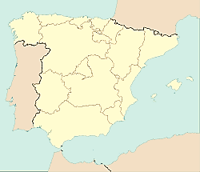
Algebra circa 800
Muslim Spain becomes one of the principal centers of learning and discussion in all of Europe. This activity was mostly located in Cordoba.

Slide 12
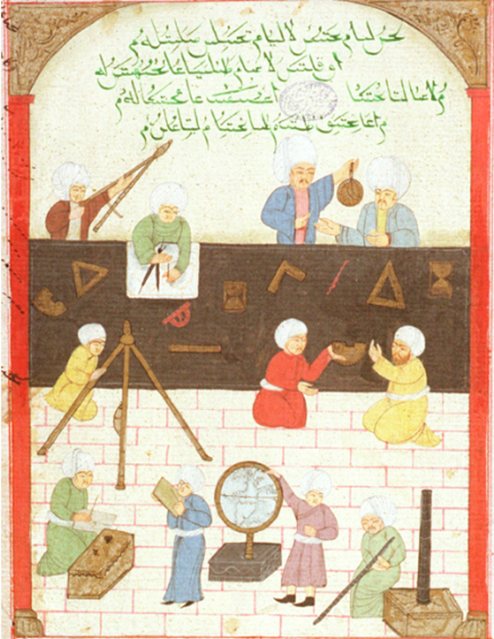
Astronomy
Astronomy was important to Muslims for practical reasons as it contributed to navigation
Observations of the sun and moon were used to determine prayer times and an accurate calendar
Large observatories were established and new instruments such as the astrolabe were developed

Slide 13
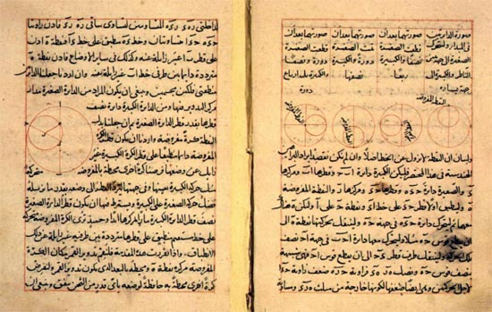
Nasir al-Din al-Tusi 1201-1274
Most significant alteration of Ptolemy model – replaced epicycles with complex nesting of circles
Copernicus knows about this work and seems to have borrowed it for his book
But fails to improve the accuracy of prediction of planetary positions

Slide 14
By the 12th and 13th Centuries, Muslim contributions to knowledge and fundamental texts rivaled those of the Greeks

Slide 15
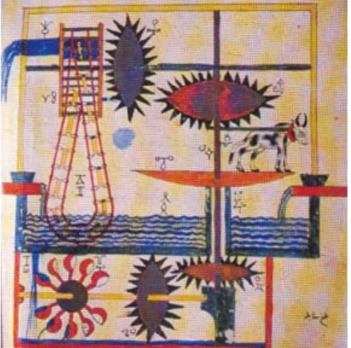
Arab world is arid and so water storage and use was critical; they developed much technology related to aqueducts, water wheels, and irrigation systems like this water raising contraption

