Slide 1
Human’s Relationship with Nature
Perhaps we don’t have one anymore.
Our current relationship seems to be that Nature is a market commodity.
Historically, Humans Order Nature to better understand it and offer explanations of natural phenomena → this facilitates exploitation which will come with the Industrial Revolution.
Do we need to create laws and rules that structure the way nature behaves?
Can we function with a strictly empirical understanding of nature?

Slide 2
Human Understanding Of Nature
How do societies develop a consensus on understanding the natural world?
Are we compelled to teach the consensus (thereby ignoring the anomaly)?
Why are societies reluctant to admit the degrees of uncertainty?
Are we really that afraid of the unknown?

Slide 3
The Nature of Science
Ideas are supported by testable and verifiable data or observation
Science is a process or way to investigate nature.
Scientific knowledge doesn’t mean possessing the truth.
Science seeks consistency between observations and models

Slide 4
Science as a way of knowing
Science is a method of asking questions about the way that Nature behaves
There are Universal conditions that govern the way that Nature behaves but we may never be able to know that.
Nature is understandable and predictable (if we know enough)
Observations and experiments are reproducible or they are invalid
Cause and effect relationships exist in nature
The world is neither arbitrary or magic but it can be mysterious

Slide 5
Things We Don’t Talk About
What is the connection between Science and Religion
Faith is belief without evidence → Is that more important than actual evidence?
Who defines the Truth?
Educated people that insist they know
Government institutions?
Religious Institutions?
Consensus among the masses?

Slide 6
Quantitative Aspect of Science
Ordinary language is unable to capture scale of precision necessary for scientific discourse
Numbers and math are essential to discussion and understanding.
Consistent Units of measurement are required for knowledge transmission and verification of experiments/observations

Slide 7
The Inevitable Conflict
Science teaches us that we are in a partnership with nature.
Human institutions often charge than nature is subservient to humans
Our future is determined by which of these two philosophies is practiced – you can not do both

Slide 8
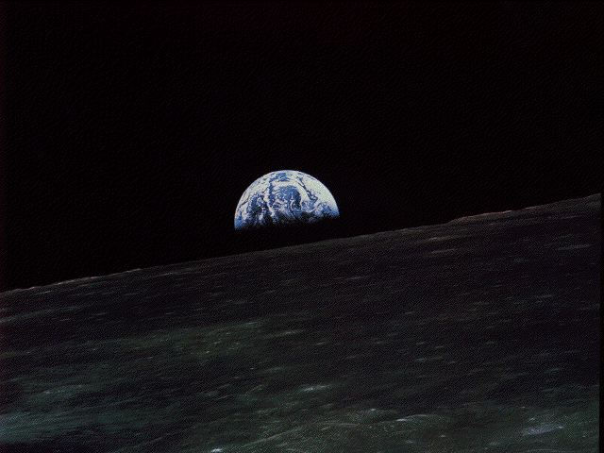
In our coming time of dwindling natural resources we must exercise wisdom to realize a future.
Science can be a pathway to wisdom.
Are we humble enough to follow it?

