Slide 1

The Enlightenment
“Age of Reason”

Slide 2
Roots of the Enlightenment
The Enlightenment grew out of the Renaissance, Reformation, and the Scientific Revolution (if this happened).
What’s new?: Enlightenment philosophers wanted to use the ideas and reason of the Science for problems in government and society.

Slide 3
Enlightenment and Government
Enlightenment thinkers criticized accepted ideas about government. Most questioned the medieval belief in the divine right of kings
Many Enlightenment thinkers stressed individual rights that governments must respect. Personal property is the primary manifestation of freedom at this time.
Enlightenment thinkers also felt that people should have a say in their government (emergence of democracy)

Slide 4
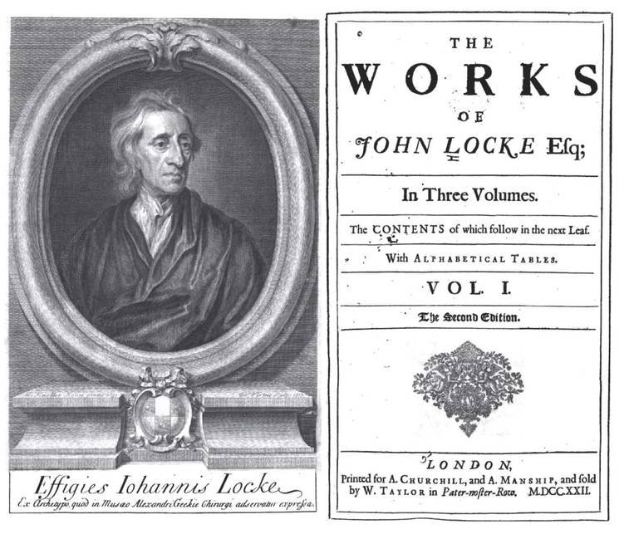
John Locke: Social Contract and Natural Rights
He wrote Two Treatises of Government in 1690.
He believed the purpose of government was to protect people’s natural rights. He said government should protect,” his life, liberty, and property—against the injuries and attempts of other men.”
His idea: The true basis of government was a social contract between people and their government. If the government didn’t respect people’s rights, it could be overthrown.

Slide 5
John Locke: Social Contract and Natural Rights
In exchange protection, people gave government the power to rule on their behalf. We call this idea the “consent of the governed.”
Lasting Impact: the idea that government could be overthrown if it failed to respect people’s rights had wide influence and was ultimately echoed in the American Declaration of Independence and the French Revolution
Example is the 1689 English Bill of Rights which limits the power of a monarch

Slide 6
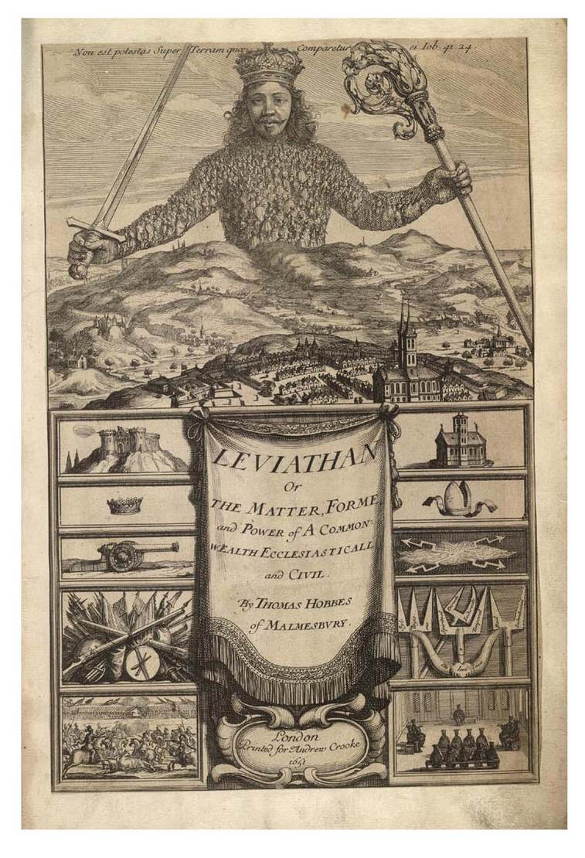
Thomas Hobbes View
Hobbes believed people are naturally selfish, cruel, and greedy.
In 1651, he published a book called Leviathan. In this book, he wrote that people are driven by a restless desire for power.
Without laws, people would always be in conflict.
In such a “state of nature”, life would be “nasty, brutish, and short.”
His idea: Governments were created to protect people from their own selfishness.

Slide 7
Hobbes continued….
Later Enlightenment thinkers might not have agreed with Hobbes…
But, he was important because he was one of the first thinkers to apply reason to the problem of politics
His ideas may sound harsh, but it was based on his own observations of human nature and reasoning.

Slide 8
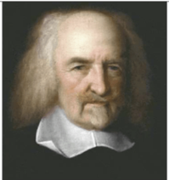
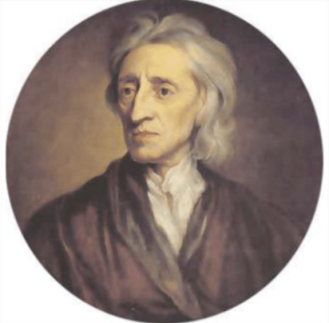
Believed that people were wicked, selfish, and cruel and would act on behalf of their best interests.
People could not be trusted to govern themselves
The purpose of the government was to keep law and order.
Believed that people were by nature good and that they could learn from their experiences.
People could be trusted to govern themselves; if provided with the right information would make good decisions.
The purpose of the government is to protect individual liberties and rights.

Slide 9
Montesquieu: Separation of Powers
Like Locke, Montesquieu was concerned with how to protect liberty from a bad government.
He Wrote The Spirit of Laws in 1748. In this book, he described how governments should be organized.
His idea: The separation of powers: By dividing different powers among more than one branch of government, no one group in the government could grow too powerful.
Lasting Impact: He greatly influenced the men who wrote the U.S. Constitution. We now have a separate legislative (Congress), judicial (courts), and executive (President) branch

