Slide 1
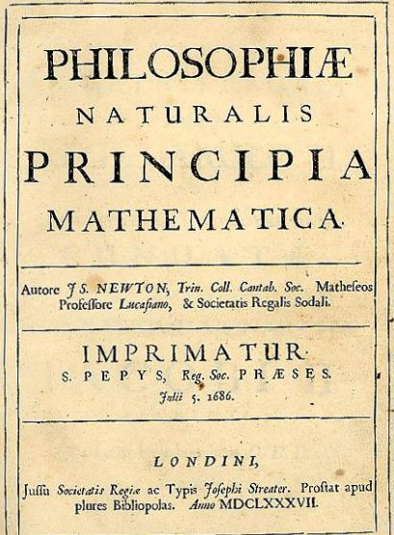

Slide 2
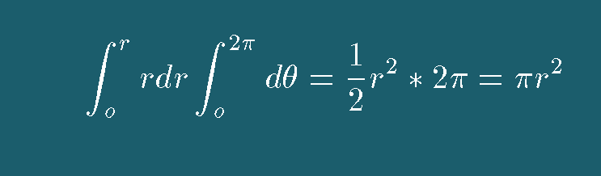
Calculus as a Language
The genius of Newton was his ability to use calculus and coordinate transformations to reveal and explain the underlying physics.
For example, how do I compute the area of a circle.
  A circle is enclosed by a surface when a line of radius r that has been rotated through 360 (2π) degrees.
  From the language of Calculus this means the following:
Language should evolve so that communication becomes more efficient; i.e. the graphic shows how to derive the area of a circle using the least amount of characters. It is only meaningful if you understand the language

Slide 3
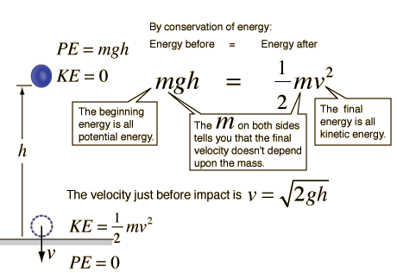

Newtonian Physics
Force causes momentum (mv) to change with time
Force operationalizes as Mass * Acceleration (F=ma); A = F/m
Mass is that which resists force (this is called inertia). M = F/a
Energy is associated with movement and position in a force field; E=F*r
Energy is conserved: m*g*h = 1/2mv²
  impact velocity from free fall
  Is independent of mass
Galileo
r =V²/2a ; E =FR = F V²/2a
F = ma ; (ma) V²/2a =1/2mV²

Slide 4
Newton’s 4 rules of scientific reasoning
We are to admit no more causes of natural things such as are both true and sufficient to explain their appearances
The same natural effects must be assigned to the same causes
Qualities of bodies are to be esteemed as universal
Propositions deduced from observation of phenomena should be viewed as accurate until other phenomena contradict them.
What does the last rule say about the nature of Science?
Does culture understand its implication?

Slide 5
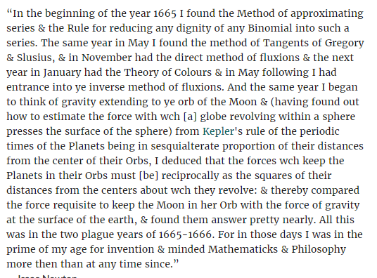
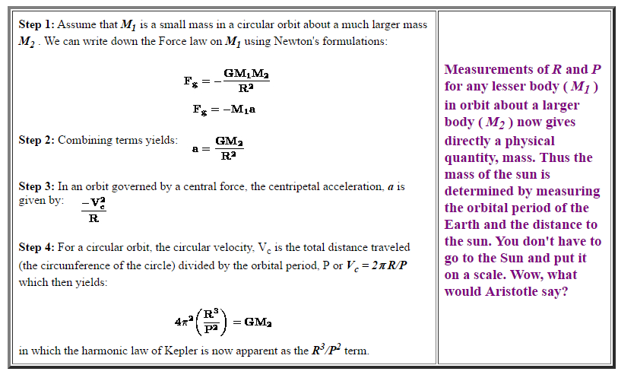
How Newton knows he is correct

Slide 6
How Newton knows he is correct

Slide 7


ALL objects attract each other with a force of gravitational attraction that depends on their masses and separations. ITS A ONE WAY FORCE.
Upon this realization, Newton's first thought was this:
Well fine, if gravity is an attractive force, then how come the Universe is still here? (resolution of this?)
And his second thought was this:
Okay then, how come the moon doesn't come crashing into the earth, or the earth into the sun.

Slide 8
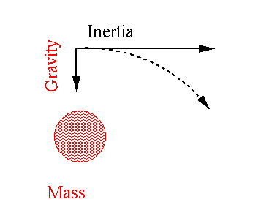
Stable Orbits
An orbit is the balance between inertial (Newton's First Law) and gravitational forces (Newton's second law). That is, the earth is continually falling toward the sun, but inertia also wants the earth to keep moving in a straight line. When these two forces are in balance a stable orbit results:

Slide 9
Newton’s view of science
I do not know what I may appear to the world; but to myself I seem to have been only like a boy playing on the seashore, and diverting myself in now and then finding a smoother pebble or a prettier shell than ordinary, whilst the great ocean of truth lay all undiscovered before me.
No great discovery was ever made without a bold guess
To explain all nature is too difficult a task for any one man or even for any one age. `Tis much better to do a little with certainty, and leave the rest for others that come after you, than to explain all things.
Truth is ever to be found in the simplicity, and not in the multiplicity and confusion of things.

Slide 10
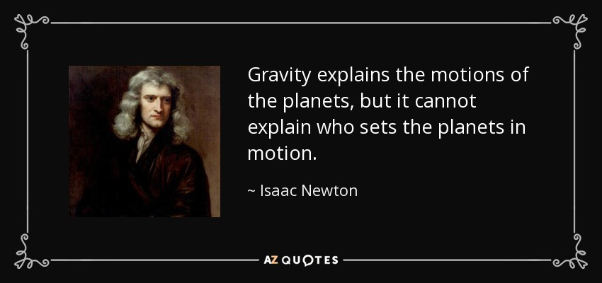
But Newton is confused by gravity
I have not been able to discover the cause of those properties of gravity from phenomena, and I frame no hypotheses; for whatever is not deduced from the phenomena is to be called a hypothesis, and hypotheses, whether metaphysical or physical, whether of occult qualities or mechanical, have no place in experimental philosophy.

Slide 11
Letter to his friend Robert Bentley
It is inconceivable, that inanimate brute matter should, without the mediation of something else, which is not material, operate upon and affect other matter without mutual contact … That gravity should be innate, inherent, and essential to matter, so that one body may act upon another at a distance, through a vacuum, without the mediation of anything else, by and through which their action and force may be conveyed from one to another, is to me so great an absurdity, that I believe no man who has in philosophical matters a competent faculty of thinking, can ever fall into it. Gravity must be caused by an agent, acting constantly according to certain laws; but whether this agent be material or immaterial, I have left to the consideration of my readers.
You sometimes speak of gravity as essential and inherent to matter. Pray do not ascribe that notion to me, for the cause of gravity is what I do not pretend to know, and therefore would take more time to consider of it.

