Slide 1
Order, Logic, Determinism, rationalism Reductionism –elements of Science?
No room for randomness

Slide 2
Rationalism
The backbone of Early Greek Science
Scientific Understanding = a consistent and logical statement.
Oriented towards discovery of patterns, a system, and ordered structure.
Science believes (but can’t prove) that all observable events are rationally explained
A framework of “laws of Nature” is required: e.g. Air, Earth, Fire and Water

Slide 3
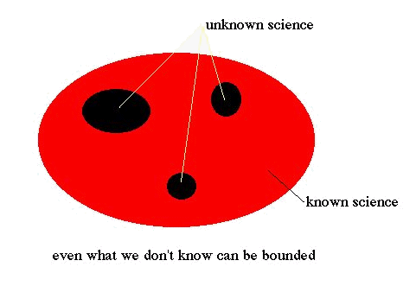
The KNOWN vs UNKNOWN
In the rational view, science progresses to reach this state of converting the unknown to the known
But perhaps in real life the proportion of areas between red and black are reversed and scientific evolution means the unknown increases

Slide 4
A Way to think about science
Science is also a dialogue between humans and Nature. Science is far from a perfect instrument of knowledge, but it provides something that other philosophies fail to, concrete results.
But these “concrete results” are definitive only within an arbitrary framework; 2+2=4 but there is nothing universal about this; this is just the way that humans have defined something (i.e. the framework)
Science is basically an objective process that asks questions about the world. Providing answers to those questions is not necessarily the purpose of science.

Slide 5
Scientific Method “Steps”
The scientific method or better stated, the scientific process of inquiry, has four principle steps:
observation/experimentation
deduction
hypothesis
Falsification
Note that there is an emphasis on falsification, not verification. If a theory passes any test then our confidence in the theory is reinforced, but it is never proven correct in a universal sense. Thus, a powerful hypothesis is one that is highly vulnerable to falsification and that can be tested in many ways. The goal of the scientific method is the construction of models and theories, all with the final goal of understanding.
But we should not assume have the right to understand. This is a human requirement that often holds back progress.

Slide 6
Reductionism
Is the belief that any complex set of phenomena can be defined or explained in terms of a relatively few simple or primitive ones. → requires that simplicity actually exists
To a reductionist, once a set of equations or mathematical relations has been found to describe a system, then the behavior of the system is considered to be explained.
Reductionism often states that between competing ideas, the simplest theory that fits the facts is the one that should be selected → This is a strong bias; maybe the world is not simple.

Slide 7
Determinism
The philosophy that everything has a cause, and that a particular cause leads to a unique effect. Another way of stating this is that for everything that happens there are conditions such that, given them, nothing else could happen.
But perhaps if the chain of dominoes is sufficiently long some random domino failure will change the pre-determined outcome. How would we know?

Slide 8
The World of Descartes
In determinism there is no room for chance, surprise and creativity. Everything is as it has to be, which gives rise to the concept of a clockwork universe and that everything is understandable

