Slide 1
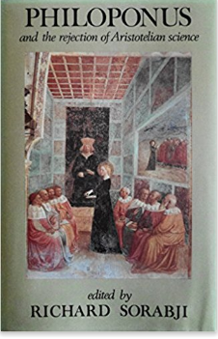
Philoponus
Commentary on Physics: 517 AD
Develops the Theory of Impetus –a
Precursor to the idea of momentum

Slide 2
Aristotle: Falling Objects
If initial weight determines the speed of fall, then when two different weights are dropped from a high place the heavier will fall faster and the lighter slower, in proportion to the two weights. A 10 lb. weight would reach Earth by the time a 1 lb. weight had fallen one-tenth as far
While this is a logical argument, again based on a false premise, it can be easily tested experimentally and utterly dismissed.

Slide 3
Projectile Motion
In Aristotle's view, objects moved parallel to the Earth's surface until it was time (i.e. it was their destiny) to fall back to the earth – so Aristotle’s Cannon would work as illustrated below
When a stone is thrown, an impetus is given to it to disturb it from its natural condition. Gradually the stone “forgets” this impetus and falls back to its natural place, the Earth

Slide 4
Logic vs. Experiment
Aristotle says: For any two portions of fire, small or great, will exhibit the same ratio of solid to void, but the upward movement of the greater is quicker than that of the less, just as the downward movement of a mass of gold or lead, or of any other body endowed with weight, is quicker in proportion to its size.
Actual measurements do not confirm this at all and Philoponus made many such measurements

Slide 5
Falling Bodies
Philoponus experimentally shows that speed is not proportional to the weight of a moving body. So all weights when dropped from same height reach the ground in the same amount of time.
Overall, Philoponus modified many of the ideas about the natural world of Aristotle as well as outright rejecting others.

Slide 6
Philoponus: Critical Questions
Why does an arrow continue to fly after it has left the bow-string?
Aristotle:
whenever there is motion there must be something which imparts the motion, (impulse)
mover and moved must be in contact (big error)
Therefore the air displaced in front of the projectile rushes round it and pushes from behind, thus propelling the projectile along.

Slide 7
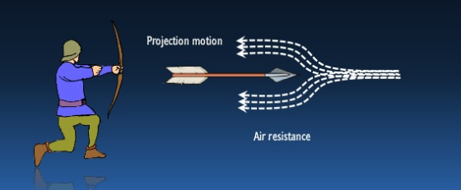
Aristotle fundamentally incorrect here
Philoponus opposed the idea that the medium (air) can propel a projectile, and in fact realizes, the medium opposed the impulse.

Slide 8
Philoponus’ Solution
Incorporeal motive energeia: arrow moves due to a “kinetic force” imparted which then exhausts itself in the course of movement (almost correct)
More importantly, Philoponus now sees the medium (e.g. the air) as an impediment to movement and not the mechanism that sustains movement.
Therefore, motion can occur in a void – direct contradiction to Aristotle. To Aristotle, the void is a logical impossibility.

Slide 9
Almost gets the concept of momentum

Slide 10
On Eternal Celestial Motion – Descartes will champion this

