Slide 1
The Aristotelian truth
The Earth Is the Motionless Center of the Universe and All Revolves Around the Earth. The sky is “held up” by crystalline spheres
“it is manifest to any observer that the earth occupies the middle place in the cosmos, and that all weights move toward it.
The crystalline sphere universe of Aristotle makes a simple prediction all the wheels move in the same direction. This means that any planet should always move in the same direction, with respect to the fixed outer-sphere of background stars

Slide 2
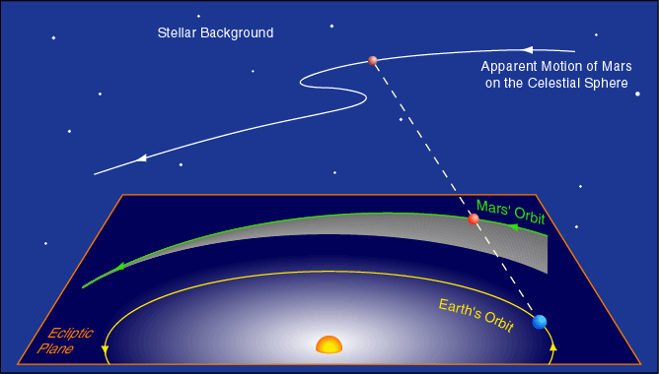
But for Mars, It sometimes doesn’t move the Correct Way
Mars moves west to east (right to left) against the background of stars. But every 780 days it goes through period of 83 days during which it moves east to west = the retrograde motion. The retrograde period occurs when Mars appears brightest in the sky. Thus, this phenomena could be established as repeatable and reliable after only a decade's worth of observations and therefore contradicts the Truth.

Slide 3
The Anomaly
Most of science and scientific theory eventually must confront "The Anomaly". The anomaly represents and observation or experiment with an unexpected outcome, relative to the current model. That is, the Truth, has been violated. How does science and culture deal with observed anomalies? There are basically three possibilities:
Ignore it
Acknowledge it but claim its irrelevant to the model
Use it as evidence that the model is incomplete.
History shows us that options 1 and 2 are the most frequent response. Option 3 requires admitting that your known Truth may be wrong

Slide 4
Save the Phenomena
Plato gave his students a major problem to work on. Their task was to find a geometric explanation for the apparent motion of the planets, especially the strange retrograde motion. One key observation: as a planet undergoes retrograde motion (drifts westward with respect to the stars), it becomes brighter. Plato and his students were also guided by the Pythagorean Paradigm.
The planets, Sun, Moon and stars move in perfectly circular orbits;
The speed of the planets, Sun, Moon and stars in their circular orbits is perfectly uniform;
The Earth is at the exact center of the motion of the celestial bodies.

Slide 5
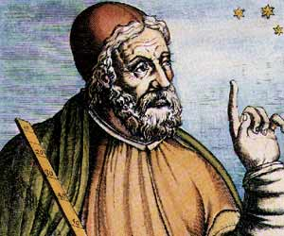
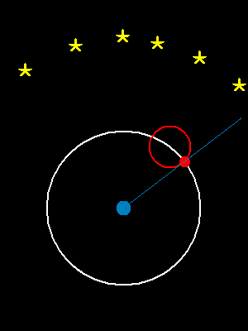
Ptolemy to the Rescue

Slide 6
The power of the Epicycle
The Ptolemaic Moment will stand unchallenged for about 1500 years. The Ptolemaic model represents an excellent example of "cultural" bias in science. Most citizens of the cultural wanted to accept the idea of the Earth being the center of the Universe (i.e. the earth was special) and therefore observations were molded in such a way so as to preserve that cultural norm.
Also, Ptolemy's model did improve the precision to which planetary positions could be predicted. Remember, however, the precision at measuring planetary positions was quite poor and therefore there was a large random error involved when comparing predictions with observations. This does not make the model correct.

Slide 7
The Dissenting View
One student named Aristarchus (of Samos 280 BC - Google Him – he was clever) violated rules of Pythagoras and developed a model with the Sun at the center. He submitted his solution to Plato
His model was not accepted because of the obvious observations against a moving Earth. But, his model/idea was preserved in the library. Archimedes read the idea and presented this viewpoint to King Gelon:
But Aristarchus has brought out a book consisting of certain hypotheses, that are contrary to our common understanding.
His hypotheses are that the fixed stars and the sun remain unmoved, that the earth revolves about the sun on the circumference of a circle, the sun lying in the middle of the orbit.

