Slide 1
Population Dynamics in European Countries
As modified by the Industrial revolution

Slide 2
Population dynamics are at the root of things like global trade and development, ability to maintain and army, ability to maintain a productive work force and they determine the overall infrastructure requirements of your country.
Prior to the onset of the Industrial Revolutions, European countries were generally growing in a slow linear manner making them somewhat easier to manage than, by say 1820, when the population is growing in an exponential fashion yet no one really understands that is occurring. Exponential growth requires rapidly increasing supply chains and thus the consumption crank is now turning on.
In any exponentially growing population, resource availability is an issue. In 1798 Malthus publishes a widely read manuscript stating that it is now a fact that population is growing faster than the ability to feed this growing population. If this is believed by government’s then new kinds of policy or resource management need to come into place.

Slide 3
Thomas Malthus 1798

Slide 4
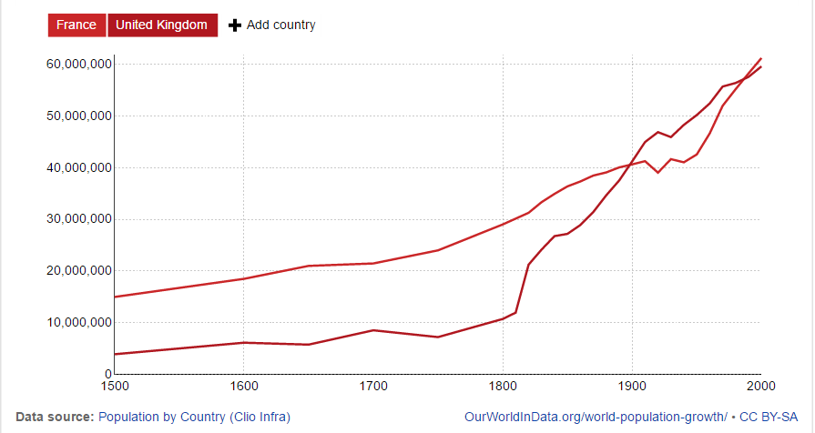
The Data: England vs France

Slide 5
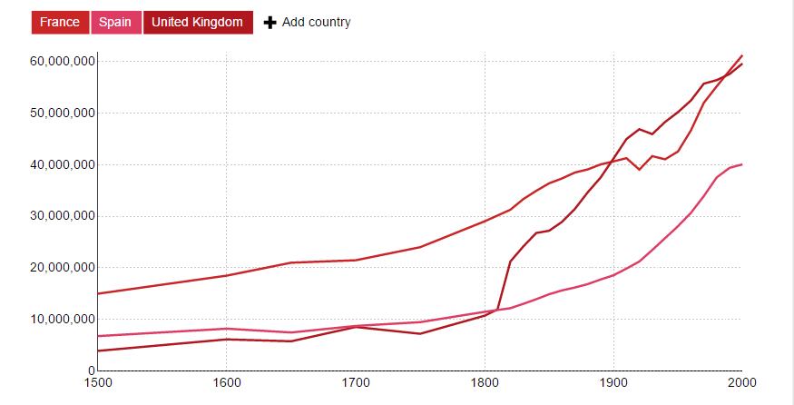

Slide 6
