Slide 1
The Discovery of New Planets and Orbital Motion anomalies
For the case of Mercury the observed anomaly can not be reconciled with Newton

Slide 2
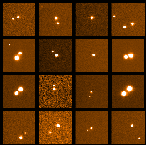
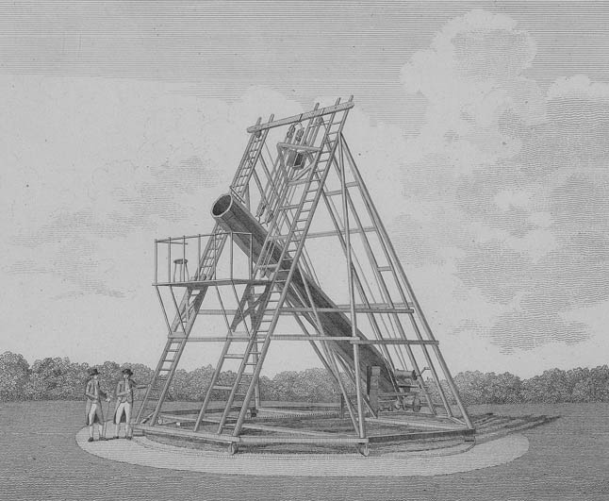
William Herschel
Built the largest telescope (49.5 inches) in the world by far; Discovered Uranus in 1781
Herschel in the 1780s studied the motions of double stars and showed that they obeyed Kepler’s Laws
Why is this important?

Slide 3
Bessel measure Stellar Parallax 1839
Now we have the concept of the light year as a unit of distance (the star he measured had a distance of 10 light years)
The distance to Uranus, the furthest known object in our solar system at this time is a mere 3 light hours ; the distance to the parallax star is thus 30,000 times farther away than the distance to Uranus.
This creates an immediate physics problem→ what is the energy source of these distant objects?

Slide 4
The Random Alien Test
In RAT, the aliens show up randomly one day and ask a random earthling basic questions about the Universe that everyone else knows. In this case,
WHAT IS THE ENERGY SOURCE OF STARS?

Slide 5
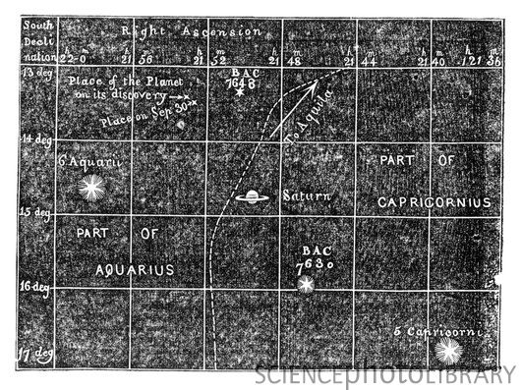
A motion anomaly – fully resolved
After about 50 years of observation, observers noticed that something was “wrong” with the orbit of Uranus
Next, comes the triumph of mathematics and the validation of precision The 1846 Discovery of Neptune:

Slide 6
The Problem With Mercury.
Precision measurements in the 1840's and 1850's showed that the orbit of Mercury did not conform to Newtonian Mechanics. As in the case of Uranus, a suspected perturbing body was the likely explanation.
However, in 1859, Levierre (the same guy involved in the discovery of Neptune) showed, using precision calculations, that this could not be the source of the observed anomaly in the orbit of Mercury.
So what to do Dismiss the Anamoly or Dismiss Newton?
What would Newton Say if presented these data?

