Slide 1
Measurements and Reality
The Very Nature of Quantum Mechanics

Slide 2
Big questions
Is the physical world shaped in some sense by our perception of it?
Is there an element of randomness in the universe or are all events predetermined?
Reality doesn't exist until it is measured and this can be profoundly disturbing. Most physicists don't let this bother them and take the utilitarian approach all of the time.

Slide 3
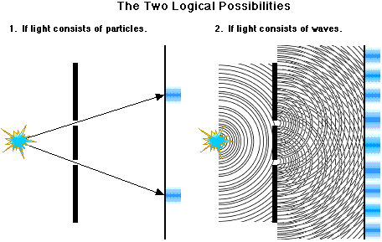
Many, many, experiments
A beam of electrons behaves the same way! – interfering probability waves

Slide 4
John Wheeler
The most profound lesson of quantum mechanics, he remarks, is that physical phenomena are somehow defined by the questions we ask of them.
“This is in some sense a participatory universe”

