Slide 1
Resistance to Cultural Change
Is Profound!

Slide 2
Business world analogy
The 7 reasons that (business) culture resists change
There isn't any real need for the change
The change is going to make it harder for them to meet their needs
The risks seem to outweigh the benefits
They don't think they have the ability to make the change
They believe the change will fail
Change process is being handled improperly by management
The change is inconsistent with their values

Slide 3
Mapping on to changing our cultural consumption habits
1. There isn’t any real need for change
There is no evidence that suggests our current consumption habits are damaging in any way; consumption produces a better standard of living – why change that?

Slide 4
2. The change is going to make it harder for them to meet their needs
Reducing consumption and consumption fossil fuel based energy is too hard to do and will significantly compromise my current lifestyle. Furthermore, since there is not evidence that compels me to make such a change, Fuck it …

Slide 5
3. The risks seem to outweigh the benefits
My short term economic security is far more important than long term benefit for the planetary ecosystem

Slide 6
4. They don't think they have the ability to make the change
I am an individual, what can I do that will actually make any impact?

Slide 7
5. They believe the change will fail
Since there is no evidence that changing our consumption habits will have any positive effect then any such mandate to change will surely fail and have significant negative consequences.

Slide 8
6. Change process is being handled improperly by management
We don't trust our government to make a fair set of regulations. We don’t trust scientific advisors to the government to be unbiased. All policy recommendations serve only self-interests. The self appointed elite will continue to screw us worms and passing shadows, just like it has always been.

Slide 9
7. The change is inconsistent with their values
Of course it is!
We are not part of nature; we control nature; nature does not control us. We are not in partnership with nature. The Aboriginal world view is bullshit. The perfect, precise, logical, and ordered view of the Universe is correct and Humans are Special.

Slide 10
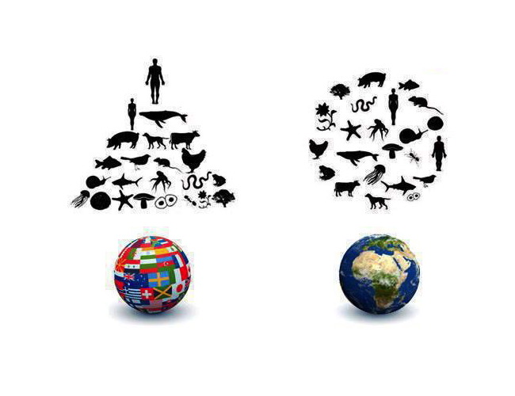
The available choice

