Slide 1
The Rise of Social Darwinism
All based on “…because it’s a scientific fact…”

Slide 2


Selection as “Deficiency Correction”→ advancement of the mean
The most common action of natural selection is to remove unfit variants as they arise (randomly) via mutation. In other words, natural selection usually prevents unfit genes from increasing in frequency in the gene pool.
Advancement of the Mean is dangerous and erroneous concept
Evolution is not an optimization process – there is never enough time for that – so why do we pretend that is natural optimization instead of natural selection?
  Supports the Social Darwinist Agenda that society can be engineered
  Takes nature out of statistical equilibrium if it can optimize to produce the Master Race

Slide 3
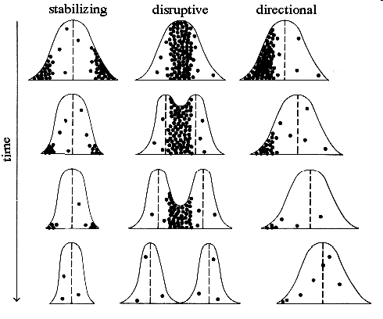
Statistical Types of Selection
Stabilization: Extreme ends of the distribution are disfavored. Moves every individual closer to the average state.
Directional: What you think is evolution – removes the deficient
Disruptive: Individuals with average traits are disfavored. Better leads to species diversification (or a class society)
Each Black
Dot in each distribution represent individuals that die out before passing on their genes
Mutations will affect largest number of individuals (i.e. average). Leads to development of new species and arguably is the process that happens on Earth via random catastrophes and mass extinction.

Slide 4
Darwin Abused: Survival of the Fittest
Social Engineering will now use this new scientific theory of evolution via adaptation as the scientific basis on which to engineer society.
Hebert Spencer: This survival of the fittest, which I have here sought to express in mechanical terms, is that which Mr. Darwin has called "natural selection” or the preservation of favored races in the struggle for life

Slide 5
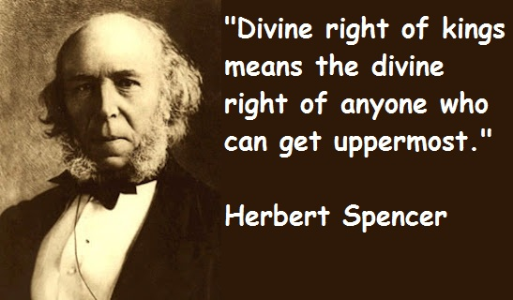
The Aberrated View of Spencer
Spencer quickly adapted Darwinian ideas to his own ethical theories. The concept of adaptation allowed him to claim that the rich and powerful were better adapted to the social and economic climate of the time, and the concept of natural selection allowed him to argue that it was natural, normal, and proper for the strong to thrive at the expense of the weak. After all, he claimed, that is exactly what occurs in nature every day.

Slide 6
What is Social Darwinism?
Social Darwinism (as a scientific fact) is:
- individuals compete naturally.
- the incompetent lose and the strong
win. ie. “survival of the fittest”.
Government must not interfere unless the unfit are stealing from the fit.
The fit are arbitrarily determine by the e(lite) based on “it’s a scientific fact”

Slide 7
Justifying Imperialism (Spencer):
“Within the human species, nations are locked in a struggle for survival. Everywhere, civilized nations are supplanting barbarous nations. Advanced civilization, obviously, has inherited valuable traits from its ancestors. Therefore, natural order obligates powerful, civilized nations to appropriate the limited resources of the weak.”
It’s a Scientific Fact

Slide 8
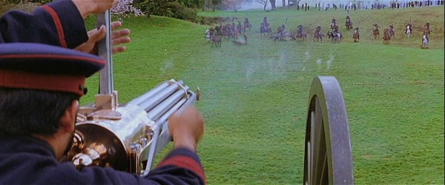
Social Darwinism and Race
Only the strong races can survive.
Technology should be kept by races that create advancement.
Justification for colonization (genocide)

Slide 9
Social Darwinism
Not only was survival of the fittest natural, but it was also morally correct.
it was morally incorrect to assist those weaker than oneself, since that would be promoting the survival and possible reproduction of someone who was fundamentally unfit.
This is also a blue print for how business should run -- “the growth of a large business is merely a survival of the fittest.“ - John D. Rockefeller

Slide 10
Social Darwinism and Business
Natural Competition controls the economy.
Government is not there to help people, but to support business.
Big business can take over small business.
Ruthless methods are OK.

Slide 11
America’s Reaction
“Self-made man” concept built the country.
“Rugged Individualism” is good.
Wealth is the reward for hard work and ability.
Failure is due to lack of ability and laziness.

Slide 12
A Modern day example:
The strangest thing about fascism in America today is that American facists are so dumb, they don't even know they're fascists. They don't even know what the word fascism means.
They vaguely know that it had something to do with Hitler and the Nazis, but that's it. They have no idea that the first words of the Nazi anthem were "Germany above all else" which was their version of "America first." And the way Nazis demonized jews was no different than the way American fascists demonize liberals. Hitler promised to "make Germany great again." And Hitler denounced the newspapers, which exposed him for what he really was, as "Lügenpresse," which is German for "fake news."
If the German Nazi party still existed today, they would look exactly like the Republican party under Trump. Hitler's rallies looked no different than Trump's rallies. And Hitler would absolutely love a well-oiled propaganda outlet like Fox News.”
― Oliver Markus Malloy, Inside The Mind of an Introvert

