Slide 1

The Negawatt
Taxes and Energy Efficiency
Prof. Roberta Mann
UO Law
May 15, 2013

Slide 2

The Energy Cost of a Tweet
90 joules = 0.02 grams of CO2
50 million tweets per day = 1 metric ton of CO2
Google search = 1 kilojoule = 0.2 grams of CO2
1 spam email = 0.3 grams of carbon

Slide 3

What does a ton of CO2 look like?

Slide 4
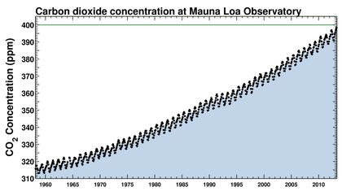
CO2 levels since 1960

Slide 5
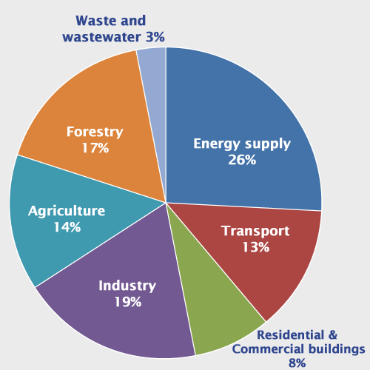
Global GHG Emissions by Source
EPA

Slide 6
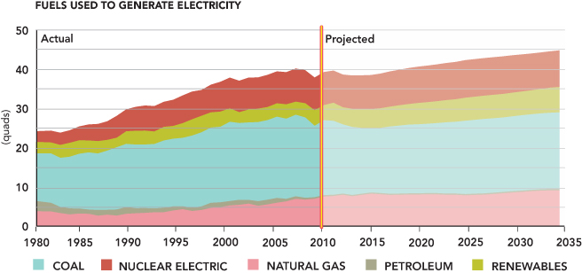
Where does our energy come from?

Slide 7
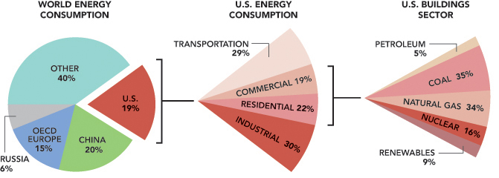
Where do we use energy?

Slide 8
Result of Investments in Energy Efficiency

Slide 9
BPA projected savings from energy efficiency
The majority of the savings comes from reducing energy use from lighting and electronics. 56% of the savings is from residential, 30% from commercial, 14% from the industrial sector.

Slide 10












Do companies care about energy?

Slide 11
Barriers to Energy Efficiency
Imperfect information
  Energy savings are difficult to measure, hard to get information about performance of different technologies
Split incentives
  E.g. landlord buys the equipment, tenant pays the electricity bill
  Homebuyers pay energy bills, homebuilders do not
Imperfect competition
  Oligopoly or monopoly
Externalities
  Energy efficiency can reduce the costs of energy supply and consumption by reducing impacts on the environment
High Start Up/Renovation costs

Slide 12

How Taxes can Help
Increasing taxes on persons who engage in disfavored behavior discourages that behavior
Reducing taxes on persons who engage in preferred behavior encourages that behavior

Slide 13
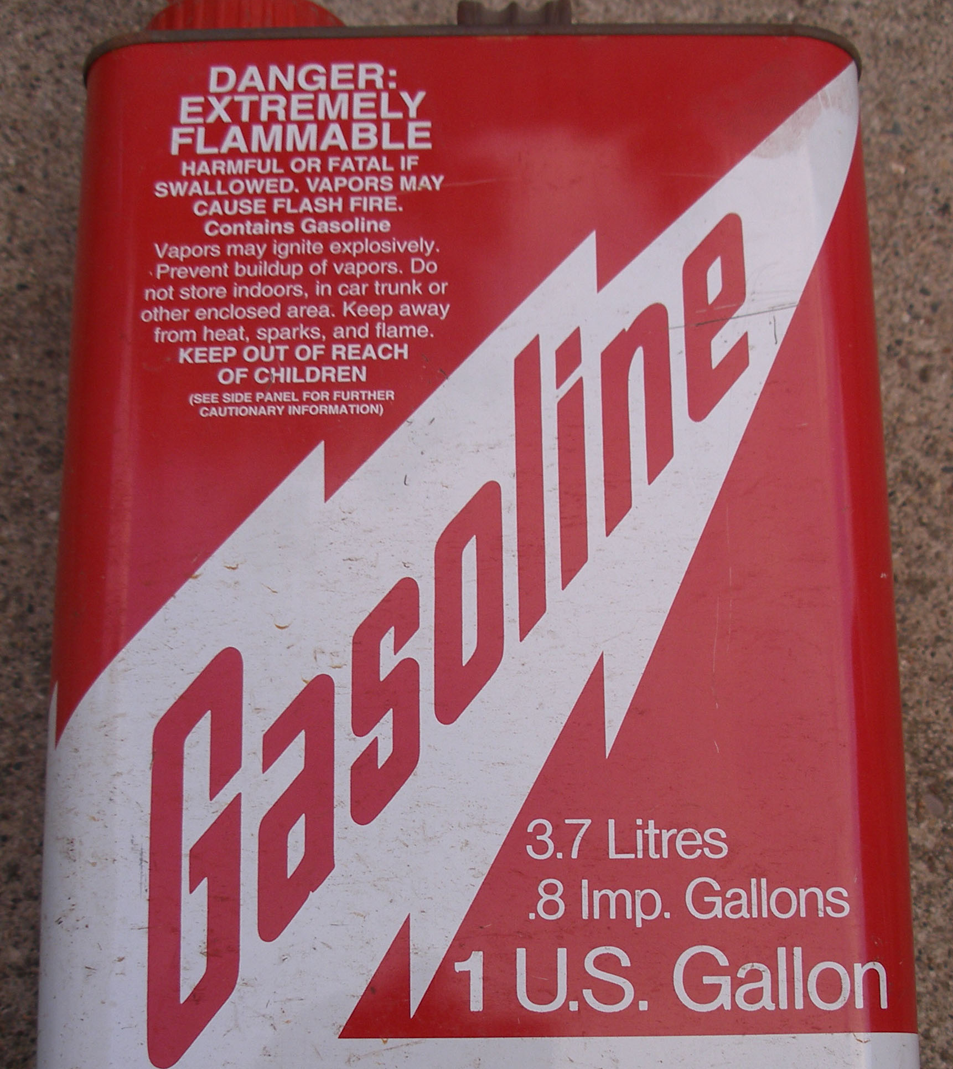
How much tax on a gallon of gas?
Country | $/gal | Tax | % tax
Germany | $5.15 | $3.69 | 72%
Japan | $3.98 | $2.10 | 53%
Canada | $2.24 | $0.86 | 38%
U.S. | $1.79 | $0.39 | 22%
(2004 prices)
The average-per-capita consumption of gasoline in the United States is more than four times higher than in the United Kingdom or several other European countries.

Slide 14
How are taxes calculated?
The taxing equation
Example
Gross Income
minus Deductions
Taxable Income
X Tax Rate
Tentative Tax Liability
minus Credits
Tax Liability
$120,000
$20,000
$100,000
X 25%
$25,000
$5,000
$20,000
Reduced tax liability by $5,000

Slide 15

Sticks and Carrots
The stick
  Carbon taxes
  Gas taxes
The carrots
  Tax deductions
    Reduce taxable income
  Tax credits
    Reduce tax liability
  Tax exemptions
    Reduce taxable income
  Accelerated depreciation
    Reduce taxable income – more quickly!

Slide 16

Your Student Loan
Loan Balance | $30,000
Interest rate | 6.8%
Loan term | 10 years
Monthly payment | $345.24
Number of payments | 120
Total payments | $41,427.97
Total interest paid | $11,428.97
How much would you save if you hadn’t needed a loan? Or if you paid it off more quickly?

Slide 17
Depreciation
Year | Cost | Straight-line | Accelerated
1 | $10,000 | $2,000 | $4,000
2 |  | $2,000 | $2,400
3 |  | $2,000 | $1,440
4 |  | $2,000 | $1,080
5 |  | $2,000 | $1,080
total |  | $10,000 | $10,000

Slide 18
Present value of tax savings
Year | Cost | Tax savings | PV | Tax Savings | PV
1 | $10,000 | $500 | $500 | $1,000 | $1,000
2 |  | $500 | $476 | $600 | $571.20
3 |  | $500 | $453.50 | $360 | $326.52
4 |  | $500 | $432 | $270 | $233.28
5 |  | $500 | $411.50 | $270 | $233.28
Total |  | $2,500 | $2,273 | $2,500 | $2,364.28
Tax savings = deduction x tax rate (25%)
Assumed 5% rate of return for PV calculations
Advantage from accelerated depreciation = $91.28

Slide 19
Existing Federal Tax Benefits for Energy
Transportation | Industrial | Residential | Commercial
Energy efficient vehicles | Oil and gas provisions (IDCs, percentage depletion, EOR) | Energy efficient appliances credit | Efficient commercial building deduction
Biofuels | Renewable energy (PTC, ITC) | Energy efficient homes credit
 | Energy research credit | Nonbusiness energy credit (windows, insulation,heat pumps)
 |  | Residential energy efficiency credit (PV, small wind
 |  | Income exclusion for utility property

Slide 20
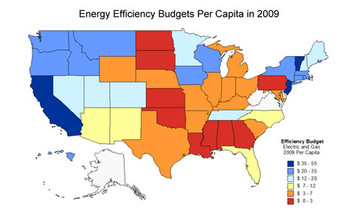
Why focus on federal? States care too.

Slide 21
Unique Role of Federal Incentives
Consistent nationwide
Uniform qualifying criteria
Longer term perspective

Slide 22
The Negawatt is cheapest!

Slide 23
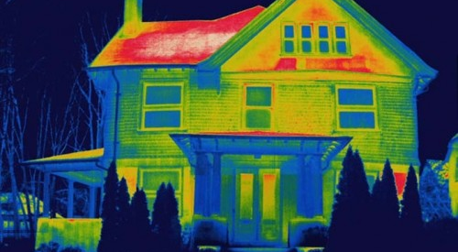
Potentially greatest saving opportunity in residential sector
52 – 69% savings in residential sector; 45 – 62% in commercial sector

Slide 24
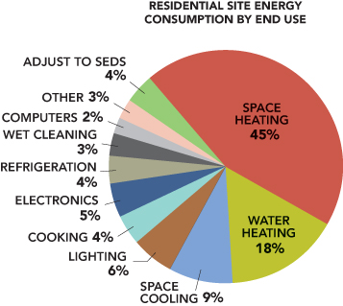
Residential energy consumption

Slide 25

It’s not all good: Rebound Effect
Energy efficiency reduces demand for energy
Falling demand leads to falling prices
Cheaper energy leads to more consumption
What is the size of the “rebound effect?”
  Two studies in UK
    26%
    37%

Slide 26
Still, lower energy intensity has already helped the economy

Slide 27
You can move policy forward
Write a law
The only way to learn how to draft legislation is by drafting legislation
General rule: state the main message
Exceptions: describe the persons or things to which the main message does not apply
Special rules: describe the persons or things to which the main message applies in a different way
Transitional rules
Definitions: define the terms used in the legislation
Effective date

Slide 28
The legislative thought process
Need for legislation
  What problem will be solved by this law?
What is the scope of the policy—to whom or what does it apply?
  Should there be exceptions?
Who is responsible for carrying out the policy?
Timing
  Should the policy take effect on enactment or at some later time?
  How long should the policy last (should the tax incentive expire? On a date certain? Upon the happening of certain criteria?)?

Slide 29
Drafting conventions
Means vs. includes
  Means is exclusive, includes is non-exclusive
Shall vs. may
  Shall is mandatory, may is permissive
The use of the singular preferred

Slide 30
Take a break
When we come back, you will draft some statutes!
Examples of each type of statute (deduction, credit, exclusion) are available for your review.

