Slide 1
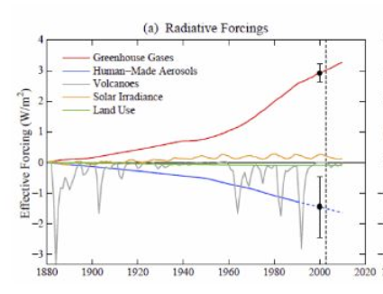
Climate Forcing

Slide 2
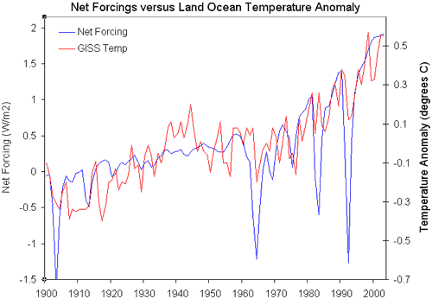
Direct Forcing from Volcanoes

Slide 3
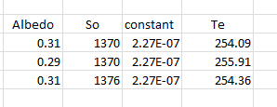
Assumptions:
1 extra W per square meter gives you 0.25K increase in surface temperature but this requires 6 extra watts per square meter from the sun given the albedo.

Slide 4
Extra Forcings
When water vapor is considered the constant is about double that of just BB radiation

Slide 5
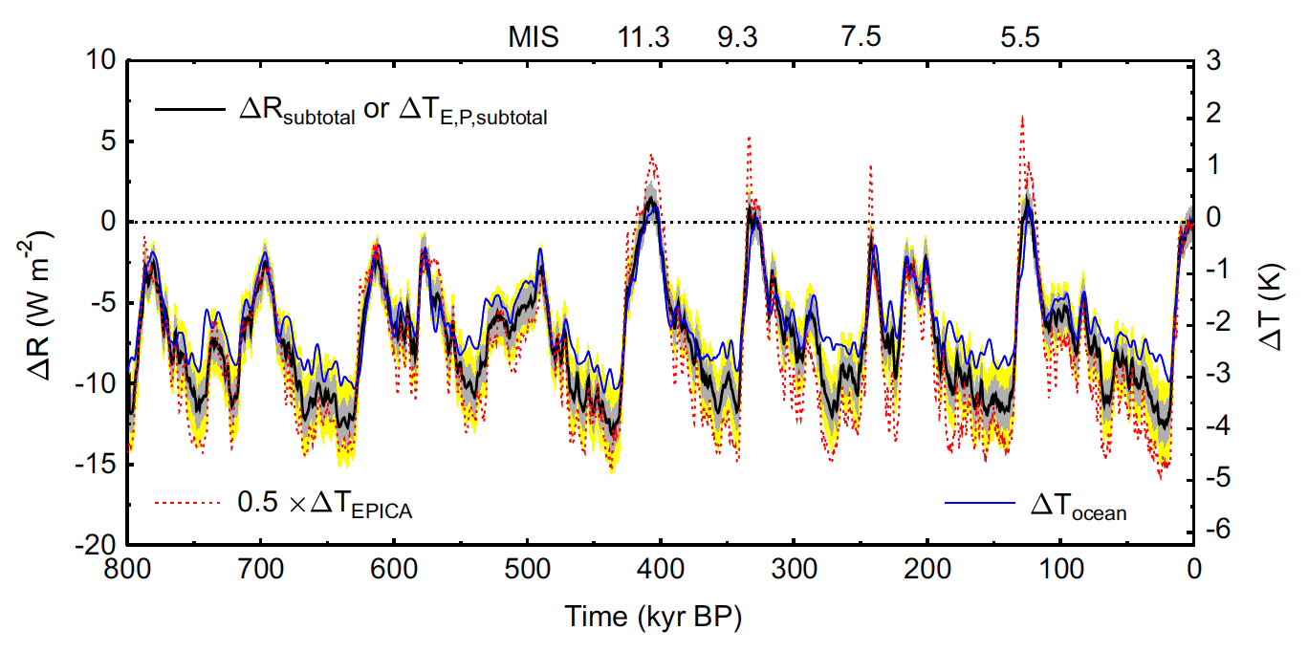
Ice Age Calibration

Slide 6
Doubling CO2 scenario
As of 2000 Combined positive (GHG) + negative (aerosols) seems to be about 2 Wm⁻²
Double CO2 = 5.35(ln2) = 3.7 Watts per square meter;
Flux on ground is about 160 watts per square meter so this is equivalent to increase in sun’s output by
3.7/160 = 2.3%; Increase S in below relation by 2.3% to get 1.5 C of
Temperature increase.
This is equivalent to 2/160 = 1.25% leading to 0.8 C increase in the year 2000
Data suggest bigger increase most likely due to water vapor feedback

Slide 7
The heat content of the land-atmosphere-ocean system is

Slide 8
Feedbacks
Water vapor changes
Clouds
Albedo changes
Lapse rate
Added GHGs
These all change OLR (outgoing long wavelength radiation)
At equilibrium

Slide 9
First term = changes in solar output
Second term = changes in lapse rate
Third term = water vapor
Fourth term = GHG
Fifth term = Clouds
Sixth Term = Albedo change
If each degree C of warming leads to a feedback factor f of additional warming this then leads to:
Constraints: 0<f<1 for the series to converge; f > 1 = runaway (Venus)

Slide 10
F –H2O is about 0.5 so doubling of C02 with H20 Feedback is now 1.5/.5 = 3 C
Suppose this results in more clouds and changes the albedo by 0.2 then this results in 1.5/(1-.5-.2) = 5 C
If its only an albedo change then its 1.5/.8 = 1.9 C

