Slide 2
Planetary Equilibrium Temperature
α = albedo; S_{o} = <1367 W per square meter>

Slide 3
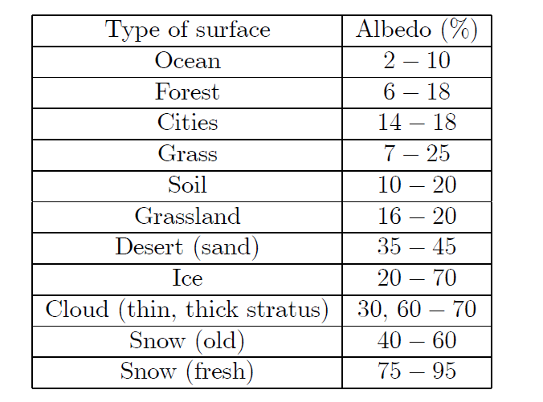
Planetary Albedo
Integrated Sum of various surface components

Slide 4
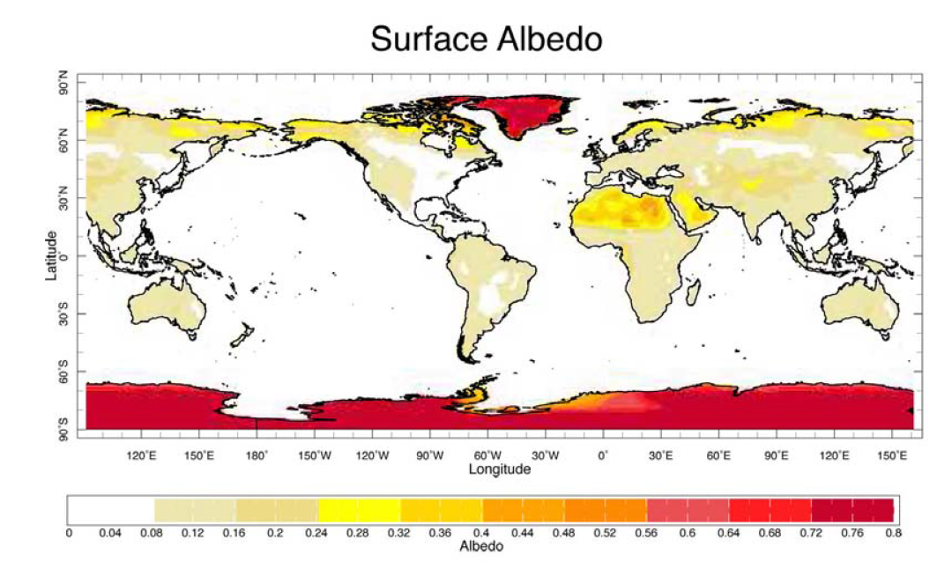

Slide 5
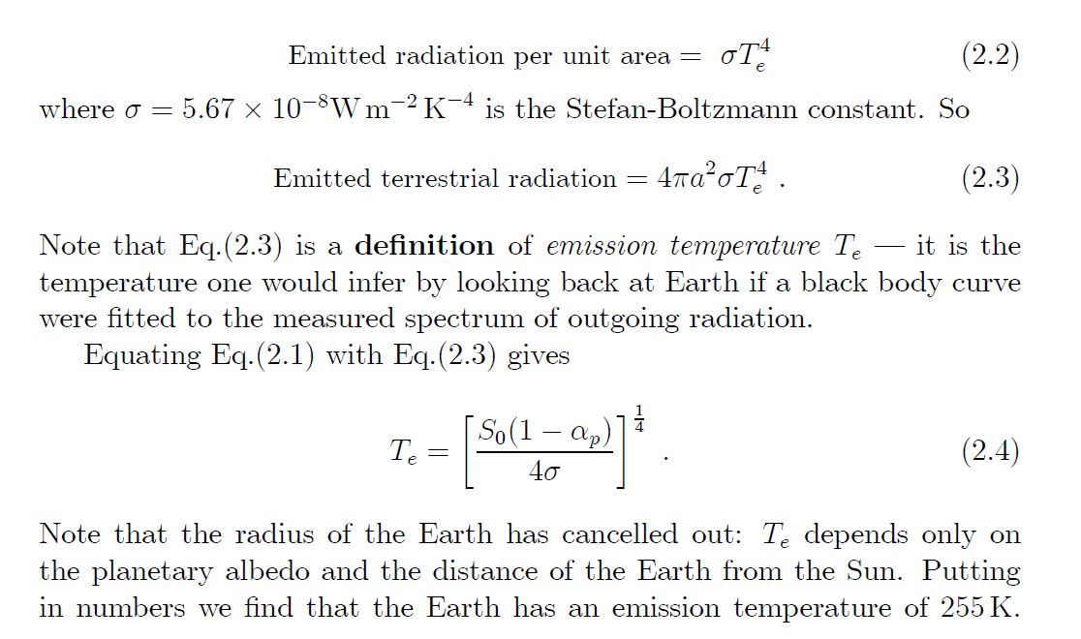
Treating Earth As Blackbody; T=255K has peak emission at 14 microns; $T_{e}$= emission temp.

Slide 6
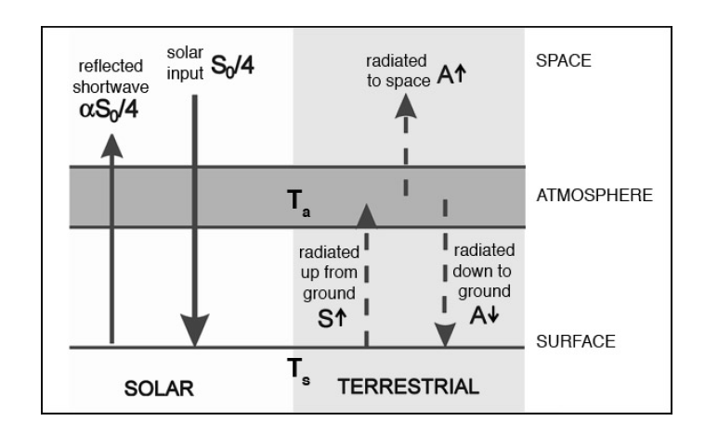
Earth is Rotating

Slide 7
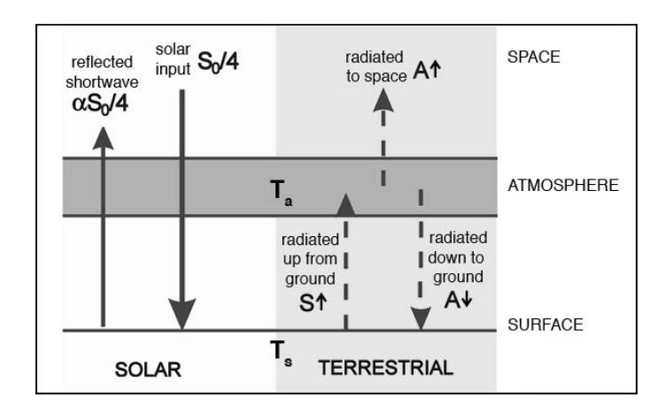
$T_{e}$=emission temp.
Received flux
In equilibrium the net flux at the ground must be zero.

Slide 8
WHY?

Slide 9
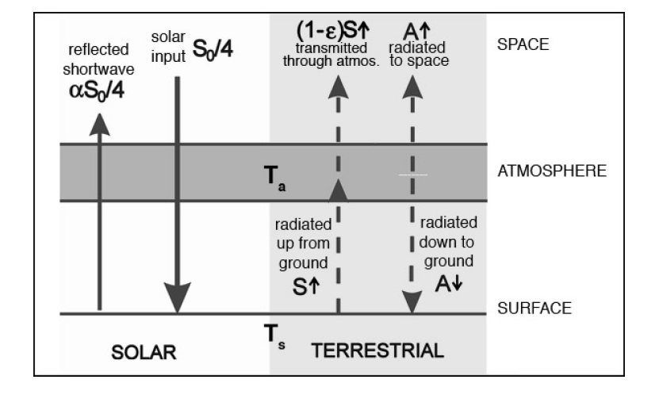

Slide 10
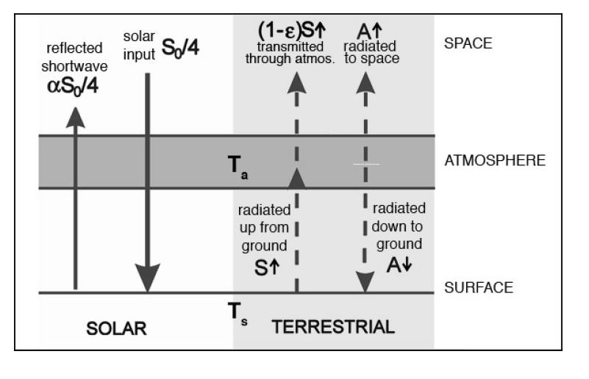
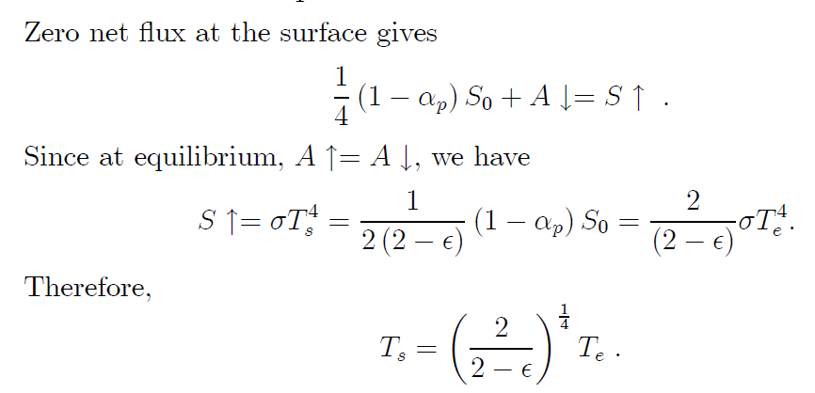

Slide 11
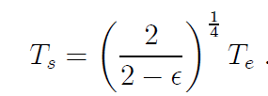
The measured value for $T_{s }$is 288K and we already know that $T_{e}$= 255K. Therefore we infer that ε = .78 for the emissivity of the atmosphere.
${1/2}^{1/4}$ = 0.841

Slide 12
Humans are Screwing with Emissivity Value for the Atmosphere

